Slide 1
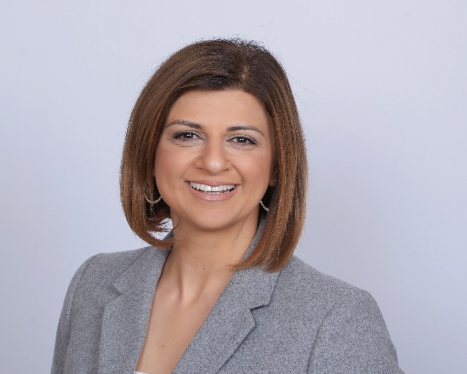
227 - Aeries Analytics
Best Practices Case Study
Roundtable
Ron Anderson |
Trainer
Elen Meltonyan |
Director, Enterprise
Product Management
March 08, 2024 Period 4
Information shared throughout this presentation is the property of Aeries Software. Information or images may not be reproduced, duplicated, or shared without the prior written consent of Aeries Software.

Slide 2
“
“
If you have knowledge, let others light their candles in it!
Margaret Fuller

Slide 3
Session
Format
Share Ideas
Best Practices
Lessons Learned
Notes:
Ron will login to Aeries.com
Ron will be the driver
AA Starter Kit – Ron
Customizing Starter Kit for my school/district - most successful disricts have a small team that makes these decisions -

Slide 4
Aeries Analytics Users
How familiar are you with Aeries Analytics Functions?
1 – beginner 4 – expert
What key functions/dashboards to you use most often?
What aspects of Aeries Analytics saves time and/or makes your life easier?
What data is difficult to locate/visualize in Aeries Analytics?
My Aeries Analytics “best practice” or idea I’d like to share is….
My burning question about Aeries Analytics is…

Slide 5
Suggested Discussion Topics
01
AA Starter Kit
05
Newer Item Types
02
Sample Dashboards
06
Dynamic Student Groups
03
LCAP Analytics Items
07
ELPI Annual Progress
04
Customizing Starter Kit
08
Other
Notes:
Aeries Analytics Starter Kit
Sample Dashboards in Starter Kit
LCAP Analytics Items / Dashboads
Customizing Starter Kit for my School/District
Newer Item Types / Potential Uses
Dynamic Student Groups based on Analytics Data
ELPI Annual Progress
Other __________________

Slide 6
Related Conference Sessions
# 220 – AA Intro to Dashboards & EWS
Overview of Analytics / Early Warning System
Processing / Displaying a wide-range of data
Designed for clients new to Aeries Analytics
# 225 – AA Advanced Analysis of Data
Configuring data Items and Dashboards
How Analytics can highlight selective data
Designed for clients who are using Analytics
# 228 – AA Advanced Applications
Dynamic Student Groups based on AA data
Extended Field Query Configuration / Queries
Example Case Study: ELPAC / ELPI monitoring

Slide 7
Online Learning Resources
Aeries Online Demo: https://www.aeries.com/products/online-demos
Sign in automatically to view and practice with demo databases
“Admin” (Office Staff, including Counselors)
Teacher – Elementary or Secondary
Parent or Student
Aeries Academy: https://www.aeries.com/academy
Flexible, learn at your own pace
Individual Topics of Interest to Counselors include
Fundamentals of Aeries (free)
Scheduling (Currently free)
Secondary Counseling Applications Course (Currently free)
Includes 6 individual modules.

Slide 8
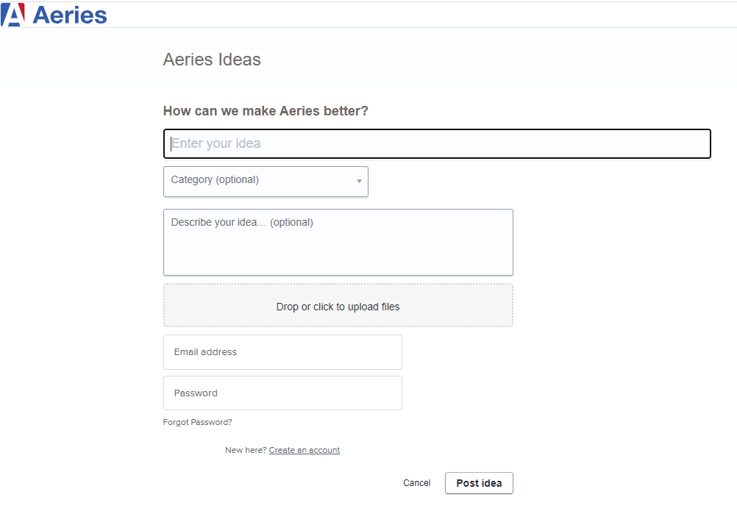
Aeries Ideas: Help Us to Improve
Go to: https://ideas.aeries.com/
Create an account
Use your work email address
Search ideas, add your ideas, or vote on other ideas

Slide 9
Online Support Resources
Aeries Support Online (FreshDesk) https://www.aeries.com/support/
Search for
Articles – view and print
Video
Also available directly from within Aeries
Resource Hub

Slide 10
THANK YOU!
Please take a moment to complete our session survey.
http://surveys.aeries.com/s3/AeriesCon-Session-Feedback-Survey-Spring-2024

Slide 11
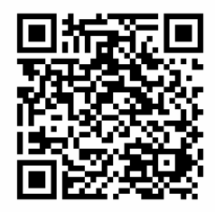
Share your Feedback
(Session #227):

