Slide 1
Enrollment Management
Presented by:
Minott Opdyke, Business Analyst

Slide 2
Internal Team Members
Business Analysts
Minott Opdyke
System Architects & Developers
James Kelly
Internal Advisors
Michele Sullivan, Leslie Stawarz, Deb Cartwright, Susan Prow, Jenifer Johnson, Elena Lohr, Carrie Muchow
Aeries Advisory Group
PHOTO CAPTION

Slide 3
Overview of Feature
Enrollment Management in Aeries tracks the Students enrollment from the time the Student enters the District until they leave. It keeps a record of the Schools the Student has attended and the dates, and the reasons for entering/leaving Schools and the District. The Enrollment Record is essential for State Reporting and must be maintained accurately. It includes Attendance Programs, Grade changes, and inter/intra- district transfers.
We plan to make the process easier and more intuitive with guided workflows and reminders. All Enrollment related tasks will be centralized and processes such Enrollments, No Shows, and Withdrawals will be customizable
We will work to ensure the data meets all State Reporting and Ed-Fi Standards for interoperability with 3rd parties.
PHOTO CAPTION

Slide 4
Customer Challenges
After reviewing Aeries Ideas, communicating with Customers and getting input from internal Stakeholders, some of the challenges Districts have dealing with Enrollment are:
Separate Databases. Difficult to manage the Student in different years
Multiple pages to visit to manage enrollments, Demographics, Attendance Enrollment, Enrollment History…
Many times, the same piece of data needs to be entered in more than one place. And if it changes, it has to be updated in multiple places
Students say they’re going to Enroll, we Add them to Aeries, gather their data, and they change their mind and don’t enroll. So now we have these Student Records to deal with.
Data validation errors because the Attendance Program doesn’t match Enrollment Program, overlapping enrollments, wrong Exit reasons, etc.
PHOTO CAPTION

Slide 5
Key Expectations for Next Gen
What are the “Must Haves” in order for our customers to consider Enrollment management to be vastly improved in Next Gen?
Data is centralized.
  Data only exists in one place
  When a piece of data is updated, all pages that display that data will show the new data
A Single database
Customizable Withdrawal and No Show forms
Customizable, more efficient Enrollment process
Built in Data Validations
Ability to notify others of an Enrollment, i.e., ELL, Nurse, SPED, etc.
PHOTO CAPTION

Slide 6
Changes & Differences – Enrollment Management
Current Aeries
Aeries NextGen
Information exists in three places
  Student Demographics
  Enrollment History
  Attendance Enrollment
Changes for a Student can be made on:
  Student Demographics Page
  Attendance Enrollment Page
  Enrollment History Page
There is no way to view and manage multiple Students’ enrollment history. Each Student needs to be updated individually
An Enrollment History that will combine all the fields
All Enrollment can be managed for a Student on the Student Information page in the Enrollment History
Will have the ability to work with multiple Students on one page
PHOTO CAPTION

Slide 7
Changes & Differences – The Enrollment Process
Current Aeries
Aeries NextGen
The Enrollment process is initiated by clicking ‘Add’ on a random Students’ Demographics page at the School where the Student is enrolling
The process consists of:
  Inserting a New Student record and filling out the fields on the Demographics page
  Adding an Attendance Enrollment Record
  Adding Contacts on the Contacts page
  Scanning/copying documents for the CUM file or uploading on the Student Documents page
There will be a separate Enrollment process. All Student Records will exist at the District Level and then be assigned to Schools
There will be only one Student Information record that will be associated to Schools
The process will consist of:
  A guided enrollment process with a customizable list of Tasks to be completed for the enrollment
  All the information can be gathered in this step-by-step process
  Documents can be uploaded at each step
PHOTO CAPTION

Slide 8
Changes & Differences – The Enrollment Process
Current Aeries
Aeries NextGen
Problems with the process:
  If you start to Add a Student and you don’t have all the Required information, you have to Cancel the process and start all over again later.
  If the process is started but not completed for a Student that has never been at the District, another Office Staff may add the Student again for Enrollment without completing the Search first.
  If there is information missing, we have to remember which Student we were working on and go back to the Demographics page to add the information. We may forget to do that.
  If we have been Enrolling a lot of Students, it becomes very difficult to track which ones we need to go back to and what they need.
  Once a Student is enrolled, we may forget to let others know about them, such as the Nurse, Counselor, Food Service, etc.
A Student record can be saved in an ‘Incomplete’ state if not all required information is available
As the basic Student Demographic information is entered, a Search will happen in the background for any matching Students or Siblings, and you will be prompted to use their information
The Manage Enrollments page will show the Enrollment status of all Students. If one is unfinished, you may continue the process where you left off. This allows you to keep track of multiple Enrollments.
Once the basic Enrollment is finished, you will be prompted to notify others through the Alerts in the application
PHOTO CAPTION

Slide 9
Changes & Differences – No Shows & Withdrawals
Current Aeries
Aeries NextGen
There is a No-Show Setup that needs to be configured at each School
Withdrawals require navigating to each Student and updating the Exit Reason/Completion Status and then navigating to Attendance Enrollment and updating the Leave code
The No-Show setup can be configured for multiple Schools
Withdrawals can be completed for Students on their Information page or the Manage Enrollments page
PHOTO CAPTION

Slide 10
Some Visualization
What could Enrollment Management look like?

Slide 11
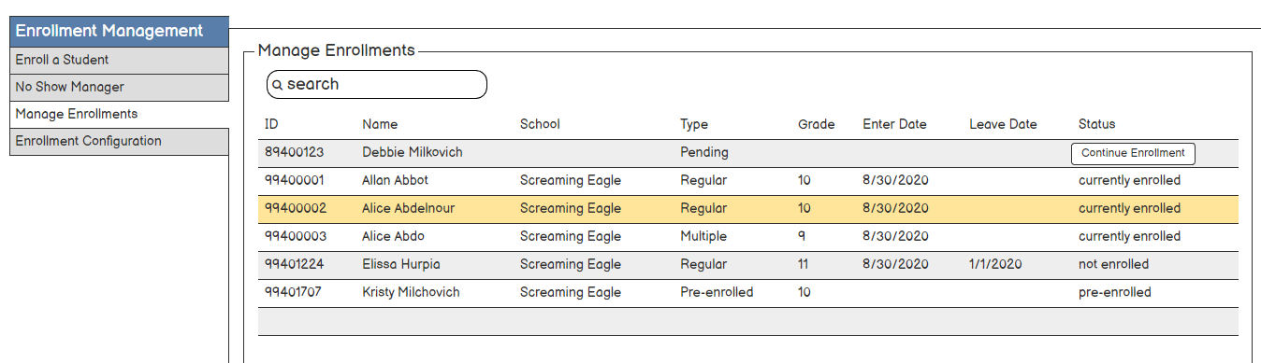
Manage Enrollments
PHOTO CAPTION

Slide 12
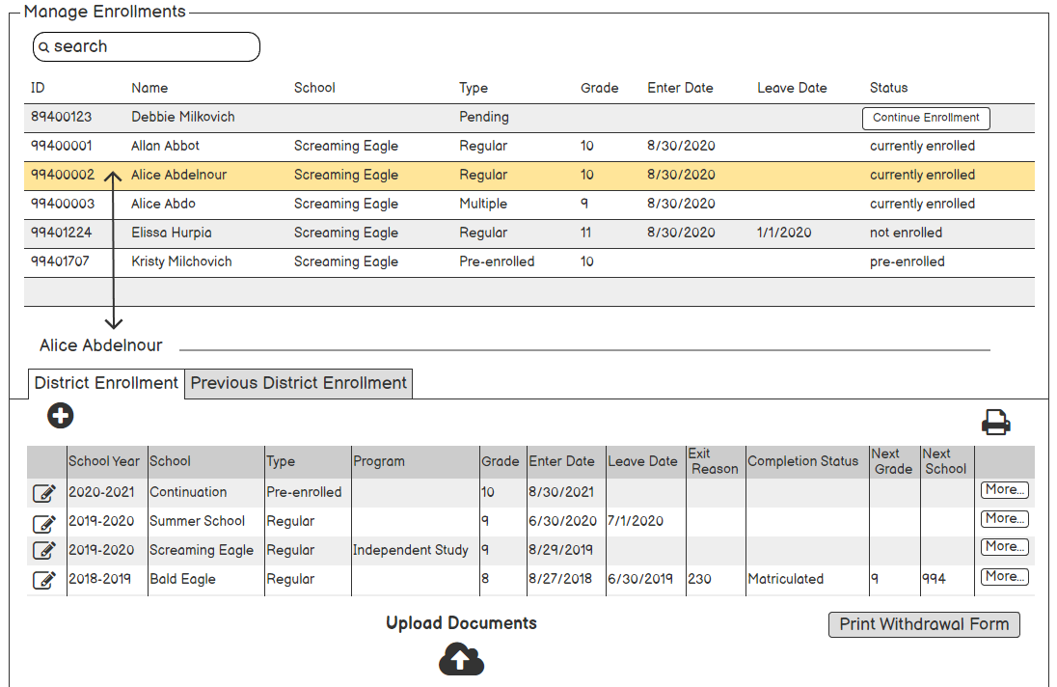
Manage Enrollments
From here you can Exit the Student, add/change Programs or add another Enrollment
PHOTO CAPTION

Slide 13
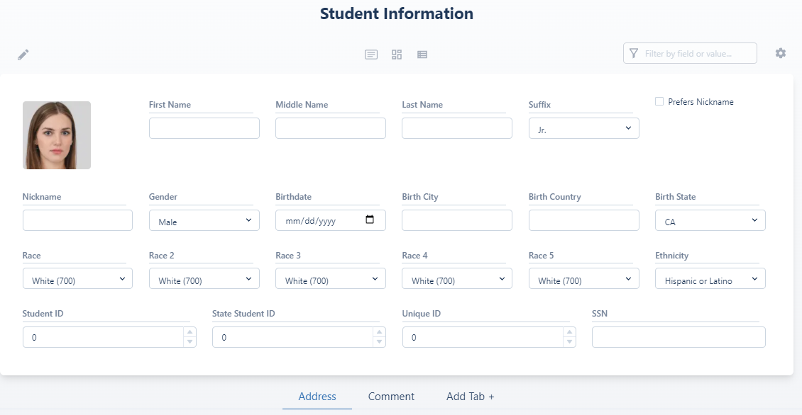
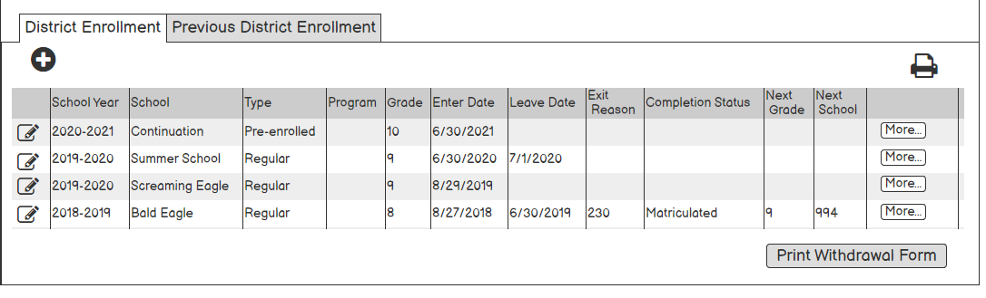
Student Information page
The same actions can be taken on the Student Information page
PHOTO CAPTION

Slide 14
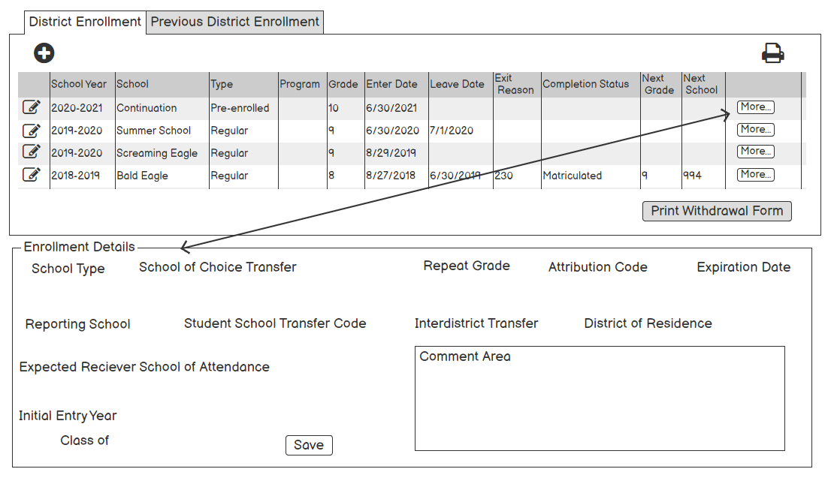
More information
PHOTO CAPTION

Slide 15
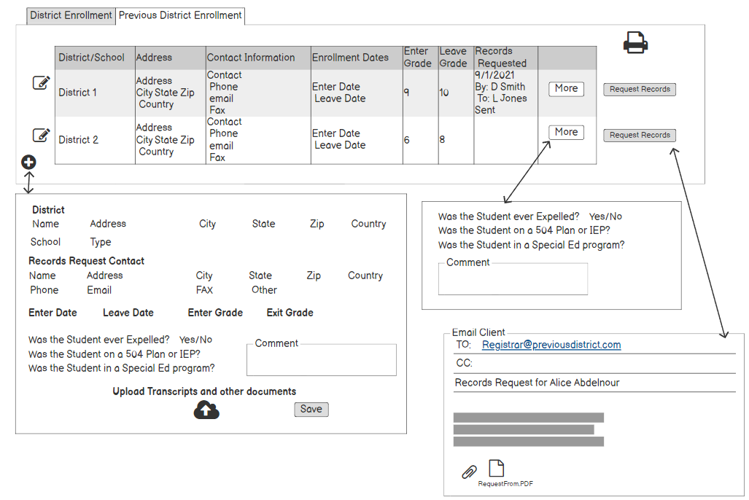
Previous District Enrollment
PHOTO CAPTION

Slide 16
Some Visualization
What will Enrolling a Student look like?
The new ‘Workflows’

Slide 17
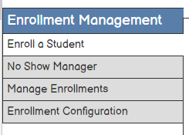
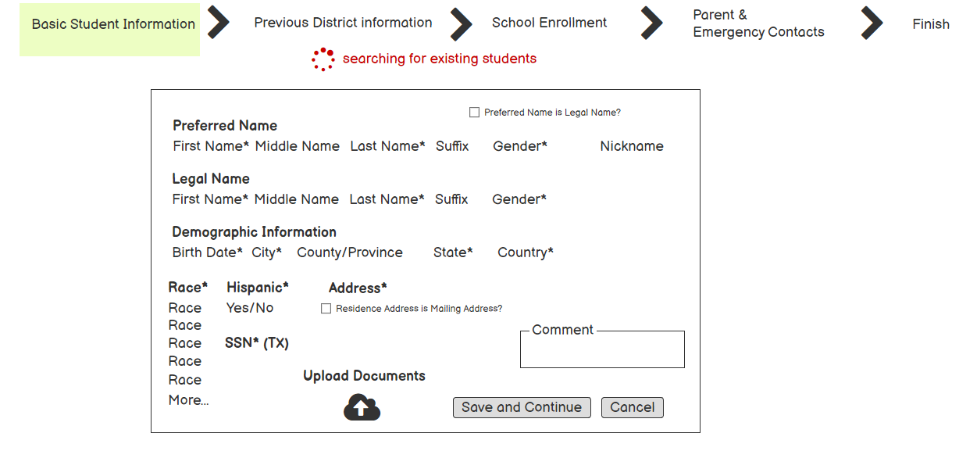
Enrollment Workflow
Search includes current Students, Inactive Students, Online Enrollments and Siblings
PHOTO CAPTION
Record is assigned an Enrollment ID not a Student ID

Slide 18
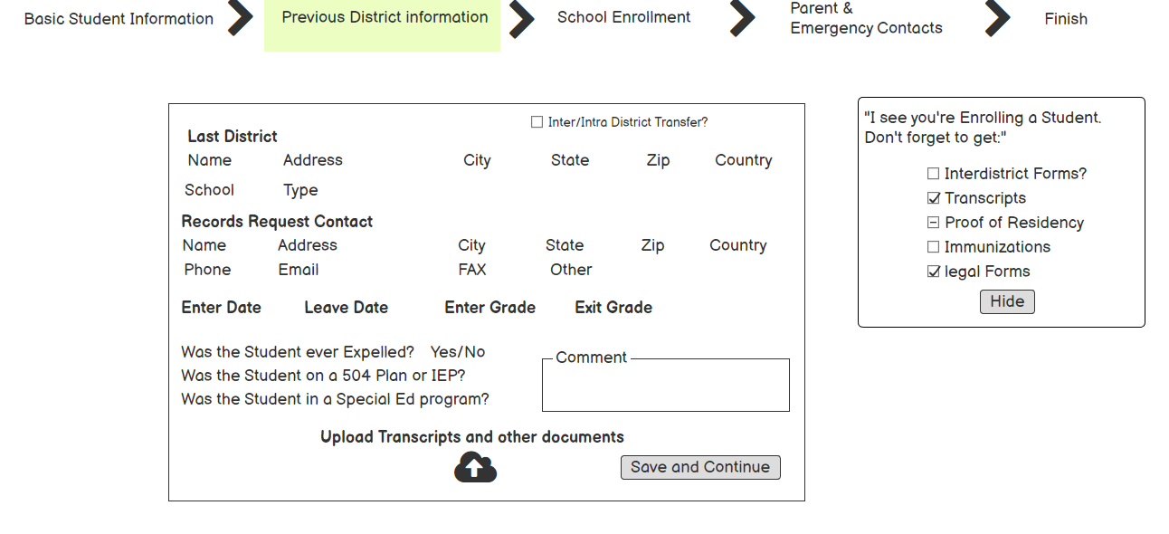
Enrollment Process
Pop-up Task Reminders
PHOTO CAPTION
You can stop at any Step and leave the page and the process will remember where you left off on this Student so you can come back later

Slide 19
Enrollment Process
X
Pop-up Task Reminders
PHOTO CAPTION

Slide 20
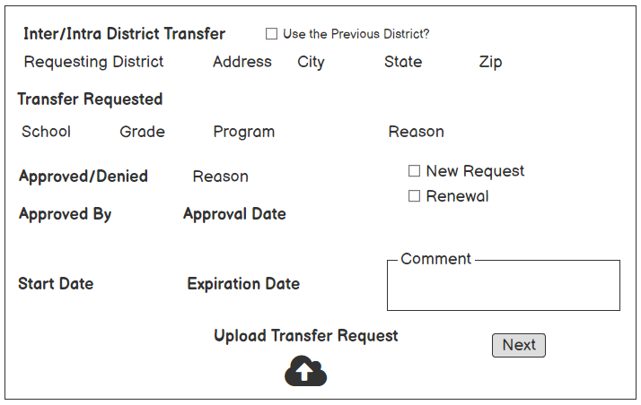
Enrollment Process
X
Pop-up Task Reminders
PHOTO CAPTION

Slide 21
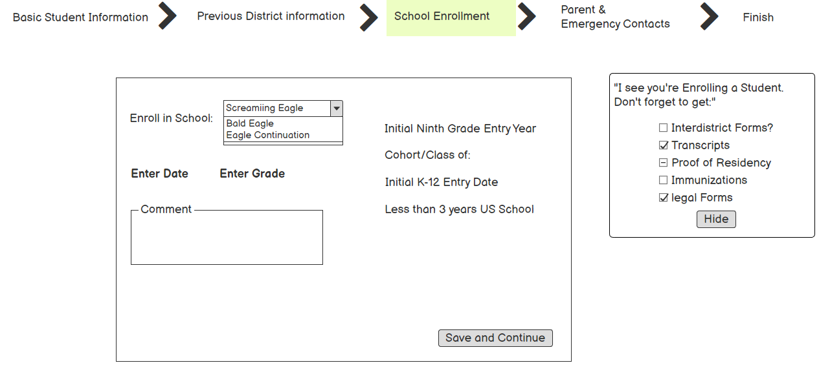
Enrollment Process
PHOTO CAPTION

Slide 22
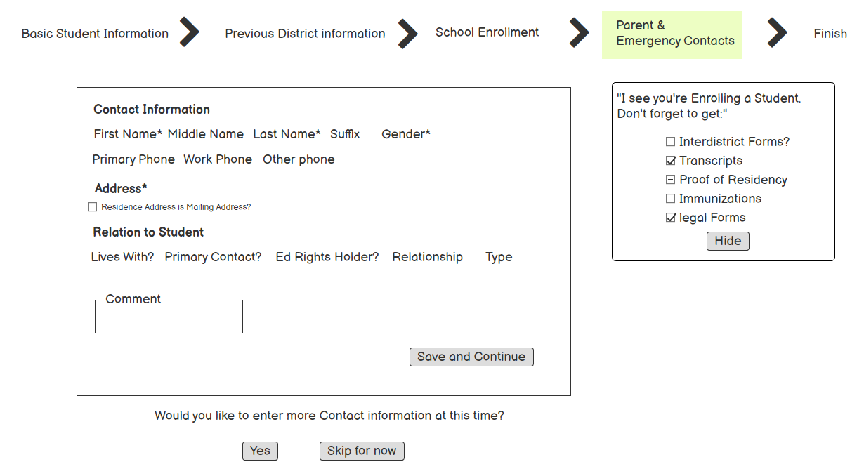
Enrollment Process
These Steps are customizable. You can add more Steps and also change the order
PHOTO CAPTION
Entering All the Contact information could be optional at Enrollment.
Once assigned To a School, the site Staff could complete this information

Slide 23
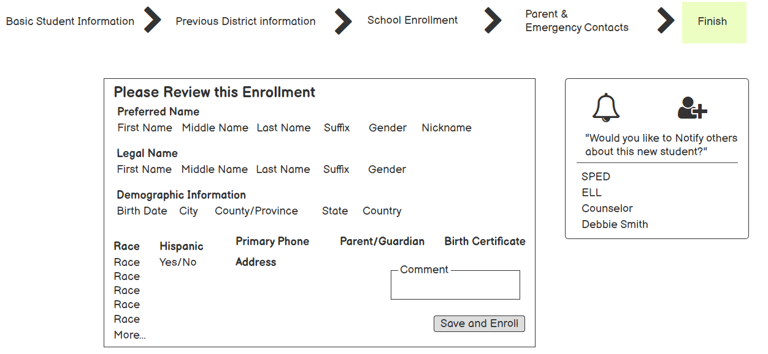
Enrollment Process
You are prompted to send a Notification to others about this new Student
PHOTO CAPTION
Student ID is assigned

Slide 24
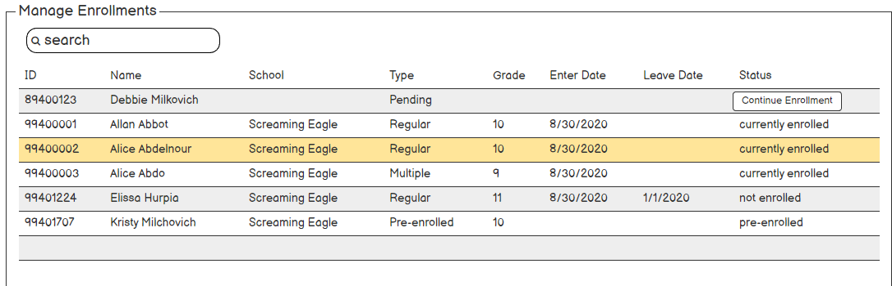
Manage Enrollments
PHOTO CAPTION

Slide 25
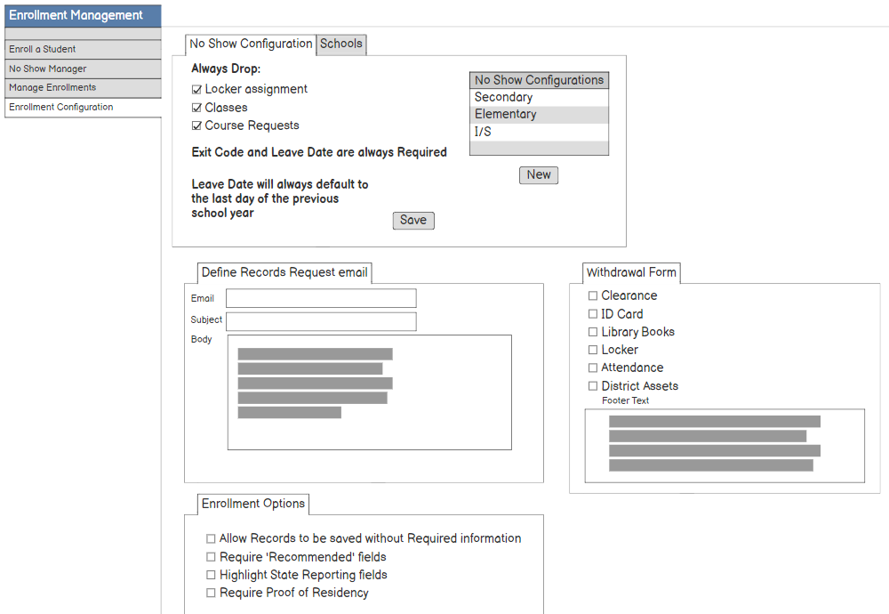
Enrollment Configuration
PHOTO CAPTION

Slide 26
Other Features:
Status Tags are going away!
The current Enrollment status will be the indicator. When a Student is no longer actively enrolled, the Enrollment status will show on the Student Information page.

Slide 27
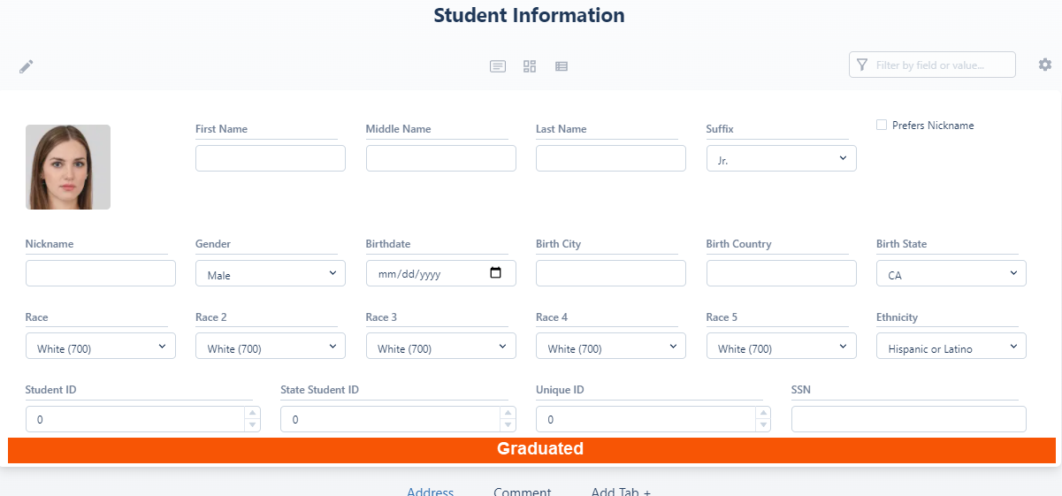
Student Information page
PHOTO CAPTION
Status Indicator with Exit Reason/Pre-enrolled instead of a Status tag

Slide 28
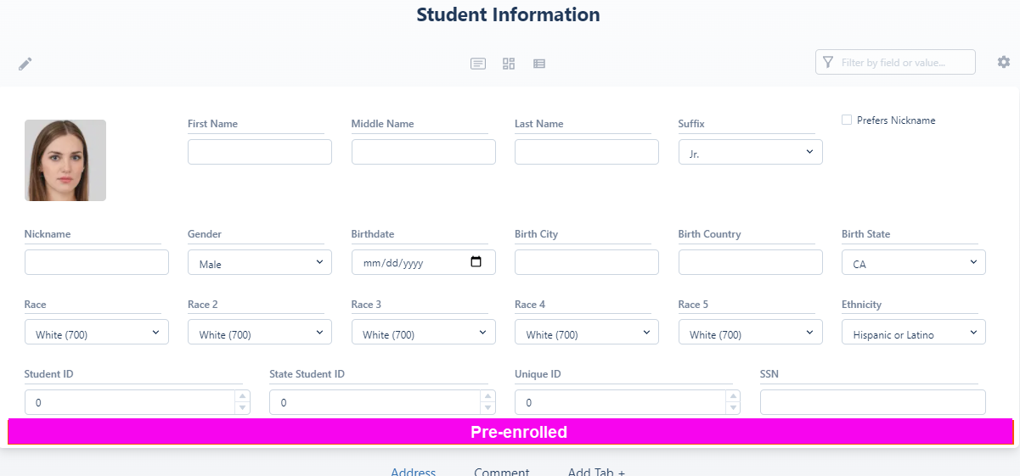
Student Information page
PHOTO CAPTION

Slide 29
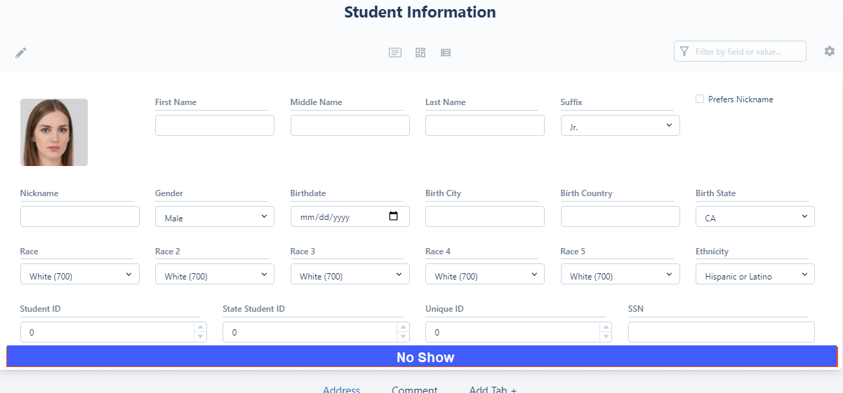
Student Information page
PHOTO CAPTION
The District can customize the colors

Slide 30
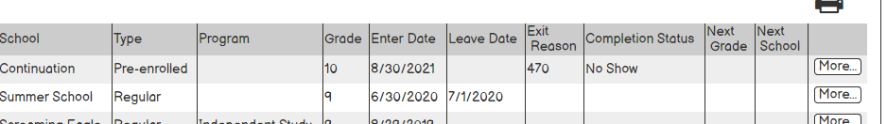
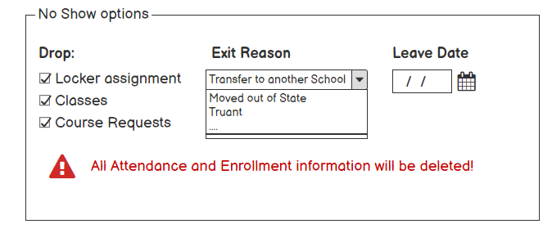
No Show Form
The No Show form can be triggered by editing the Student’s Enrollment from the Student Information page or the Manage Enrollments page
PHOTO CAPTION

Slide 31
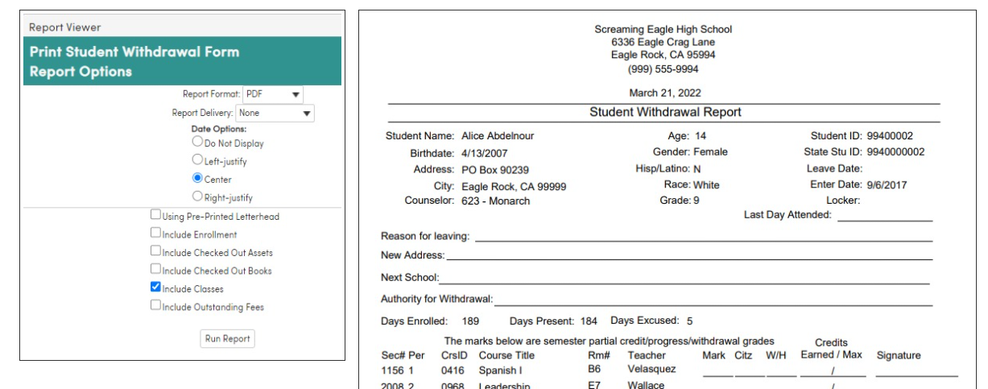
Withdrawal Form
PHOTO CAPTION

Slide 32
Other Features:
Data Validation
We plan on including Data Validations for all edit operations that check for potential conflicts or missing data. Some examples could be:
‘If you enter a 230 exit code you must enter a completion status’
‘A Student’s enter date cannot overlap an exit date’
‘If a Leave Date is entered an Exit Code must be selected’
Basic Validations would ship with the application, but Customers can add their own.

Slide 33
Roadmap
Data Model
  Enrollment History
  Other District Enrollment
Enrollment History view
Enrollment Management Processes
  No Shows
  Withdrawals
Enrollment Process
Import Students
PHOTO CAPTION

Slide 34
Plan Summary
Enrollment Management in Aeries NextGen will become more intuitive and process-oriented. This will enable Office Staff to easily manage a Students Enrollment, Enrollment Status and History, and completion of their enrollment in the District.
This process should avoid duplicate Student records, having to update data on multiple pages, help eliminate data errors, and allow a District to customize the Enrollment process.
PHOTO CAPTION

Slide 35
Questions?
Aeries Enrollment Management

