Slide 1
Advanced Data Validation
Session 973-2
Hannah Rhinebeck TECHNICAL SUPPORT ENGINEER SUPERVISOR
Information shared throughout this presentation is the property of Aeries Software. Information or images may not be reproduced, duplicated, or shared without the prior written consent of Aeries Software.

Slide 2
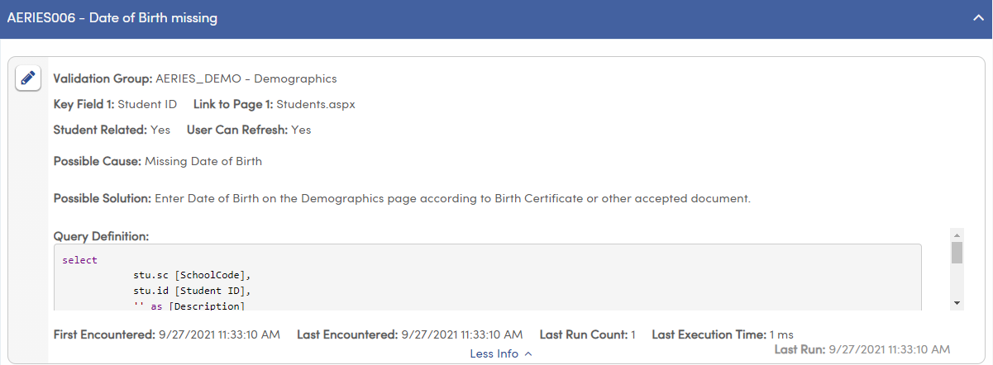
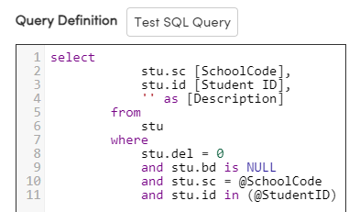
Post Input Validation – Data Validation
Run SQL queries within the Aeries interface…

Slide 3
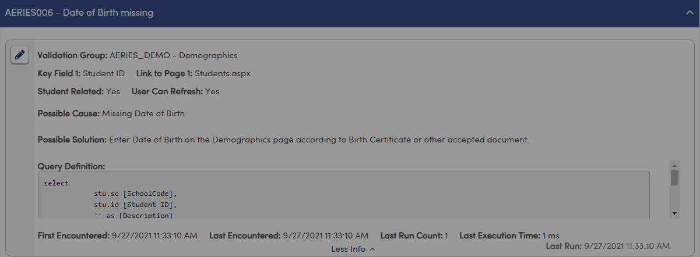
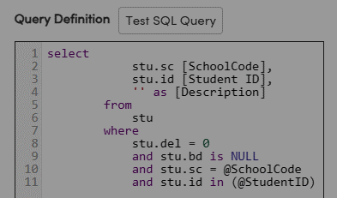
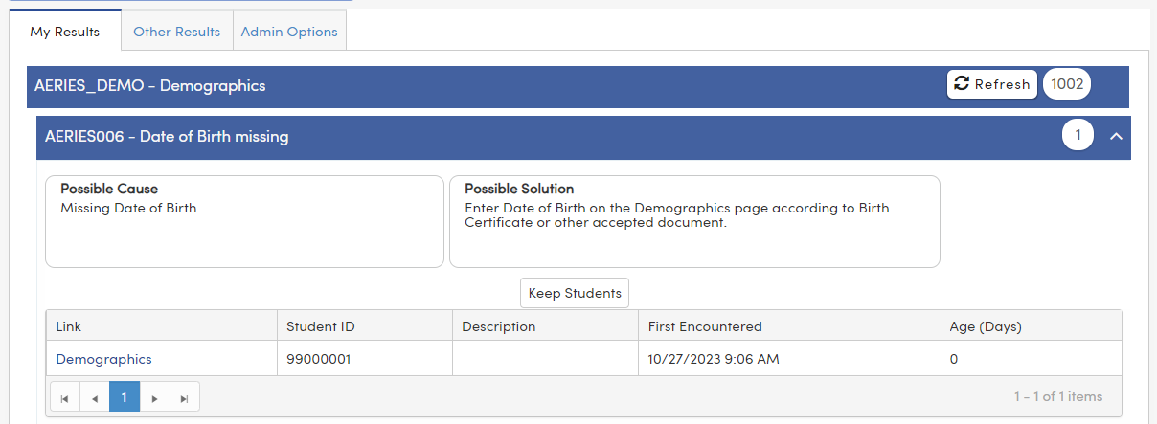
Post Input Validation – Data Validation
Run SQL queries within the Aeries interface…
…and generate a user-friendly list of results

Slide 4
Data Validation Benefits
Define rules for any criteria
Run automatically or on demand
Automatically notify staff of errors
Use built-in definitions or create your own!

Slide 5
Add Custom Groups

Slide 6
Data Validation Groups
Click to add new Data Validation Group

Slide 7
Data Validation Groups
Enter a short name and a description

Slide 8
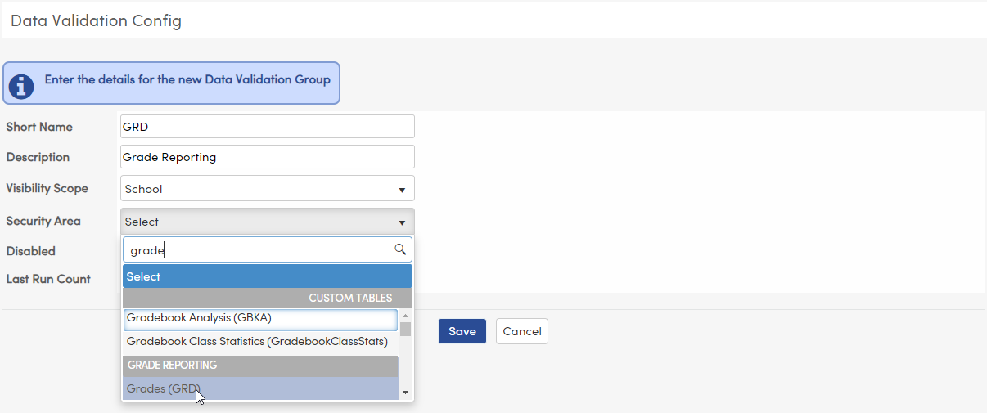
Data Validation Groups
Visibility Scope
If you want the results to display when logged into a school, choose “School”
If you want the results to display when logged in at the district level, choose “District”
Select the Security Area
Users will need permission to the selected table to view the results for this Data Validation Group
Results will show at school level
Choose Visibility

Slide 9
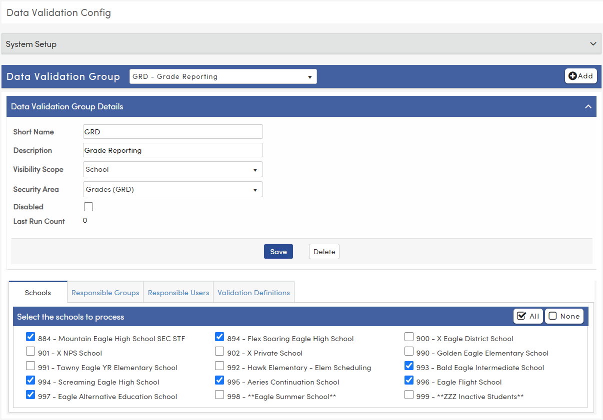
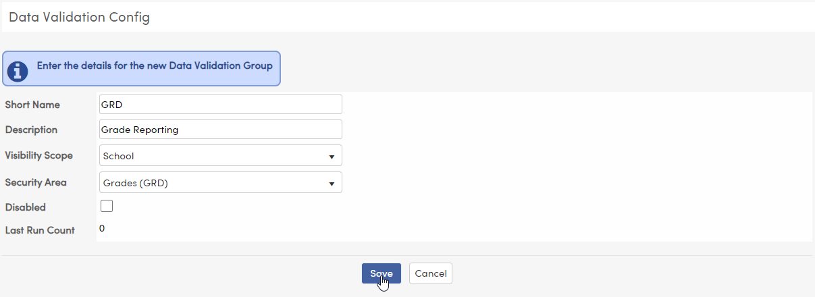
Data Validation Groups
Disable the whole Data Validation Group
See number of results from the group’s last run
Additional options will appear below
Click “Save”

Slide 10
Data Validation Groups
Select the schools where the definitions in this group will run

Slide 11
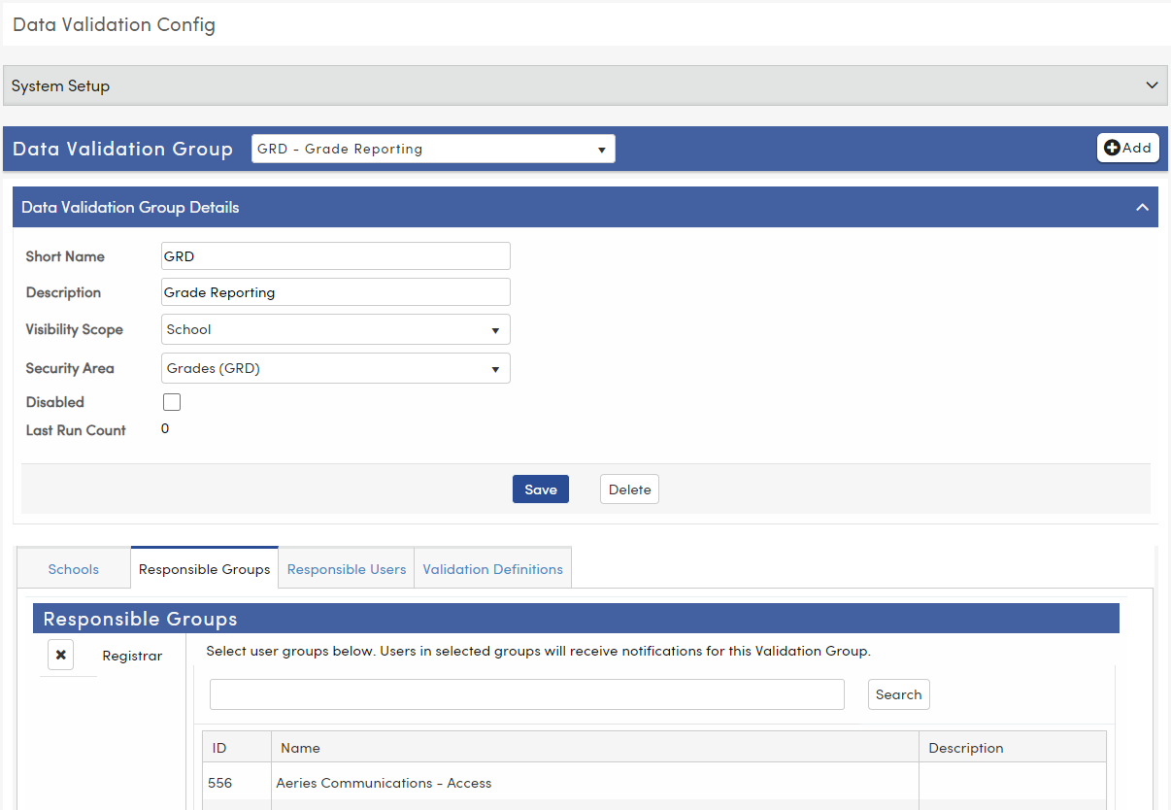
Data Validation Groups
Select any Responsible Groups (from UGN)

Slide 12
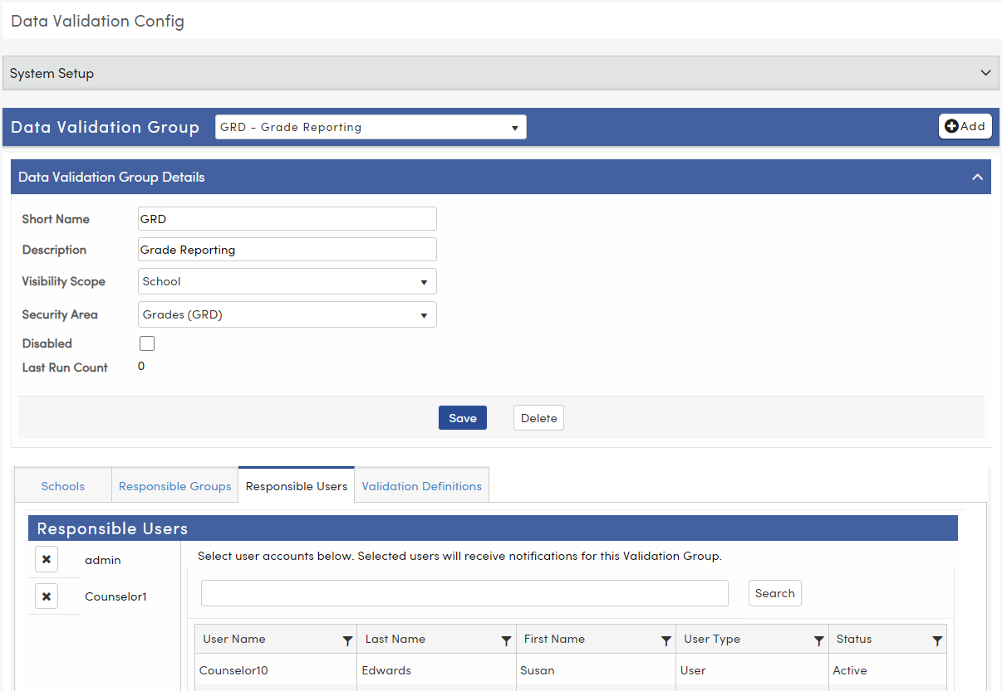
Data Validation Groups
Assign Specific Users (from UGN)

Slide 13
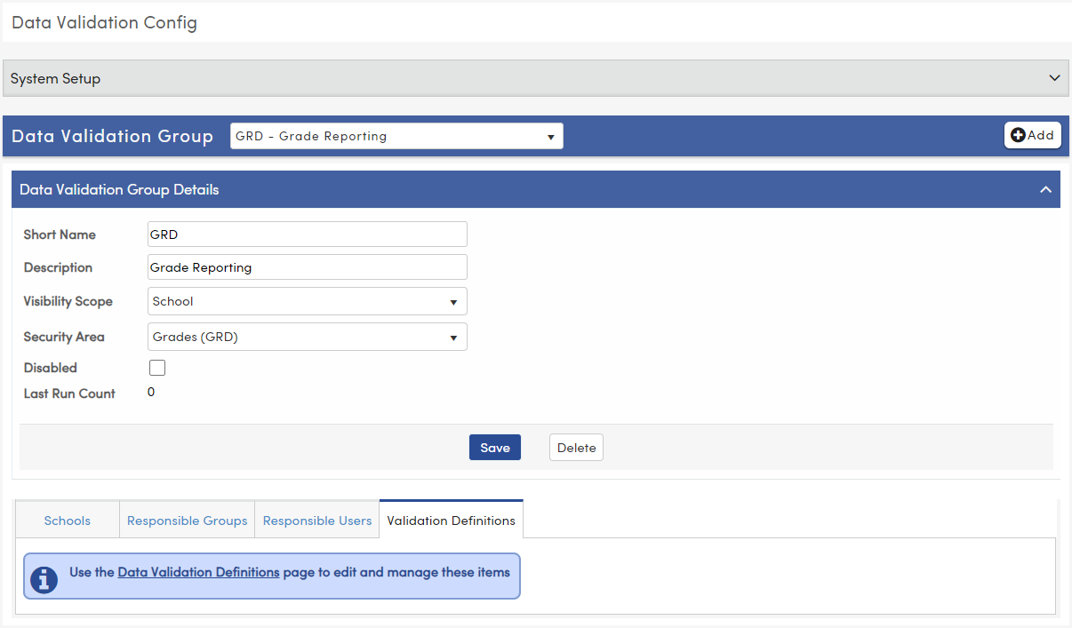
Data Validation Groups
Once Definitions have been created for this group, they will be listed here

Slide 14
Data Validation Definitions

Slide 15
What makes a good Definition?

Slide 16
A good definition…
can be cleared
If your definition generates errors that cannot be resolved and cleared, people will ignore them altogether
uses deep linking
is well documented
executes quickly

Slide 17
A good definition…
can be cleared
Many Aeries pages support “deep linking” to specific records. Make use of them to streamline data correction efforts
uses deep linking
is well documented
executes quickly

Slide 18
A good definition…
can be cleared
Be thorough in your descriptions of the problem and solution. Link to internal and/or Aeries documentation as appropriate.
uses deep linking
is well documented
executes quickly

Slide 19
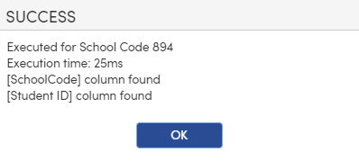
A good definition…
The “Test SQL Query” button will show you how long it took to execute
can be cleared
People love instant gratification. Write fast queries so that they can be allowed to refresh their results immediately after correcting the errors.
(< 200ms)
uses deep linking
is well documented
executes quickly

Slide 20
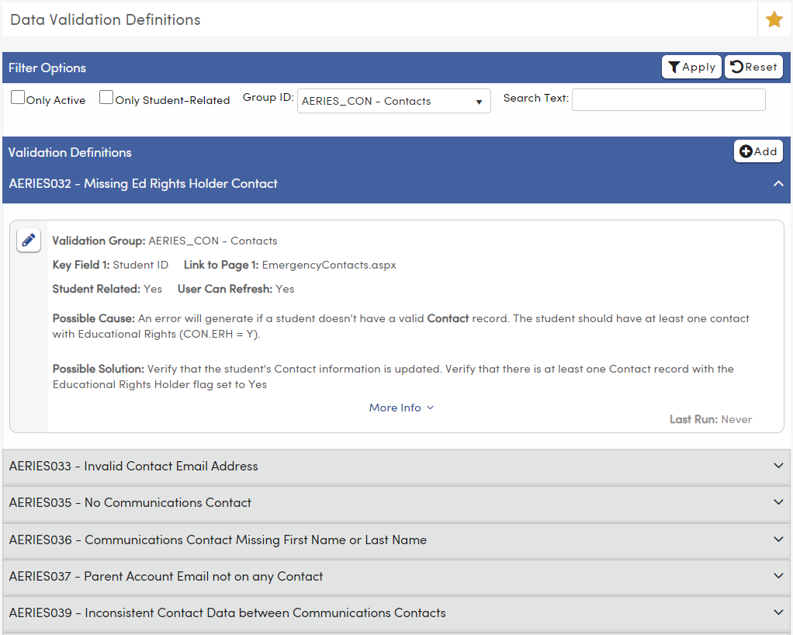
Data Validation Definitions
NOTE: multifactor authentication must be enabled to access the Data Validation Definitions page
View existing definitions
Edit existing definitions
Create custom definitions

Slide 21
Definitions - Field Descriptions
Which Validation Group members are responsible for correcting this error?
Give your definition a short name and a description
NOTE: This also determines the scope
Key Field 1 is required
Key Field 2 is optional
These fields will display on the Data Validation Results page
Links to pages within Aeries to help the user clear the error
If this message appears, deep linking may be supported
To allow users to refresh their results, check this box
To have this definition run within a date range, enter the start and end date
Severity Level is for information only. You can add custom values in the COD table
To exclude this definition from running, check this box
If this definition is student related, check this box

Slide 22
Definitions - Field Descriptions
Which Validation Group members are responsible for correcting this error?
Give your definition a short name and a description
NOTE: This also determines the scope
Key Field 1 is required
Key Field 2 is optional
These fields will display on the Data Validation Results page
Links to pages within Aeries to help the user clear the error
If this message appears, deep linking is supported
To allow users to refresh their results, check this box
To have this definition run within a date range, enter the start and end date
Severity Level is for information only. You can add custom values in the COD table
To exclude this definition from running, check this box
If this definition is student related, check this box

Slide 23
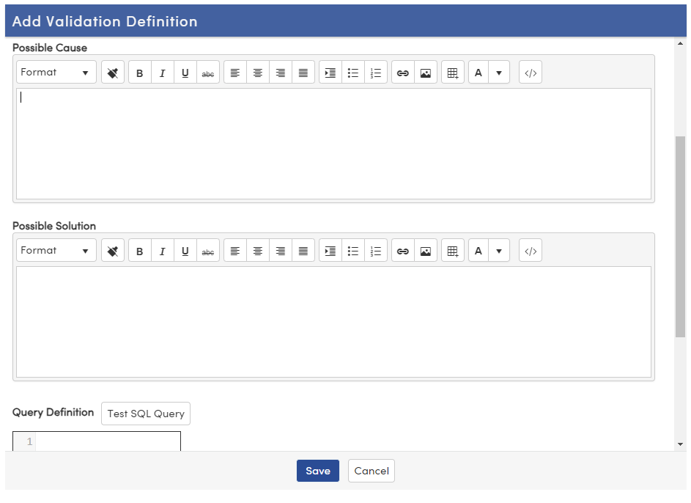
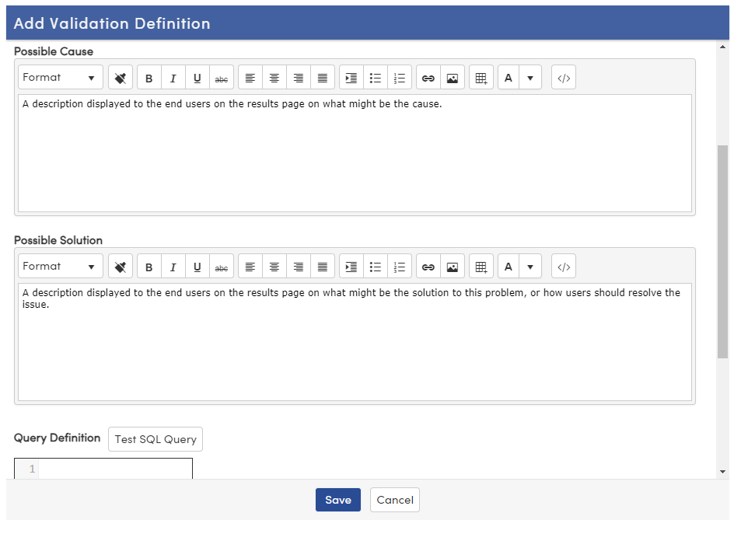
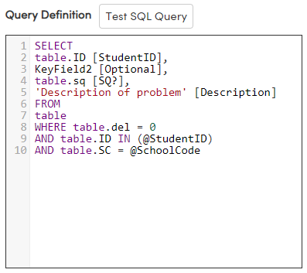
Definitions - Cause, Solution, and Query
HTML formatting is supported
What is the error?
How is the error resolved?
You will need to reference the definition details to create your SQL script

Slide 24
Definitions - Query Definition
You will need to reference the definition details to create your SQL script

Slide 25
Adding Custom Definitions

Slide 26
Definitions - Query Definition
You will need to reference the definition details to create your SQL script
The value in Key Field 1 must be a column
If Key Field 2 has been populated, the value in Key Field 2 must be a column
Are you utilizing a deep link? The specified column must end in a question mark
Every definition requires a column titled “Description”
Every definitions requires a column titled “Description”
Is the definition student-related? If so, the @StudentID parameter must be in the WHERE clause
NOTE: Student Related definitions must have a column titled “StudentID” or “Student ID”.
If your Key Field 1 or Key Field 2 is not one of those titles, “StudentID” or “Student ID” must be added as a separate column
Don’t forget to exclude del-tagged records!
Is the Assigned Data Validation Group school-scoped? If so, the @SchoolCode parameter must be in the WHERE clause

Slide 27
Definitions - Query Definition
You will need to reference the definition details to create your SQL script
The value in Key Field 1 must be a column
If Key Field 2 has been populated, the value in Key Field 2 must be a column
Are you utilizing a deep link? The specified column must end in a question mark
Every definition requires a column titled “Description”
Every definitions requires a column titled “Description”
Is the definition student-related? If so, the @StudentID parameter must be in the WHERE clause
NOTE: Student Related definitions must have a column titled “StudentID” or “Student ID”.
If your Key Field 1 or Key Field 2 is not one of those titles, “StudentID” or “Student ID” must be added as a separate column
Don’t forget to exclude del-tagged records!
Is the Assigned Data Validation Group school-scoped? If so, the @SchoolCode parameter must be in the WHERE clause

Slide 28
Definitions - Query Definition
You will need to reference the definition details to create your SQL script
The value in Key Field 1 must be a column
If Key Field 2 has been populated, the value in Key Field 2 must be a column
Are you utilizing a deep link? The specified column must end in a question mark
Every definition requires a column titled “Description”
Every definitions requires a column titled “Description”
Is the definition student-related? If so, the @StudentID parameter must be in the WHERE clause
NOTE: Student Related definitions must have a column titled “StudentID” or “Student ID”.
If your Key Field 1 or Key Field 2 is not one of those titles, “StudentID” or “Student ID” must be added as a separate column
Don’t forget to exclude del-tagged records!
Is the Assigned Data Validation Group school-scoped? If so, the @SchoolCode parameter must be in the WHERE clause

Slide 29
Definitions - Query Definition
You will need to reference the definition details to create your SQL script
The value in Key Field 1 must be a column
If Key Field 2 has been populated, the value in Key Field 2 must be a column
Are you utilizing a deep link? The specified column must end in a question mark
Every definition requires a column titled “Description”
Every definition requires a column titled “Description”
Is the definition student-related? If so, the @StudentID parameter must be in the WHERE clause
NOTE: Student Related definitions must have a column titled “StudentID” or “Student ID”.
If your Key Field 1 or Key Field 2 is not one of those titles, “StudentID” or “Student ID” must be added as a separate column
Don’t forget to exclude del-tagged records!
Is the Assigned Data Validation Group school-scoped? If so, the @SchoolCode parameter must be in the WHERE clause

Slide 30
Definitions - Query Definition
You will need to reference the definition details to create your SQL script
The value in Key Field 1 must be a column
If Key Field 2 has been populated, the value in Key Field 2 must be a column
Are you utilizing a deep link? The specified column must end in a question mark
Every definition requires a column titled “Description”
Every definition requires a column titled “Description”
Is the definition student-related? If so, the @StudentID parameter must be in the WHERE clause
NOTE: Student Related definitions must have a column titled “StudentID” or “Student ID”.
If your Key Field 1 or Key Field 2 is not one of those titles, “StudentID” or “Student ID” must be added as a separate column
Don’t forget to exclude del-tagged records!
Is the Assigned Data Validation Group school-scoped? If so, the @SchoolCode parameter must be in the WHERE clause

Slide 31
Definitions - Query Definition
You will need to reference the definition details to create your SQL script
The value in Key Field 1 must be a column
If Key Field 2 has been populated, the value in Key Field 2 must be a column
Are you utilizing a deep link? The specified column must end in a question mark
Every definition requires a column titled “Description”
Every definition requires a column titled “Description”
Is the definition student-related? If so, the @StudentID parameter must be in the WHERE clause
NOTE: Student Related definitions must have a column titled “StudentID” or “Student ID”.
If your Key Field 1 or Key Field 2 is not one of those titles, “StudentID” or “Student ID” must be added as a separate column
Don’t forget to exclude del-tagged records!
Is the Assigned Data Validation Group school-scoped? If so, the @SchoolCode parameter must be in the WHERE clause

Slide 32
Definitions - Query Definition
You will need to reference the definition details to create your SQL script
The value in Key Field 1 must be a column
If Key Field 2 has been populated, the value in Key Field 2 must be a column
Are you utilizing a deep link? The specified column must end in a question mark
Every definition requires a column titled “Description”
Every definition requires a column titled “Description”
Is the definition student-related? If so, the @StudentID parameter must be in the WHERE clause
NOTE: Student Related definitions must have a column titled “StudentID” or “Student ID”.
If your Key Field 1 or Key Field 2 is not one of those titles, “StudentID” or “Student ID” must be added as a separate column
Don’t forget to exclude del-tagged records!
Is the Assigned Data Validation Group school-scoped? If so, the @SchoolCode parameter must be in the WHERE clause

Slide 33
Definitions - Query Definition
You will need to reference the definition details to create your SQL script
The value in Key Field 1 must be a column
If Key Field 2 has been populated, the value in Key Field 2 must be a column
Are you utilizing a deep link? The specified column must end in a question mark
Every definition requires a column titled “Description”
Every definition requires a column titled “Description”
Is the definition student-related? If so, the @StudentID parameter must be in the WHERE clause
NOTE: Student Related definitions must have a column titled “StudentID” or “Student ID”.
If your Key Field 1 or Key Field 2 is not one of those titles, “StudentID” or “Student ID” must be added as a separate column
Don’t forget to exclude del-tagged records!
Is the Assigned Data Validation Group school-scoped? If so, the @SchoolCode parameter must be in the WHERE clause

Slide 34
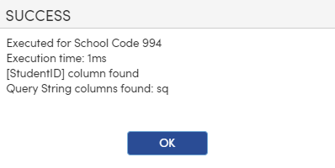
Definitions - Query Definition
Before saving, test your SQL Query to verify there are no errors
You will need to reference the definition details to create your SQL script
The value in Key Field 1 must be a column
If Key Field 2 has been populated, the value in Key Field 2 must be a column
Are you utilizing a deep link? The specified column must end in a question mark
Every definition requires a column titled “Description”
Every definition requires a column titled “Description”
Is the definition student-related? If so, the @StudentID parameter must be in the WHERE clause
NOTE: Student Related definitions must have a column titled “StudentID” or “Student ID”.
If your Key Field 1 or Key Field 2 is not one of those titles, “StudentID” or “Student ID” must be added as a separate column
Don’t forget to exclude del-tagged records!
Is the Assigned Data Validation Group school-scoped? If so, the @SchoolCode parameter must be in the WHERE clause

Slide 35
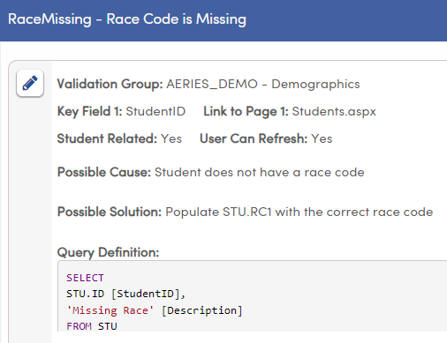
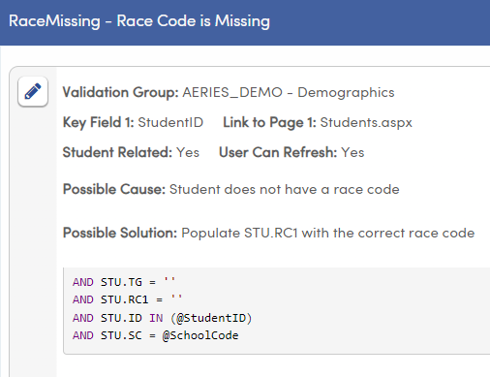
SQL Syntax Notes – Student-Related Definitions
Student-related definitions require a column named “StudentID” (or “Student ID”)
This will most likely be the Key Field 1
The @StudentID parameter is required in the WHERE clause

Slide 36
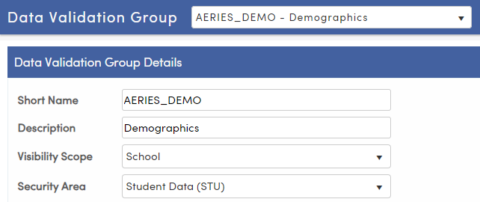
SQL Syntax Notes – School-Scoped Validation Groups
The @SchoolCode parameter is required in the WHERE clause
This is essential for properly breaking down results by school.

Slide 37
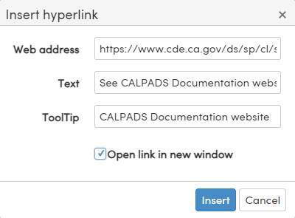
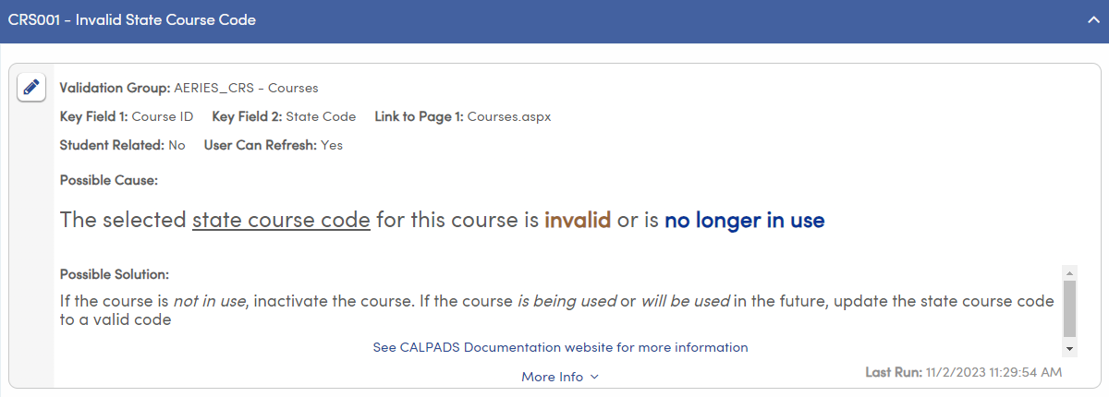
Documentation
HTML formatting is supported in the Possible Cause and Possible Solution text areas. Help clarify or emphasize information using these tools
Include links to related documentation that can help clear the error

Slide 38
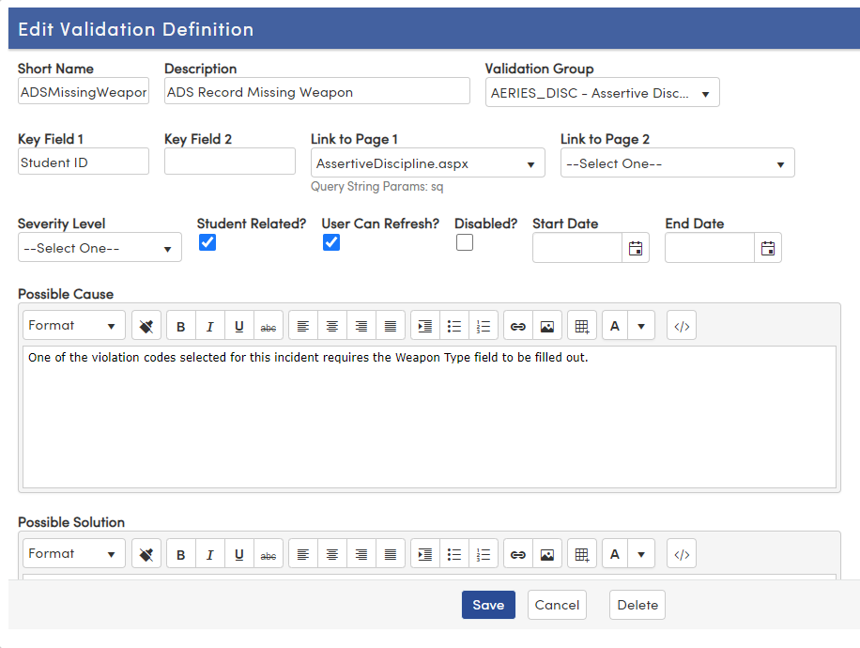
Deep Linking
When “Query String Params:” appears below the linked page, you may be able to use deep linking to target the specific record needing attention
URL without using deep link
URL with deep link

Slide 39
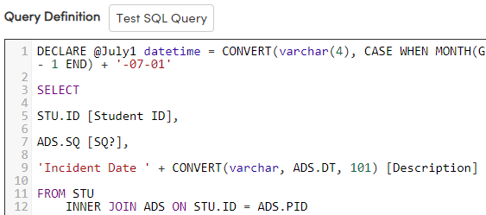
Deep Linking
Add the specified column to your SQL query definition, ending the column name with a question mark

Slide 40
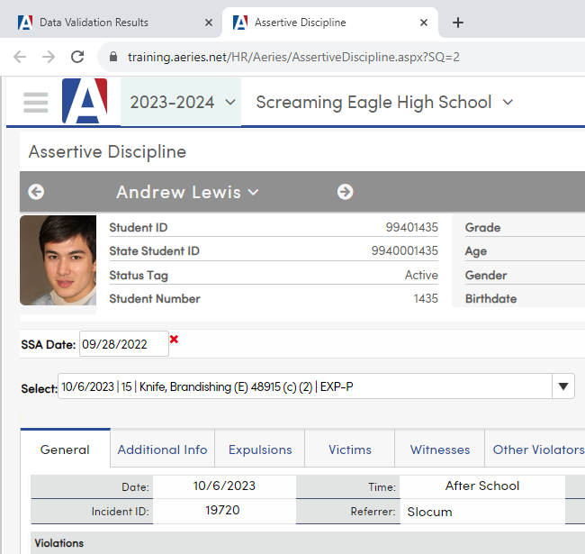
Deep Linking
Add that column to your SQL query definition, ending the column name with a question mark

Slide 41
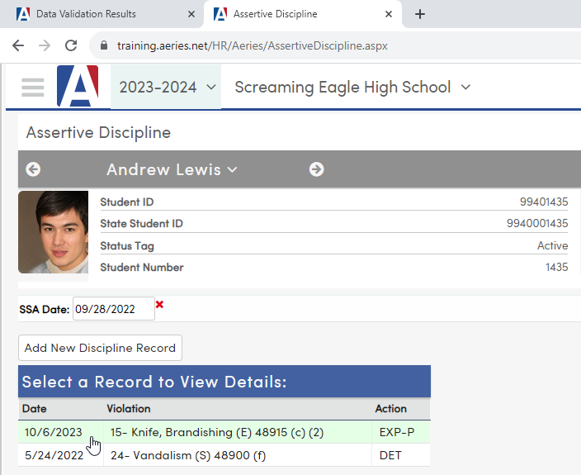
Deep Linking
Without Deep Linking
The staff member will have to select the record to correct.

Slide 42
Deep Linking
With Deep Linking
The record needing correction is automatically selected

Slide 43
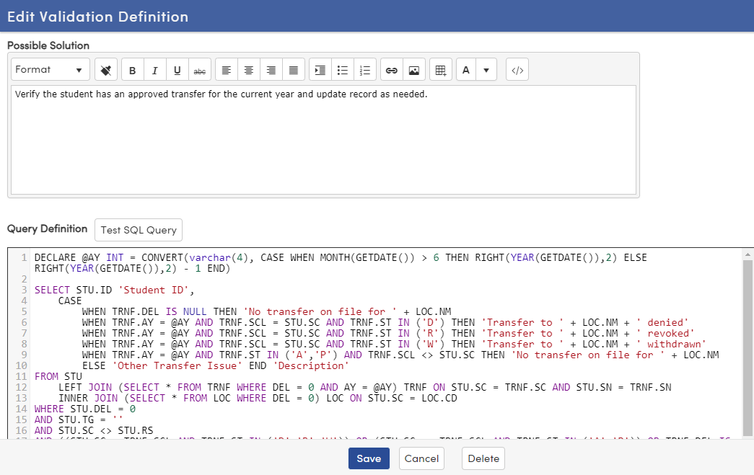
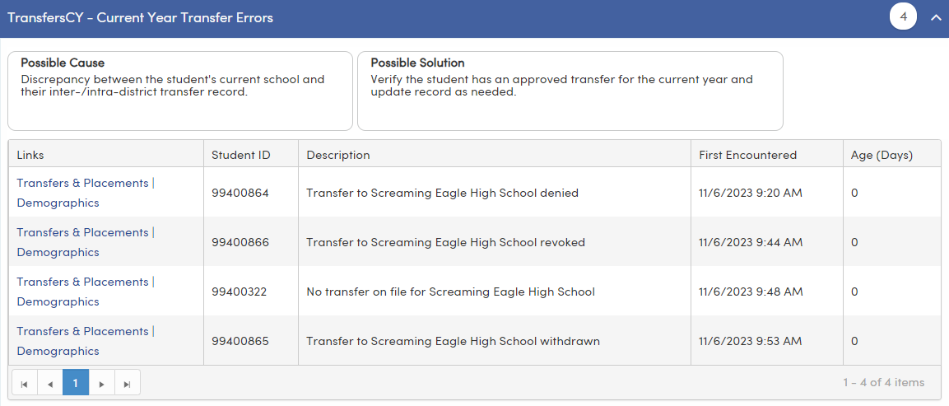
Combine Similar Errors
Use a CASE statement or a UNION to combine similar errors into one definition. List the specific error in the Description field.

Slide 44
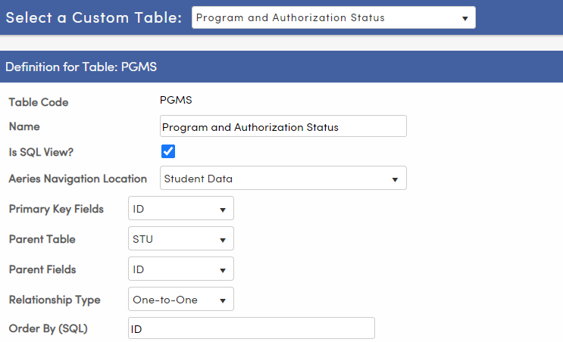
Use Custom Tables
Data Validation Definitions can be created using custom tables and views

Slide 45
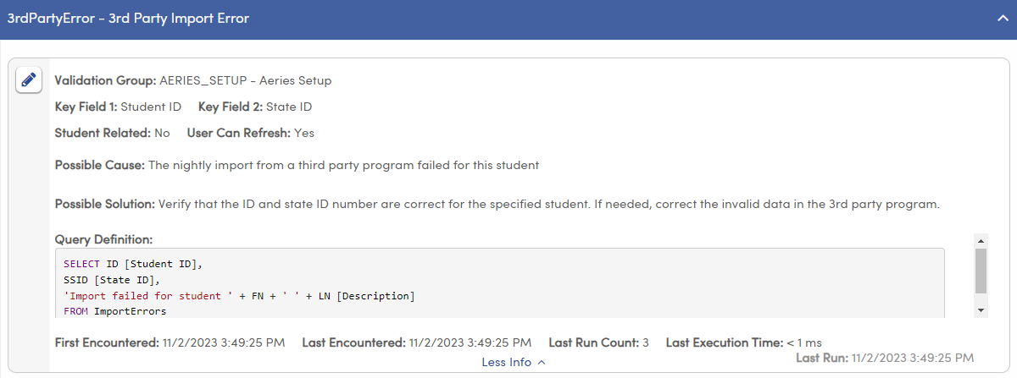
Use Custom Tables
Any table in the database can be used in your definition – even if that table is not defined in Aeries

Slide 46
Use Custom Tables
Any table in the database can be used in your definition – even if that table is not defined in Aeries
The key fields in this example are not linked to a student record as this custom table contains errors for unmatched students from a 3rd party program

Slide 47
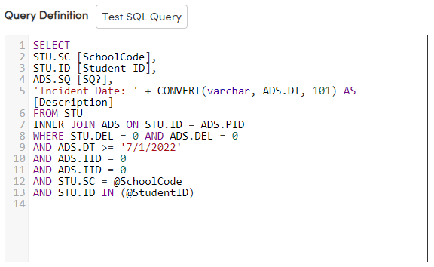
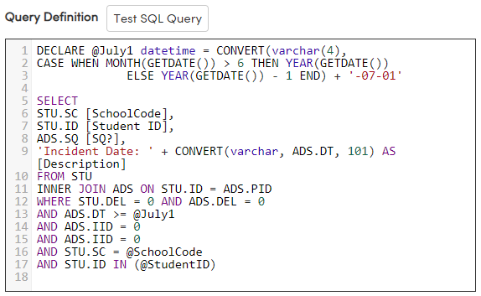
Make them Dynamic
Try to create Data Validation Definitions that do not require updating.
Use variables instead of static dates if possible

Slide 48
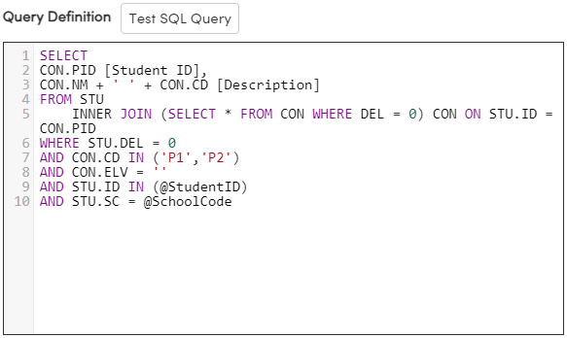
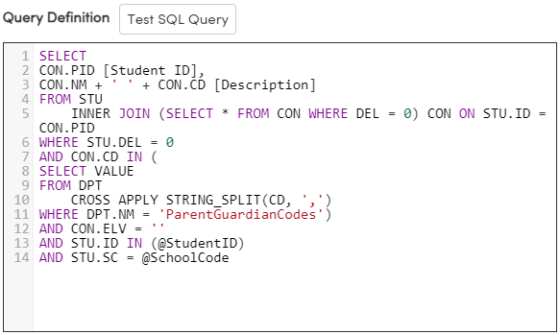
Make them Dynamic
Try to create Data Validation Definitions that do not require updating.
If the codes identifying Parent/Guardian in Contacts (CON.CD) change, this definition will need to be updated
This definition grabs the Parent/Guardian code values defined in DPT, so it does not require updating

Slide 49
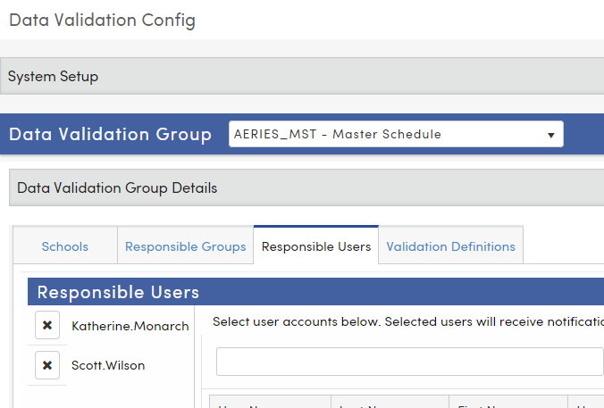
Target Specific Staff Members
If a column called “TargetedStaffID” is in the SQL output, it will limit "My Results" to an individual, rather than anyone in the Responsible Users/Groups.
Katherine.Monarch and Scott.Wilson are both listed as responsible users for the AERIES_MST – Master Schedule validation group

Slide 50
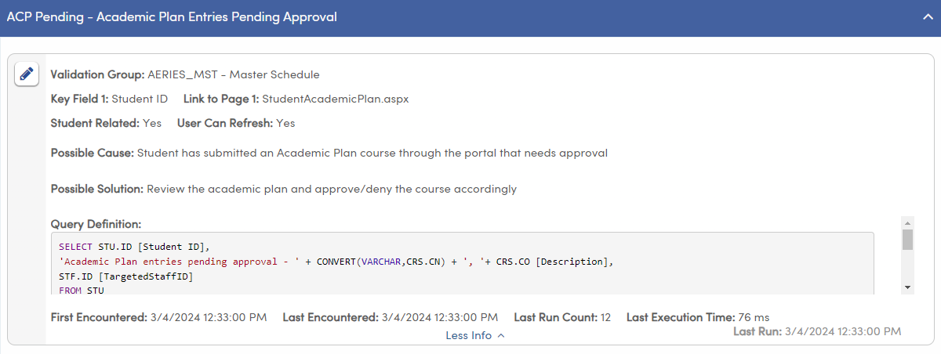
Target Specific Staff Members
AERIES_MST – Master Schedule is the assigned validation group for ACP Pending – Academic Plan Entries Pending Approval
The SQL output has a column called [TargetedStaffID]

Slide 51
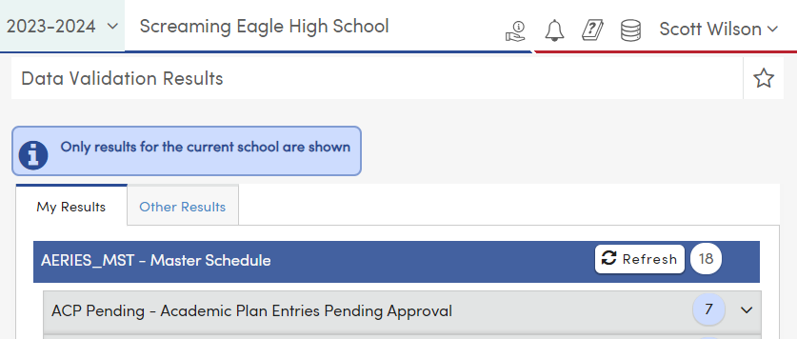
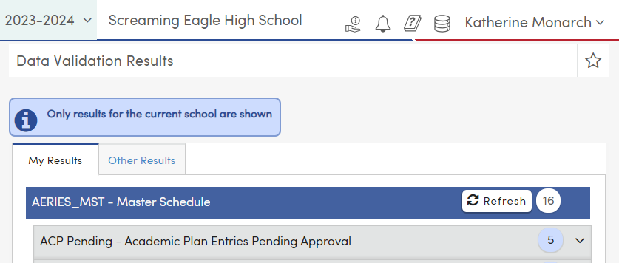
Target Specific Staff Members
Both users see results for “ACP Pending” at Screaming Eagle High School, but their totals are different

Slide 52
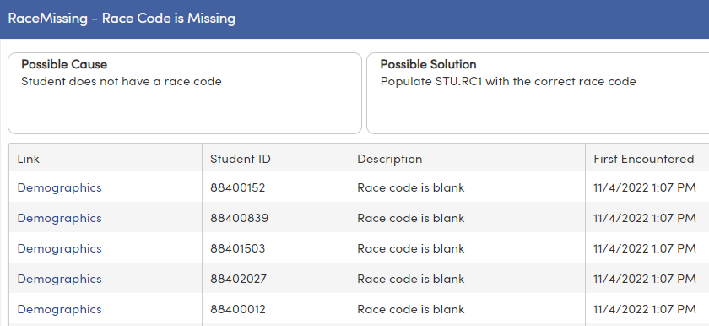
Convert Existing Queries/Reports
Converting your reports and queries into data validation definitions saves you from having to repeatedly run the report or query. The appropriate staff member will even be notified when an error occurs

Slide 53
Data Validation Definition Examples

Slide 54
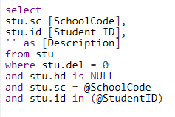
Student-Related, School Scope
Validation Group is School-Scoped
Student ID is a Key Field
“Student Related?” is checked
Column named “Student ID”
Column named “Description”
Student ID parameter in the WHERE clause
School Code parameter in the WHERE clause

Slide 55
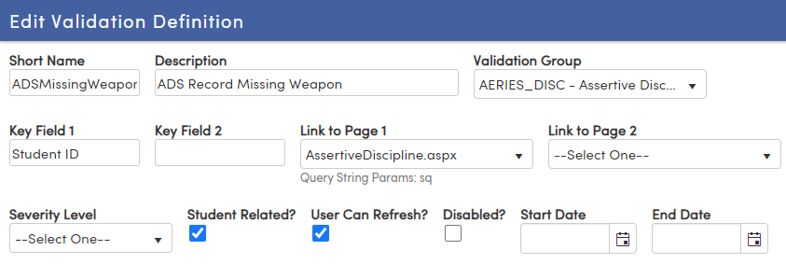
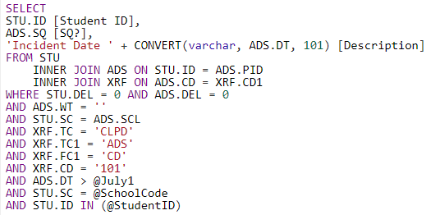
Student-Related, School Scope
With deep link
Validation Group is School-Scoped
Student ID is a Key Field
Link to Page 1 Supports Deep Linking
“Student Related?” is checked
Column named “Student ID”
Column named “Description”
Deep Link used for ADS.SQ
Student ID parameter in the WHERE clause
School Code parameter in the WHERE clause

Slide 56
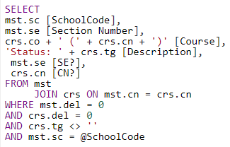
Not Student-Related, School Scope
With deep link
Validation Group is School-Scoped
Key Field 1 Populated
Link to Page 1& 2 Supports Deep Linking
Key Field 2 Populated (Optional)
“Student Related?” is unchecked
Key Field 1 column
Key Field 2 column (only required when populated)
Column named “Description”
Deep Link used for MST.SE and CRS.CN
School Code ID parameter in the WHERE clause

Slide 57
Not Student-Related, District Scope
Validation Group is District-Scoped
Key Field 1 Populated
“Student Related?” is unchecked
Key Field 1 column
Column named “Description”

Slide 58
Recommended Sessions
Aeries Query
SQL Query
Data Validation
250 – Basics of Query
255 – Intermediate Query
265 – Multi-Table Queries
270 – Advanced Query
272 - Flex Queries
940 – SQL Query Basic
950 - SQL Intermediate Query
1002 – SQL Query Advanced
973-1 Intro to Data Validation

Slide 59
THANK YOU!
Please take a moment to complete our session survey.
http://surveys.aeries.com/s3/AeriesCon-Session-Feedback-Survey-Spring-2024

Slide 60
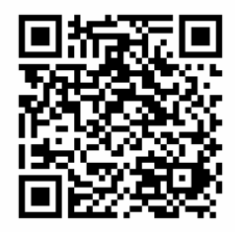
Share your Feedback:

