Slide 1
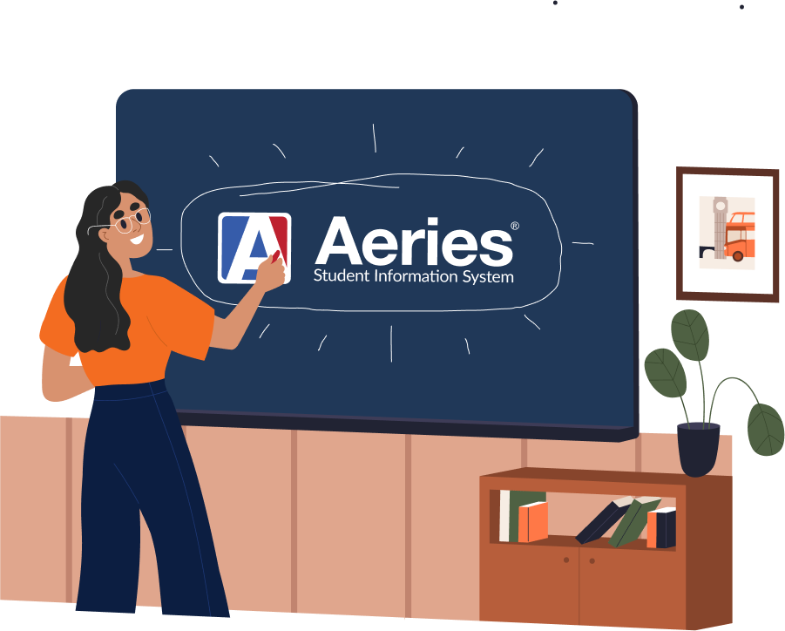
Ask Aeries! Scheduling
March 28, 2024
Host: Jennifer Opiela Presenter: Carole Williams Moderators: Lisa Golisano, Connie Hooks

Slide 2
“How do we convert to 'Section Staff' without moving to Flex scheduling?” Checkbox on Scheduling Setup: “Can this be done by school without changing the entire district?” Yes “Is there documentation on ‘Section Staff’?” https://support.aeries.com/support/solutions/articles/14000069816-scheduling-setup#Convert-to-Section-Staff-only-(non-flex)-%E2%86%91
Notes:
Communicate with your entire team before you make the switch to Section Staff. Be aware of the pros and cons:
Pros: more than three teachers per section; anyone in the Staff (STF) table can be attached to a section; itinerant teachers will only need one STF record for entire district and it will be used for all the schools; management of staff enters and leaves is easier
Cons: the STF table will need timely maintenance (a staff member can’t be attached to a section if no record in STF exists); STF is district-wide; STF is typically HR or someone at the district office with specific permissions; currently the system does not accomplish Load Monitoring (see Query below for workaround)
If you decide to transition to Section Staff, consider also enabling Use Staff ID Based Counselor Tracking on School Options. Documentation: https://support.aeries.com/support/solutions/articles/14000129278-staff-id-based-counselor-tracking-beta
Don’t forget the Scheduling Info (SSI) and Job Assignments (STJ) tables (tabs on the Staff page). Data entry in SSI will make your life easier when you add SMS/MST sections (Max, Room, Low Grade, High Grade will all pre-fill a new section as it is added). STJ data will be needed if the teacher teaches at multiple schools (also, it is reported to the state).
Link to support documentation on Scheduling Setup and using Section Staff without converting to Flex: https://support.aeries.com/support/solutions/articles/14000069816-scheduling-setup#Convert-to-Section-Staff-only-(non-flex)-%E2%86%91
If you’re using Section Staff, this Query can be used for teacher Load Monitoring; First run a list of sections with the MST.TS for Total Students. Export to Excel and create a Pivot Table to get the totals. LIST MST SSE STF (( STF.LN + ". " + STF.FN )) MST.TS IF SSE.PR = 1 AND MST.TS > 0

Slide 3
“Could Scheduling Exclusions, currently only on the Course Requests page, also appear on the Class Schedule page throughout the whole year? This would be immensely helpful and reduce liability when rescheduling a student or for multi-term schools (2+).” Not currently, but Ideas exist: https://ideas.aeries.com/forums/925735-aeries-ideas/suggestions/42579013-display-scheduling-exclusions-on-the-classes-page https://ideas.aeries.com/forums/925735-aeries-ideas/suggestions/44928772-year-round-scheduling-exclusions
Notes:
Great idea!
Aeries Ideas are already added for the same thing:
https://ideas.aeries.com/forums/925735-aeries-ideas/suggestions/42579013-display-scheduling-exclusions-on-the-classes-page
https://ideas.aeries.com/forums/925735-aeries-ideas/suggestions/44928772-year-round-scheduling-exclusions

Slide 4
“I would love to be able to utilize the SMS board for developing and scheduling all 4 Quarters at my school. Since we are a credit recovery/ continuation school we have 4 completely separate master schedules and scheduling processes that need to occur throughout the year. No terms, or classes automatically rollover.” Alt Ed scheduling uses placeholder sections (typically one section per teacher/period). Placeholder sections can be set up in the Scheduling Master Schedule (you could even wait to do this in the Master Schedule). Placeholder sections can be for any Term length, including Quarters (if needed). Once you know what Courses the students will be taking, that information will be added, per student, on the Classes page.
Notes:
Alt Ed scheduling is simpler than you might think.
Create placeholder sections for each teacher/period.
Put the students into the correct placeholder section(s).
During the school year, a “Course being taught” is added per student, per placeholder section.
So each student stays in their placeholder section(s) all year long (unless they have change to another teacher).
The “Course being taught” can be changed throughout the year, without the student’s placeholder section(s) changing.

Slide 5
“We populate all our homeroom sections. I then create sections for our Specialist sections (i.e., Art, Music, PE, Science Lab), one section per homeroom so the Specialist teacher has access to all students. I then copy all homeroom sections to the respective specialist section. I have been told that CALPADS does not like having student names appearing so many times, in so many sections. My question is "Can I create a homeroom section and have all my Specialists (5 total specialist teachers) be 'co-teachers’?” I have tried in the past, but it doesn't seem to work.” 1. Use your current setup. Create other sections for the specialists and exclude the sections from Attendance. 2. If you switch to Section Staff or Flex scheduling, yes. Any number of Section Staff can be attached to a section. See previous slide re: Section Staff. Other options: Use Student Groups for the specialist teachers. Use the View All Students in Current School permission (this means all, however).
Notes:
Student Groups: add the homeroom students to separate groups. Add the specialist teachers to their students’ groups.
Teacher-specific permission: View All Students in Current School. If you don’t want to add this to your Teachers Portal Group, separate individual user accounts could be added for the specialists. Cons: this account would be a separate login from their teacher account and this permission would let them see all students.

Slide 6
“What is the best way to handle CTE, Online, and other indicator fields only found in the Master Schedule sections in an Alt Ed School for Independent Study? Are we supposed to create placeholders for each subject area so we can manually assign the indicators in CALPADS so they report correctly? I want to be sure we are going about this right because each teacher at my school is currently assigned a placeholder per period. If this is the case, would I have to create subject areas for each teacher and then tell the counselor schedule the students according to Subject Area? I would imagine that would create a lot of section records to maintain. Please tell me there is another way!” Currently, you need to create multiple placeholder sections (one for each different course attribute) so that students can be enrolled in the correct section for the type of course they are taking. Think of it as “how this is being taught” (which is reported to the state). Aeries Idea exists: https://ideas.aeries.com/forums/925735-aeries-ideas/suggestions/47700416-enhance-alt-ed-scheduling-to-allow-placeholder-se
Notes:
Currently, you need to create multiple placeholder sections (one for each different course attribute) so that students can be enrolled in the correct section for the type of course they are taking. Think of it as “how this is being taught” (which is reported to the state). So the counselor will need to put the student into the correct placeholder section, depending on the course attribute (for example, Independent Study, Distance Learning, CTE). Note that the Subject Area will still come from the “course being taught” (think of it as “what is being taught”). In other words, Alt Ed scheduling allows a student to stay in the same section, even if the Course changes. If “how” it is being taught changes, they’d need to move to a different placeholder section. Aeries Idea exists:
https://ideas.aeries.com/forums/925735-aeries-ideas/suggestions/47700416-enhance-alt-ed-scheduling-to-allow-placeholder-se

Slide 7
“How to manage year long classes built as semester terms so the students get the same teacher both semesters. Teams?” Option 1: Team Course Group/Team# example in bold: Option 2: Class Link example in bold:
TmCrsGp/Team# | Fall section | Spring section
Teacher Smith | SMS/MST.CG = A SMS/MST.TM = 100 | SMS/MST.CG = A SMS/MST.TM = 100
Teacher Jones | SMS/MST.CG = A SMS/MST.TM = 200 | SMS/MST.CG = A SMS/MST.TM = 200
Teacher Lopez | SMS/MST.CG = A SMS/MST.TM = 300 | SMS/MST.CG = A SMS/MST.TM = 300
Class Link | Fall section | Spring section
Teacher Smith | SMS/MST.CL = 1234 | SMS/MST.CL = 1234
Teacher Jones | SMS/MST.CL = 2345 | SMS/MST.CL = 2345
Teacher Lopez | SMS/MST.CL = 3456 | SMS/MST.CL = 3456
Notes:
Multiple options exist to get to the same result:
Use Team Course Group/Team#. Same Team Course Group (from COD table) for ALL sections in the entire set of Fall/Spring sections. Then, same Team# (number > 0) for each section in a teacher’s pair.
Use Class Link. Same Class Link (max of six digits, so from 1 – 999999) for each section in a teacher’s pair.
Teacher Prf (teacher preference) could potentially also work – but it won’t keep the students together in one pair of sections (if other pairs exist for the same teacher).
Use year long Courses/sections instead of Fall/Spring sections.

Slide 8
Wrap Up

