Slide 1
300 Class Schedule Maintenance
Classes and Course Attendance
Presenter: Carole Williams

Slide 2
We are going to talk about . . .
How to get to my PowerPoint
Scheduling in the current school year
Pages in Aeries:
Classes: a student’s schedule (SEC table)
Course Attendance: dates when the student is/was in a section during current school year (CAR table)
Master Schedule: multiple students can be mass moved/copied from one section to another
Course Attendance dates: why are they important?
Reports
Classes

Slide 3
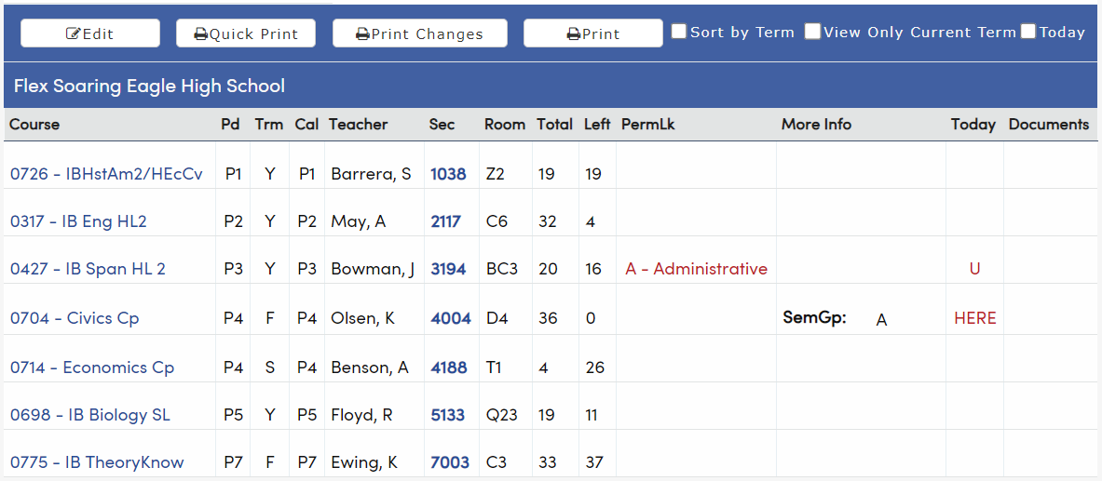
Classes page has two modes: View and Edit
View Mode
Where is the student now? HERE
What is the student’s schedule?
Many staff at the school use View Mode

Slide 4
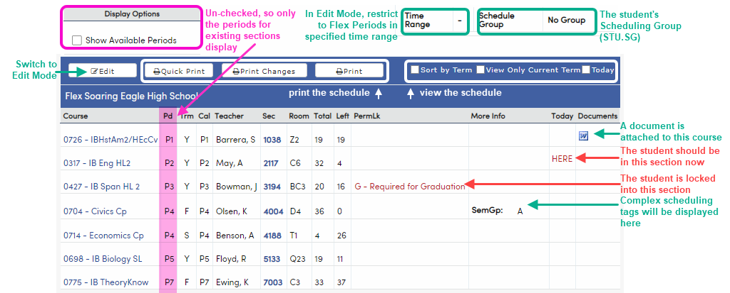
Classes View Mode: Flex with Show Available Periods un-checked
See where the student is right now: HERE
Print the schedule
Schedule related information
Blue links to courses, teachers, sections

Slide 5
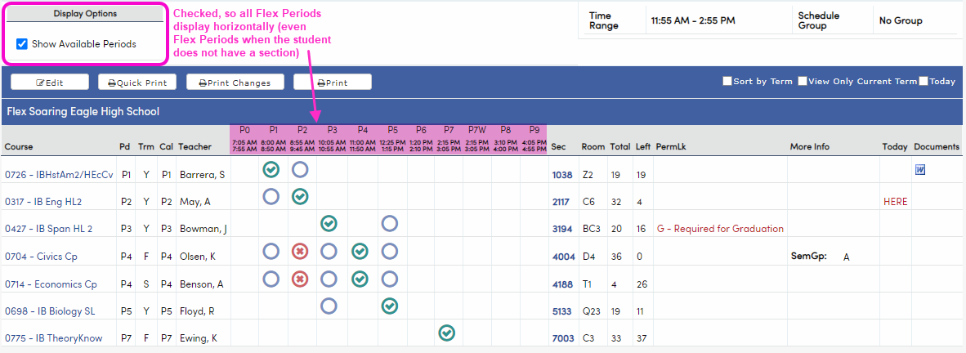
Classes View Mode: Flex with Show Available Periods checked
With Show Available Periods checked, what has changed?
All Flex Periods are displayed; provides a preview of whether a section change is possible
Green check indicates Flex Period when the student is scheduled into a section
Blue circle indicates Flex Period where section(s) exist for the course and a seat is available
Red x indicates Flex Period where section(s) exist for the course, but the section(s) are full

Slide 6
Classes View Mode and Course Attendance: Flex with Primary Class
Elementary school with MST using Flex
Classes and Course Attendance will usually have fewer records to display
If no pullouts are scheduled, it may be only one section – their grade-level self-contained class
Primary Class tracking: a gold sun symbol next to their Primary Class (they should have one and only one)

Slide 7
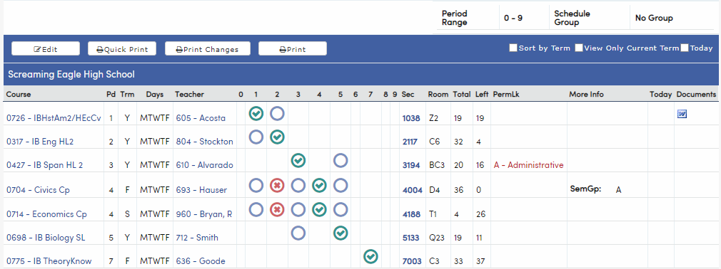
Classes View Mode: Non-Flex
Looks almost the same as Flex with Show Available Periods checked
Standard 0-9 periods instead of Flex Periods are displayed
Period Range (instead of Time Range) to restrict to specified periods in Edit Mode
No Display Options

Slide 8
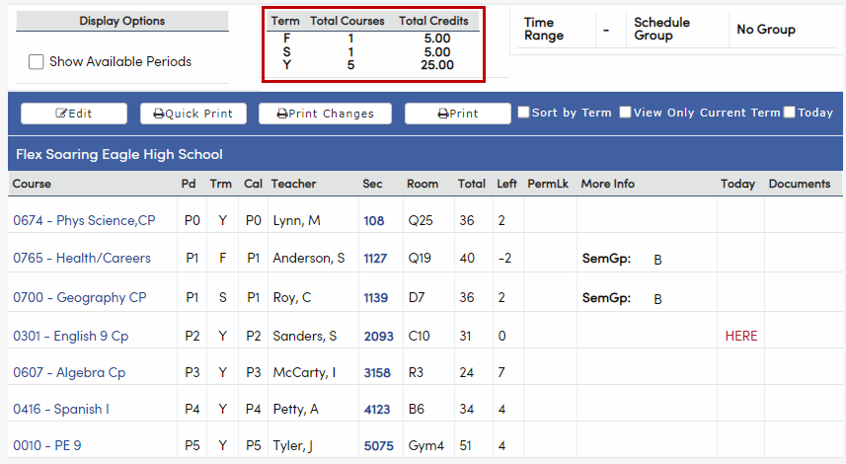
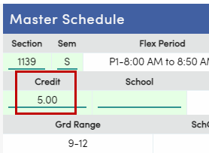
Classes View Mode: Something New-ish
The Total Courses/Total Credits table is now displayed on both Classes and Course Requests:
The Total Credits column add up Credit (MST.CR) for each section, per term:

Slide 9
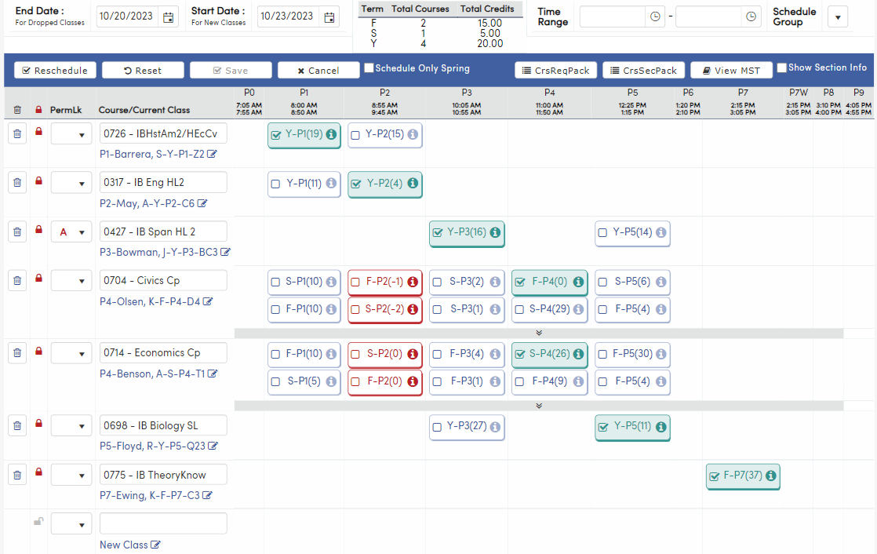
Classes page has two modes: View and Edit
Edit Mode
Worksheet grid of courses and sections
What are we doing? Adding sections and dropping sections
Multiple ways to add/drop sections
Do what works for you and for the student
Reschedule to let Aeries choose sections
Hand schedule to make decisions yourself
Changes are not recorded to SEC and CAR until Save is pressed
End Date will be last date for dropped section(s)
Start Date will be first date of added section(s)
Dates are not recorded in the SEC table (Classes); dates are kept in CAR (Course Attendance)
Only schedulers use Edit Mode

Slide 10
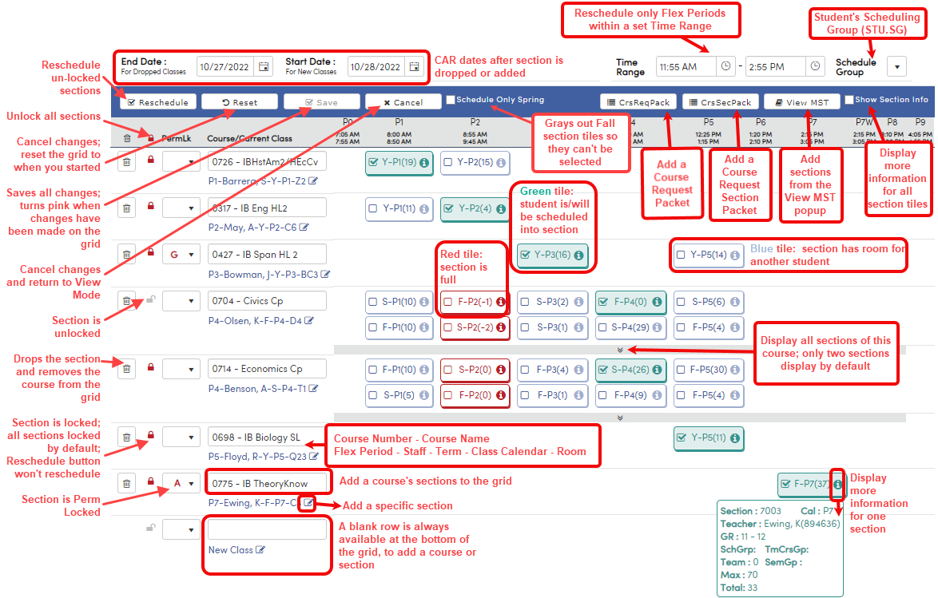
Classes Edit Mode Guide Version 1: the Kitchen Sink

Slide 11
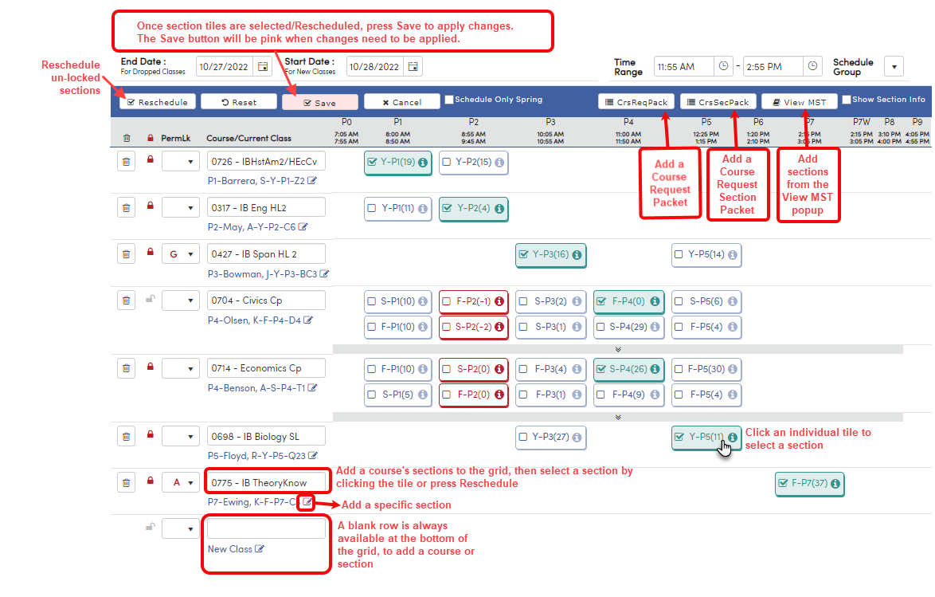
Classes Edit Mode Guide Version 2: Add Sections

Slide 12
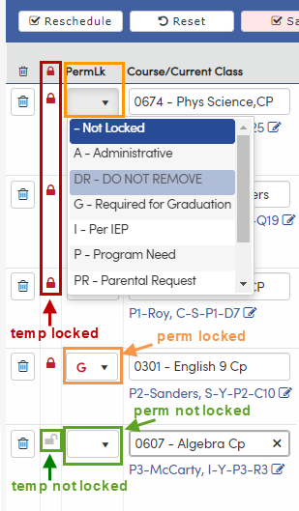
Classes Edit Mode Locks
Reschedule button will not re-schedule any locked sections.
Two ways to lock a section:
1. Temporary locks:
Click to toggle the red padlock “temp locked” symbol or grey padlock “unlocked” symbol
In Edit Mode, the default is locked, so each time you open Edit Mode, all sections will be locked
Click on the red padlock to unlock a single section
Click on the red padlock at the top of the column to unlock all sections
2. PermLk:
Blank value indicates “not locked”
Any code means the section is locked; the code’s description indicates why it is locked
Values in the dropdown are the codes and descriptions for table.field SSS.PL
SSS.PL codes can be modified or added using the Update Code Table page (you may not have permissions; ask your Aeries administrator if you want to change or add a PermLk code)
SSS.PL values are used district-wide, so communicate with others who use Classes or Course Requests (which also uses PermLk) before making changes

Slide 13
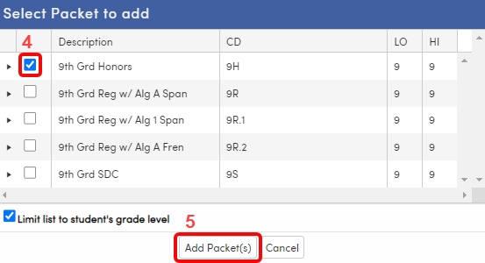
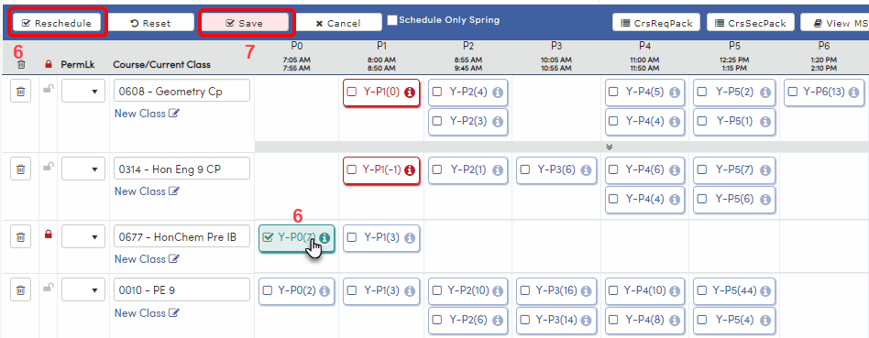
Classes Edit Mode: Add sections using a Course Request Packet
Press Edit button.
Check Start Date: the first date student will be in the new section(s).
Press CrsReqPack button.
Select checkbox for the Packet to add.
Press Add Packet and courses plus sections will be added to grid.
Select a section for each course by clicking tiles or press Reschedule.
Press Save.

Slide 14
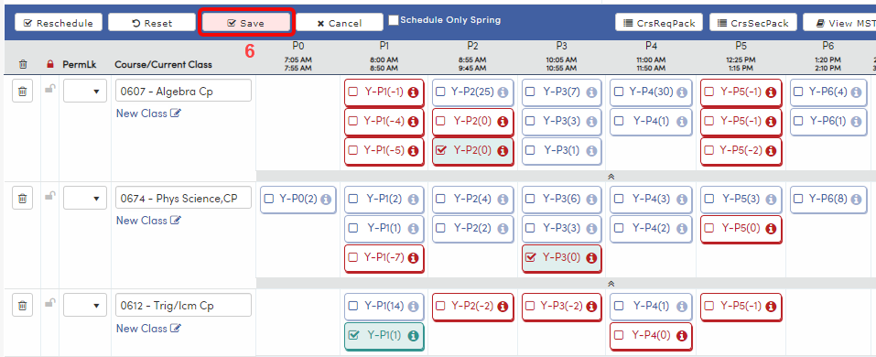
Classes Edit Mode: Add sections using a Course Request Section Packet
Press Edit button.
Check Start Date: the first date student will be in the new section(s).
Press CrsSecPack button.
Select checkbox for the Packet to add.
Press Add Section Packet(s). Courses plus sections will be added to grid and sections will be selected.
Press Save.

Slide 15
Classes Edit Mode: Add sections using the View MST popup
Press Edit button.
Check Start Date: should be first date student will be in the new section(s).
Press View MST button.
Use sort or filters to find a section.
Press the Add button.
Press Save.

Slide 16
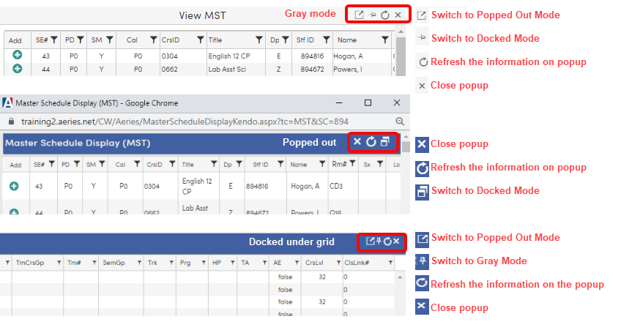
View MST Popup
Three modes:
Gray is moveable
Blue “popped out” can be dragged to another monitor
Blue can be “docked” under the grid
Switch between modes using the controls at top right
Refresh often to keep the displayed data current!

Slide 17
Classes Edit Mode: Add a section using the Course/Current Class field
Press Edit button.
Check Start Date: should be first date student will be in the new section(s).
Type a course number or course name (partial input, then selecting from dropdown is supported) into Course/Current Class field.
Click on section tile or press Reschedule button.
Press Save.

Slide 18
Classes Edit Mode: Add a section using the New Class field
Press Edit button.
Check Start Date: should be first date student will be in the new section.
Press the New Class edit/pencil button.
Type a section number into the blue Section field and press Enter on keyboard.
Press Save.

Slide 19
Classes Edit Mode: Dropping Sections
When section(s) are dropped, the End Date will be recorded in Course Attendance as the last date the student was in the section.
Sections can be dropped in several ways; the drop is recorded in Course Attendance when Save is pressed:
Drop a section using the Trash Can icon. The course and sections will be removed from the grid.
Drop a section and remove the course from the grid using the X in the Course/Current Class field.
Drop a section and add a section of the same course by clicking on the tile for the section you want to add.
Type a new course number or course name into the Course/Current Class field. The section will be dropped; the course and sections in the grid will be replaced by the new course.

Slide 20
Classes: how to make a schedule for a new student
Check the Start Date, which should be the first date that the student will be in their class or classes.
Add courses/sections to the grid, in whatever way you choose:
Course Request Packet
Course Request Section Packet
Course/CurrentClass
Add specific sections using the add section field or View MST popup
Press Reschedule button or select section tiles on the grid.
Adjust if needed.
Lock if needed.
Press Save button.
Print schedule for student and anyone else who needs it.
Check the Course Attendance page. Are the dates correct? If not, adjust them.

Slide 21
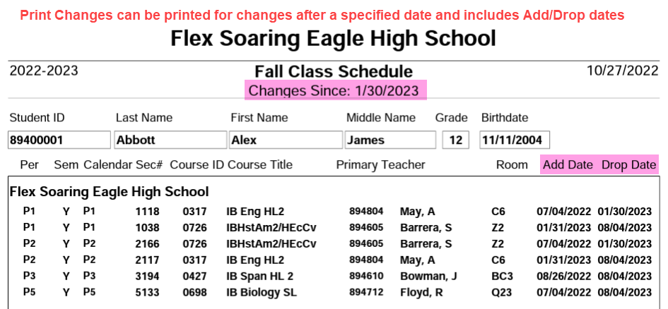
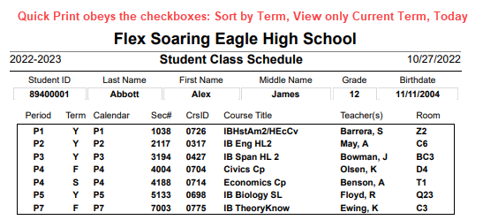
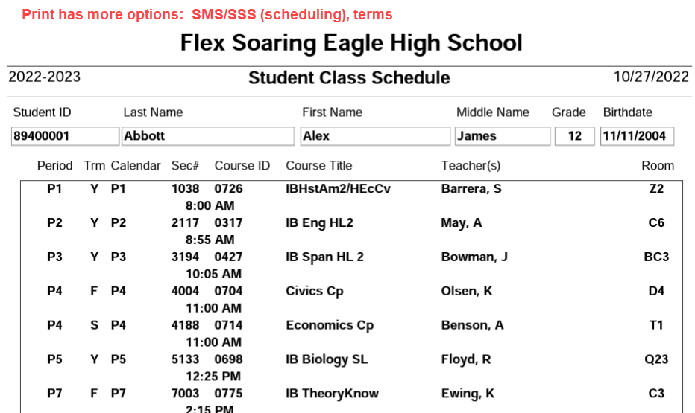
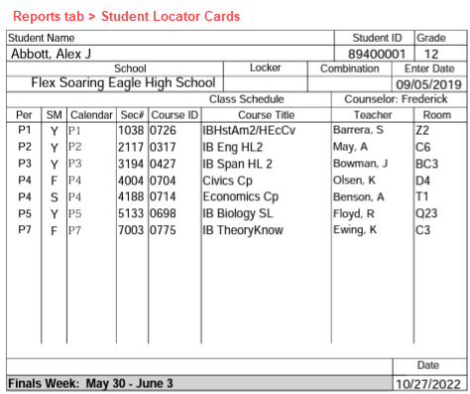
Multiple ways to print a schedule:

Slide 22
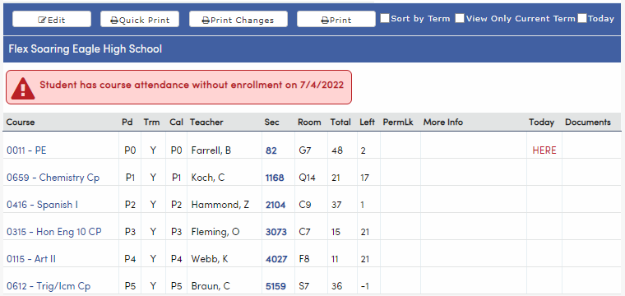
Classes Red Status Messages
These messages will be displayed on the Classes, Attendance Enrollment, and Demographics pages
The same messages print on the Attendance Audit Listing report, where each error message will be identified with a specific letter (for example, L:)
What are they? Data mismatches or potential data errors
If the message contains the words “classes” or “course attendance,” check for data mismatches between Classes (SEC), Course Attendance (CAR) and possibly Attendance Enrollment (ATT)
Cheat sheets for the Classes and Course Attendance related errors are provided on the next few slides
Note that many other red error messages may be displayed, but are not related to Classes and Course Attendance (so they are not included in my cheat sheets)
Spoiler alert: it is usually the dates

Slide 23
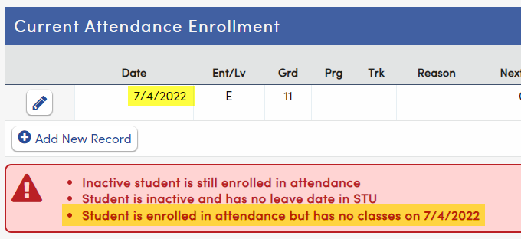
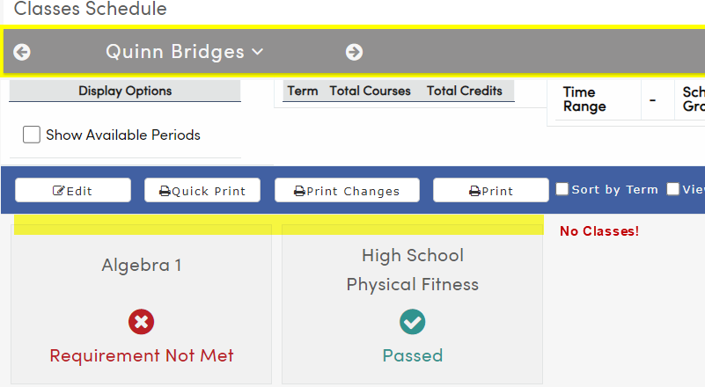
Classes Red Status Message: L: Student is enrolled in attendance but has no classes on XX/XX/XXXX
Compare the student’s Attendance Enrollment page to their Classes page:
In the example above, the student is currently enrolled on Attendance Enrollment, is set to a status of inactive on Demographics, and has no sections in their schedule classes. Typically:
Enrolled students have a status of active and have at least one section in their schedule on Classes.
or
Students who are not enrolled are set to inactive and do not need sections on Classes.
To fix the error above, figure out whether the student is currently enrolled or not.

Slide 24
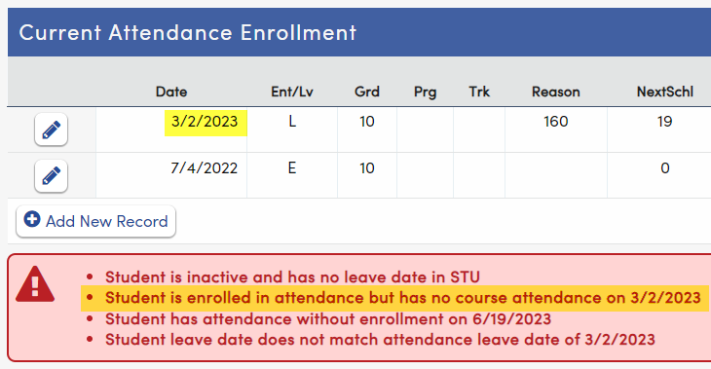
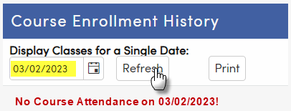
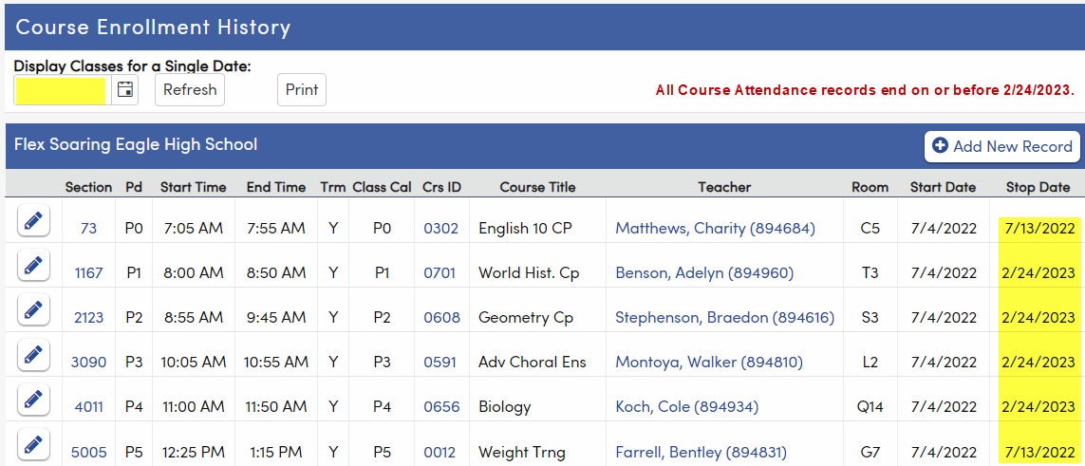
Classes Red Status Message: M: Student is enrolled in attendance but has no course attendance on XX/XX/XXXX
Compare Attendance Enrollment page to Course Attendance page:
In the example above, the student ended their enrollment at the school on 3/2/2023. From 2/25/2023 to 3/2/2023, the student has no Course Attendance.
Typically, a student who is enrolled should have one or more Course Attendance records. A student who is not enrolled, but was formerly enrolled, would typically have one or more Course Attendance records ending on the same date that their Attendance Enrollment ended.

Slide 25
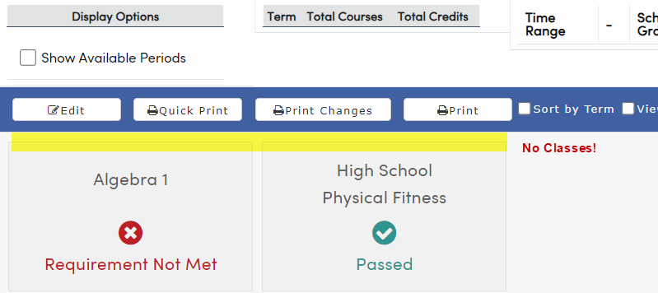
Classes Red Status Message: N: Student is enrolled in course attendance but has no classes on XX/XX/XXXX
Compare Course Attendance page to Classes page:
In the example above, the student has a Course Attendance record for section 104 ending on 6/29/2023, but section 104 does not have a record in Classes.
First, find out what the student’s schedule should be currently and in the past. The student’s Classes schedule may need to be added, or their Course Attendance dates may need to be adjusted, or both Course Attendance and Classes may need to be reconciled.

Slide 26
Classes Red Status Message: P: Student has invalid day# in course attendance
This error is typically caused by a change to the CAR Start Date (CAR.DS) or Stop Date (CAR.DE) made using a Query or using SQL, instead of making the change on the Course Attendance or Classes page. When CAR dates are changed using Query or SQL, the CAR.D1 and CAR.D2 fields must also be modified to reflect correct the Calendar (DAY) days that correspond to the Start Date and the Stop Date. If the CAR.D1/CAR.D2 fields are not modified correctly, or not modified at all, this error will display.
How to fix:
If you are hosted, you can screenshot the error message and the student’s Course Attendance page. Add the student’s Student ID number and these screenshots to an Aeries support ticket and Aeries support can assist.
If you are not hosted, this error can be fixed using a Change Query.
If you are not hosted, and you do not have Change permissions to Query, talk to your Aeries Admin.

Slide 27
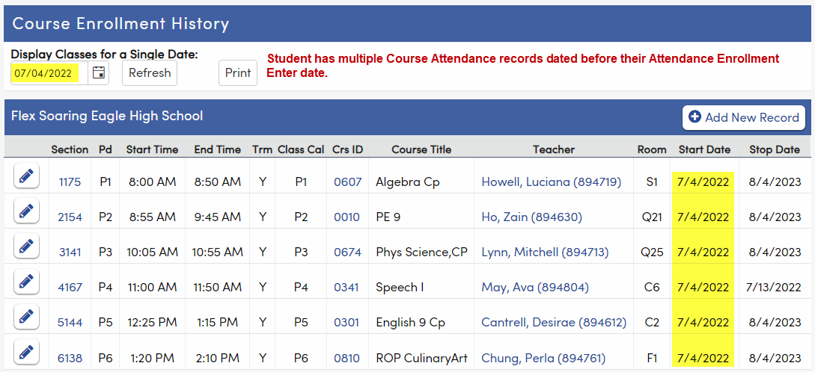
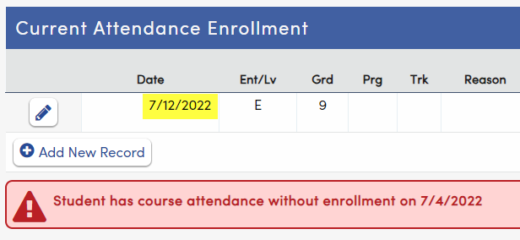
Classes Red Status Message AF: Student has course attendance without enrollment on XX/XX/XXXX
Compare Course Attendance to Attendance Enrollment.
In the example above, the student was not enrolled at the school until 7/12/2022, but the student has multiple Course Attendance records starting on 7/04/2022. Course Attendance records should not start before the student’s first date of enrollment.

Slide 28
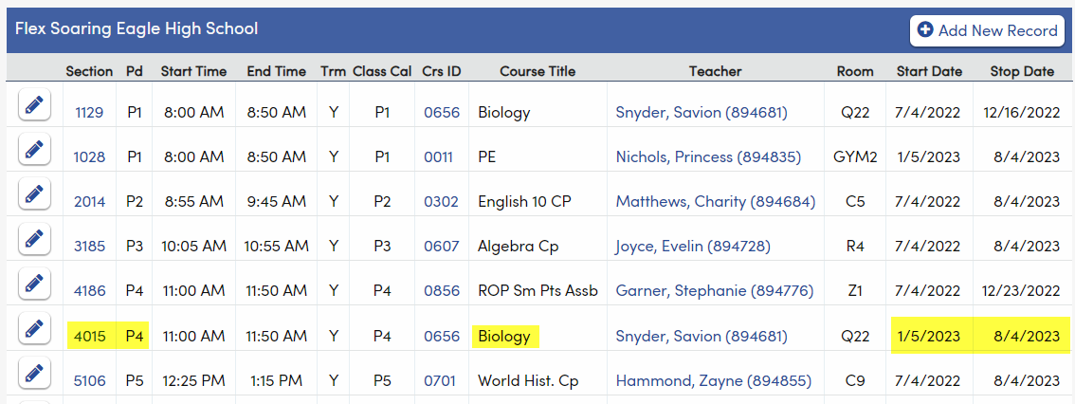
Classes Red Status Message AJ: Student has class attendance but has no course attendance for Section XX on XX/XX/XXXX
Compare Course Attendance to Attendance page (not Attendance Enrollment!).
In the example above, the student has an absence code I (for Illness) recorded on 1/2/2023 for section 4015 (Biology), but their Course Attendance dates for section 4015 do not include 1/02/2023. Was the student in the section on that date?
Either the Course Attendance date should be adjusted to include 1/2/2023 or the absence code should be deleted.

Slide 29
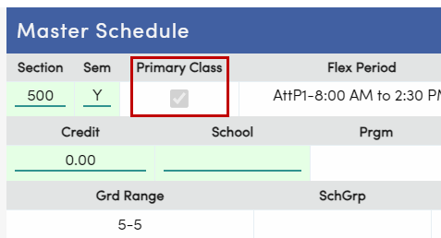
Classes Red Status Messages related to Primary Classes
These errors only apply to Flex Elementary schools, where each student should be in one, and only one, Primary Class in a single term. To clear the error, compare Classes, Course Attendance, and potentially the sections in the Master Schedule.
Primary Class identification:
On Classes, a student’s Primary Class is identified with a gold sun icon.
On Master Schedule, Primary Class sections have Primary Class checked.

Slide 30
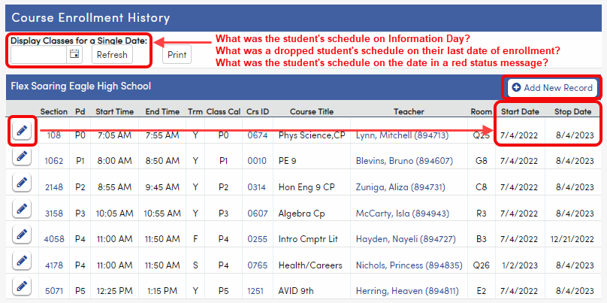
Course Attendance
Good data practice: check CAR after changes to a student’s schedule. Did you accomplish the change that you intended? Are the dates correct?
If the Start Date or End Date isn’t correct, edit the record.
Course Attendance records can be added here if you have Insert to CAR permissions; use caution, because the record will not be added on Classes or to SEC.
Display Classes for a Single Date field can help with troubleshooting.

Slide 31
Course Attendance (CAR) and why it matters . . .
Why is it important that Course Attendance is correct?
Attendance and Gradebook honor the dates in CAR
State reporting
Usually, CAR should not have overlapping Stop/Start dates during the same period and in the same term
Can a student be in two places at one time? (sometimes)
Good CAR chasing practices:
Classes (SEC) and Course Attendance (CAR) pages are partners
The Course Attendance Audit report
The Paper Trail

Slide 32
When should you make a change to a student’s schedule?
Start Date in: The Past? The Present? The Future?
Changing a student’s schedule after it happened?
Adjust Classes and Course Attendance so they are accurate.
Be aware that data which relies on CAR may need to be adjusted.
Do not be surprised to see red messages.
Changing a student’s schedule today, to start in the new class tomorrow (or on the next school day)? Hooray!!!!!!
Recommended practice: make schedule changes on the last day student is in the dropped section and the day before student is in added section. Course Attendance (CAR), Classes (SEC), and the rest will all be correct.
Changing a student’s schedule before it will happen?
Course Attendance (CAR) will be correct (if you use the correct future End Date and Start Date).
Classes (SEC) will reflect the change immediately. HERE may be incorrect.
GRD Grade Cycle initialization uses SEC, so the student may be included (or left out) unintentionally.

Slide 33
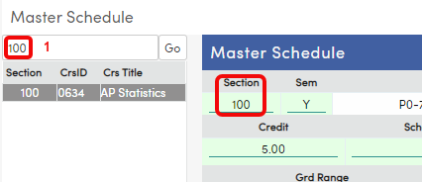
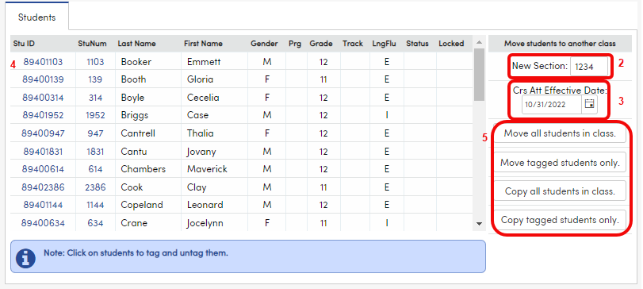
Master Schedule: mass move/copy students from one section to another
Find the section students will be moved/copied from and press Go.
Add the section number the students will be moved/copied into the New Section field on the Students tab near the bottom of the page.
Check the Crs Att Effective Date if CAR has been initialized.
If students are moved or copied, this is the first date they will be in the new section.
If students are moved, the school date before Crs Att Effective Date will be their last date in the section they were moved from.
If a subset of students should be moved/copied, tag them (click on the student names).
Press appropriate button based on whether all or tagged students should be moved or copied.
Spot-check the Course Attendance page. Are the dates correct? If not, adjust them.

Slide 34
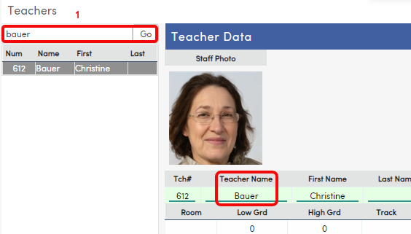
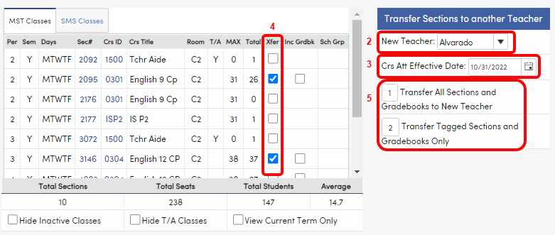
Teachers page at a non-Flex school not using Section Staff: transfer sections and Gradebooks
Select the Teacher whose section(s) will be transferred.
Select the New Teacher from the dropdown on the MST Classes tab.
Check the Crs Att Effective Date if CAR has been initialized.
This is the first date the students will be in new section.
The school date before Crs Att Effective Date will be their last date in the section they were moved from.
If only a subset of sections should be transferred, select the section(s) to transfer in the Xfer column.
Choose whether to transfer all sections or tagged sections.
Spot-check the Course Attendance page. Are the dates correct? If not, adjust them.

Slide 35
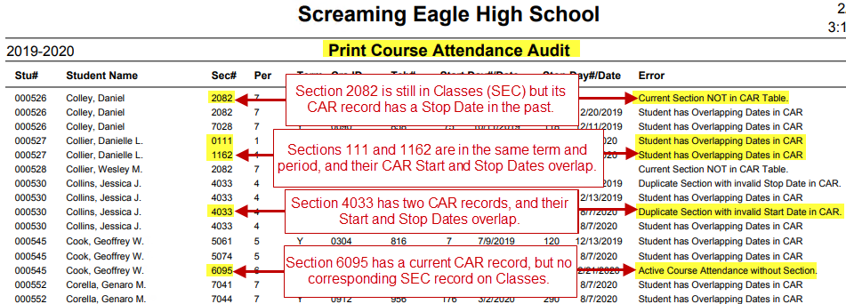
Course Attendance Audit report (non-Flex)
Compare Course Attendance and Classes
Compare Start and Stop Dates
Constant vigilance . . .
Find an error?
Find out the truth: section number + Start Date + Stop Date
Fix Course Attendance page (usually) or Classes

Slide 36
Course Attendance Audit report Flex Examples
Compare Course Attendance and Classes
Compare Start and Stop Dates
Constant vigilance . . .
Find an error?
Find out the truth: section number + Start Date + Stop Date
Fix Course Attendance page (usually) or Classes
Does your Course Attendance Audit print an excessive number of “Student has Overlapping Courses in CAR” errors? See the next slide.

Slide 37
Course Attendance Audit Report: troubleshooting at a Flex school
Help! My Course Attendance Audit just printed 100 pages of “Student has Overlapping Courses in CAR” errors!
Staff responsible for the management of Flex Periods, Class Calendars, and Custom Bell Schedules will need to do the following:
Check ALL Flex Periods to make sure there are NO unintentional overlaps of periods and there are no AMs where there should be PMs and no PMs where there should be AMs.
Check ALL Custom Bell Schedules to make sure there are NO unintentional overlaps of periods and there are no AMs where there should be PMs and no PMs where there should be AMs.
Check ALL Class Calendars to make sure that there are no dates that unintentionally overlap for Flex Periods that have the same meeting time.
Example 1 | Flex Period 1 meets 8:30 AM – 9:30 AM. Flex Period 2 meets 8:30 AM – 9:30 AM. | This is an overlap UNLESS no student in the entire school has Flex Period 1 and Flex Period 2 sections that meet on the same date(s).
Example 2 | Flex Period 4 meets 12:20 PM – 1:05 PM. Flex Period 5 meets 1:03 PM – 1:48 PM. | This is an overlap UNLESS no student in the entire school has both Flex Period 4 and Flex Period 5 sections that meet on the same date(s).
Example 3 | Section 100 is in Flex Period 1 (8:00 AM – 8:45 AM) and Class Calendar 1 (Mondays, Wednesdays, and some Fridays). Section 200 is in Flex Period 2 (8:00 AM – 8:45 AM) and Class Calendar 2 (Tuesdays, Thursdays, and some Fridays). | Because they are at the same time, you must make sure they never meet on the SAME Fridays, UNLESS a Custom Bell Schedule is attached to that day, or no student in the entire school is in both sections. Otherwise, it will be an overlap.
Example 4 | A Flex Period or Custom Bell Schedule time range is set to 8:00 AM – 9:15 PM. | This could cause an overlap in every subsequent Flex Period, because the time range makes it a 13 hour and 15 minute class instead of a one hour and 15 minute class.

Slide 38
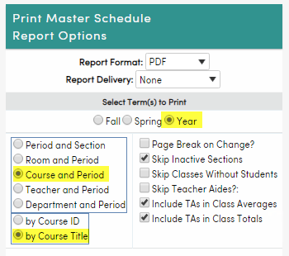
Other Class Schedule Maintenance related reports
Add/Drop Listing
Master Schedule report

Slide 39
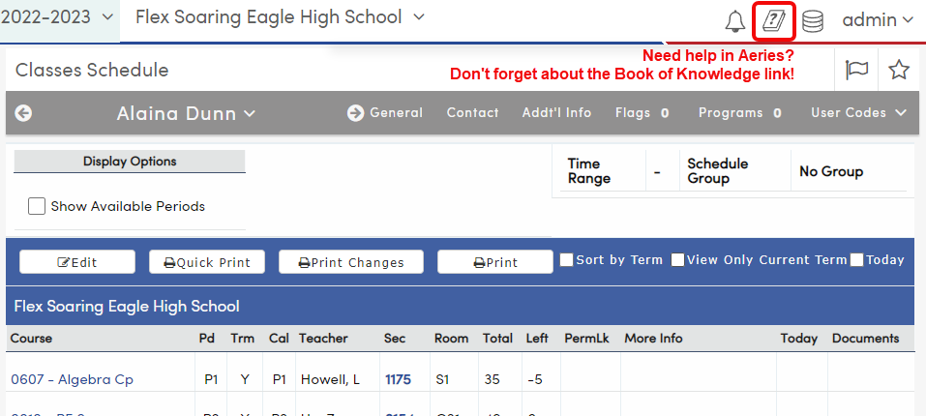
Where to go for more information
Documentation below is all from the Aeries support website: https://support.aeries.com
Class Schedule Maintenance category: https://support.aeries.com/support/solutions/folders/14000115900
Session 300 – Class Schedule Maintenance: https://support.aeries.com/support/solutions/articles/14000079377-session-300-class-schedule-maintenance
Good Morning Aeries webinar: Student Schedule Changes (recording and PowerPoint available now): https://support.aeries.com/support/solutions/articles/14000137541-student-schedule-changes
Got questions? Bring them to Open Forum!

Slide 40
Key Takeaways
Use the Classes page to change a student’s schedule
The Course Attendance page tracks the dates when a student is or was in a section
CAR dates are important; make sure they are correct
Students can be mass moved to another section on Master Schedule

Slide 41
We want your feedback!
Scan the QR code below, or visit the survey link at the bottom, to provide feedback on this session:
300 Class Schedule Maintenance.
http://surveys.aeries.com/s3/AeriesCon-Session-Feedback-Survey-Spring-2024

