Slide 1
Did You Know?
Part 5: Dashboard Delights 541-5
Jan Tokorcheck | Lead Business Analyst
March 06-08, 2024
Information shared throughout this presentation is the property of Aeries Software. Information or images may not be reproduced, duplicated, or shared without the prior written consent of Aeries Software.
Notes:
Post who you are, where you’re from and what you do
Goal is to learn something and put a smile on your face. Survey reference

Slide 2
Did You Know Part 5 - Dashboard Delights
Dashboards in Aeries that are not part of Aeries Analytics
Included Dashboards
Attendance Trend Dashboard
Discipline Dashboard
Interventions Dashboard
CCI Dashboard
Graduation/College Readiness Dashboard
Notes:
Fun one, Dashboard Delights. Nothing with Analytics at all. Not talking about LCAP, or any other Analytics. Just regular ones in Aeries.
First 3 dashboards are the same for all schools, elementary and secondary
However last 2 are secondary only, so elem folks can jump out early if they’d like, or they are more than welcome to stay and listen in.

Slide 3
DYK-5 Dashboard Delights
Attendance Dashboard
Notes:
Will try and bounce between this PPT and Aeries, to show you how it works there.
Aeries – started on Home
Turn off camera to help speed
Attendance Accounting Node to Attendance Dashboard (don’t confuse with Attendance Process Dashboard)
The top part shows a couple of graphs
All about total enrollment, broken down by gender and then present today out of enrollment.
Filters and options bar, click on dropdown. Now looks at current week.
Whatever dates you want to set up, you can
Hover over any data point, gives exact totals.
Top line is enrollment, bottom line is present
Second line gives you absent, tardy, excused absent and unexused absent
Notes these are all for elementary, all day codes. Colunms identify them.
Can remove items by clicking on the legend to turn off/on items from the chart

Slide 4
DYK-5 Dashboard Delights
Attendance Dashboard
What is it? – Trend Graph of student attendance data - displays enrollment and attendance information by date – it can be viewed only at the site
Filters and Options - Use the down arrow on the far right hand side to expand the Date Range filter. Any date range can be entered to display attendance data, however, it is recommended to limit the range to reduce the data displayed for a smaller scale. Once a date range has been modified, select the Generate Dashboards button to update the graph.
Notes:
Start at Elementary School
Att Dashboard – found under Attendance Accounting on the Navigation Tree
Trend Graph
Displays enrollment and Attendance information by date
Select date window – use the dropdown – Generate Dashboards
3 results

Slide 5
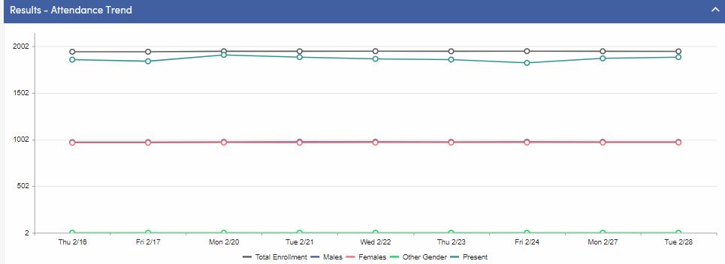
DYK-5 Dashboard Delights
Results – Graph 1
Displays number of students with attendance enrollment by date. Breakdown of number of students present by All Day Code and Gender
Enrollment labels display on the left
Dates selected display on the bottom
Notes:
1st Result
Graph 1 – Total Enrollment , Students Present, Breakdown by Gender
Enrollment labels on side
Dates on the bottom
Uses the All Day code to determine who is present – no all day code – student present
Toggle Graph lines on or off

Slide 6
DYK-5 Dashboard Delights
Results – Graph 2
Displays total number of absences, period tardies, excused and unexcused absences.
Categories determined by the ABS code
Pulls from ATT for traditional schedules
Pulls from CAT for Flex Schedules
Hover over graph marker to display information
Graph lines can be toggled on or off by selecting the label at the bottom of the graph.
Notes:
2nd Result
- Graph 2 – total number of absences, tardies, excused and unexcused absences
Hover over graph marker to see information for each date
Toggle graph lines on or off
What you see is determined by ABS codes – reads the type of attendance
Go to Update Absence Codes – View Illness, then Other
Switch to High School to Show Period Information
Absent still reads All Day Code, but Tardies are Period Tardies
Never have All Day Tardy in a period att environment

Slide 7
DYK-5 Dashboard Delights
Results – Table View
Displays Graph Information in Table View
Includes enrollment information and students present Information from Graph 1
Includes attendance breakdown Information from Graph 2
Notes:
At the bottom, it shows all the data form the graph
Print button at the bottom of the data graph
Question: What sort of instances would you use this info. Want to know what attendance is over time. There are looking for changes between days. Lots of absences before or after holidays, etc.
Look at HS and see how it’s different
Only looks at all day codes
Period tardies, excused absences and unexcused absences.
Graphic representation of what’s happening with attendance and enrollments
? To see trends over 2 school years, would need to go to analytics
Or not even sure if it would work in Analytics. Perhaps compare similar weeks in prior year databases.
3rd Result
Table View – Displays info from the 1st 2 results in table format
Ability to print the chart

Slide 8
DYK-5 Dashboard Delights
Notes about the Attendance Trend Dashboard
Not available at the District Level
Need Read Access to ATT
Graph lines can be toggled on or off by selecting the label at the bottom of the graph. When a graph line has been turned off, it will display in gray and will no longer be visible in the graph until the page is reloaded.
More information in the following sessions
361 – Daily Attendance
371 - Period Attendance
Link to Documentation – Attendance Trend Dashboard
Notes:
Return to PowerPoint to view Notes

Slide 9
DYK-5 Dashboard Delights
Discipline Dashboard

Slide 10
DYK-5 Dashboard Delights
Discipline Dashboard
What is it? – The Discipline Dashboard displays charts analyzing the total number of ADS incidents in a variety of ways.
The Dashboard pulls information only from the Assertive Discipline (ADS) table.
Discipline (DIS) data is not included on the Dashboard.
Accessed from the Guidance node of the Navigation Tree
Users must have at least Read access to ADS to view this page.
.
Notes:
Review Info on slide for elementary first, and then go to high school
Will only work on ADS not DIS - Go to Aeries Ideas and vote on an idea??

Slide 11
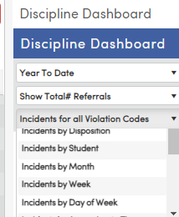
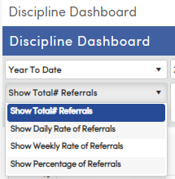
DYK-5 Dashboard Delights
Discipline Dashboard Options.
Time Frame Options
Year to Date Previous 7 Days
Previous 30 Days Previous 60 Days
Previous 90 Days Custom Date Range
Referral Options
Total # Daily Rate
Weekly Rate Percentage
Incident Options
All Violation Codes
Primary Violation Codes
By Disposition, Student, Month, Week, Day of Week, Approximate Time, Exact time, Location, Grade, Gender, Race/Ethnicity, Referrer, Hot List
Notes:
Go to Elementary School
Review Options
Time Frame
Referral Options
ADS Incident Sort

Slide 12
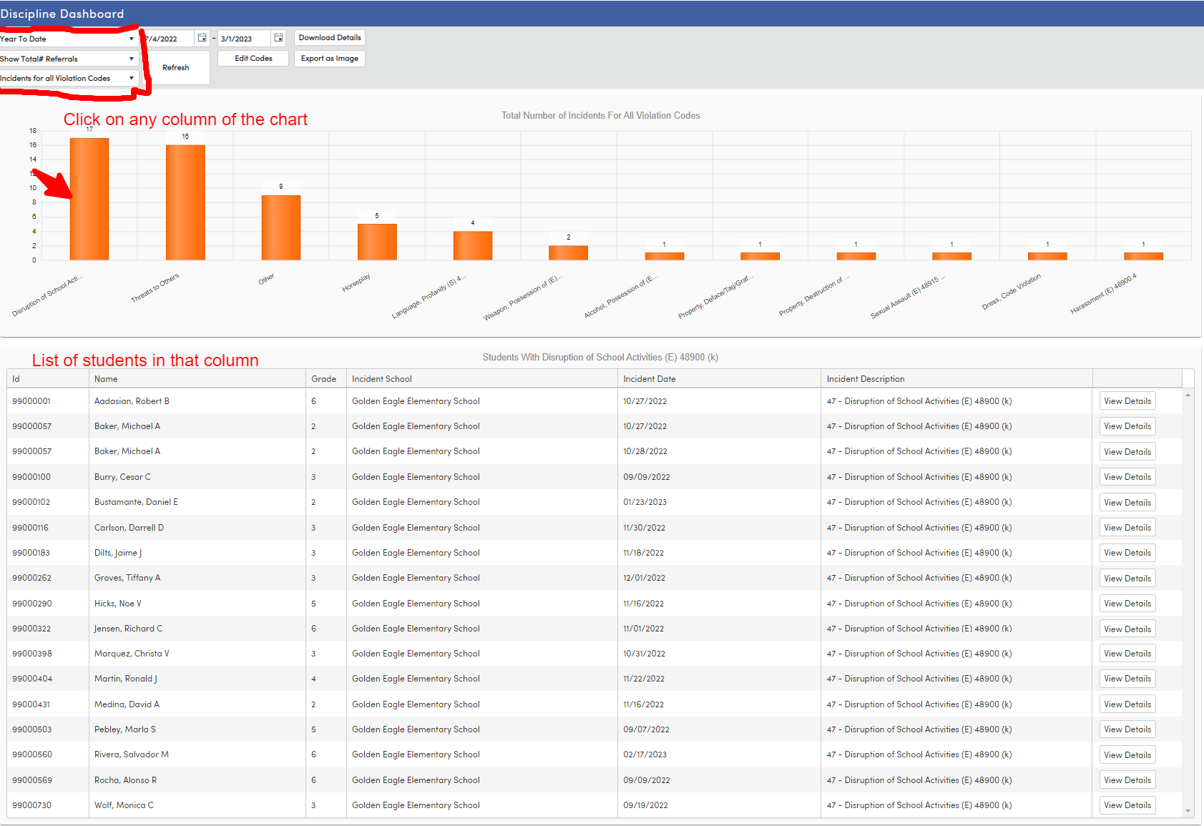
DYK-5 Dashboard Delights
Discipline Dashboard
Selected Options
Year to Date
Show Total # Referrals
Incidents for All Violation Codes
Column Selected
Disruption of School Activities
Notes:
Start with what’s already shown
Can change dates, edit codes, and download details and export chart as an image.
Year to Date
Total # of referrals
Incidents for all violations
Select disruption of school activities
and click the chart to show the students
Click on View Details to see student’s full ADS record
Select a few other options – show 90 days – Disposition
Go over date ranges
Options for Validation Codes
Switch to high school to see more results

Slide 13
DYK-5 Dashboard Delights
Other Options
Download Details – sends data to EXCEL
Refresh – Refreshes screen after other options have been changed
Edit Codes – allows selection of ADS codes to use during calculation
Export as Image – creates a PNG of the chart that can be used in presentations
Notes:
High School –
View 60 Days – Disposition
Edit Codes – Turn all off and select a few
Show Download Details – Export to EXCEL
Export as Image
Return to PowerPoint to show steps and Review the notes

Slide 14
DYK-5 Dashboard Delights
EXCEL Download

Slide 15
DYK-5 Dashboard Delights
Steps for Using the Discipline Dashboard
Select Time Frame and Date Range Options
Edit Codes if desired
Select Referral Options
Select Incident Options
Click the Refresh Button
Download to EXCEL if desired
Capture a Screen Shot of the Chart if desired

Slide 16
DYK-5 Dashboard Delights
Notes about the Discipline Dashboard
Will only pull data from ADS – Assertive Discipline
Will not pull data from DIS – Discipline
Need Read access to ADS to view the Dashboard
Get More Information in the following session
Session 581 – Assertive Discipline
Link to Documentation - Discipline Dashboard

Slide 17
DYK-5 Dashboard Delights
Intervention Dashboard

Slide 18
DYK-5 Dashboard Delights
Interventions Dashboard
What is it? – Similar in many ways to the Discipline Dashboard, the Interventions Dashboard analyzes the frequency and distribution of various Intervention programs being administered.
It can be accessed from the Navigation Tree under Student Data | Interventions.
.
Notes:
Stay at the High school – no data at Golden Eagle
Review the Options
Time Frame
# of Interventions
INV Referral Sort

Slide 19
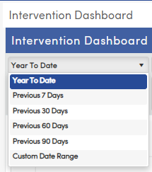
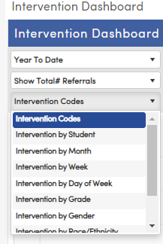
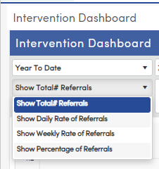
DYK-5 Dashboard Delights
Interventions Dashboard Options
Time Frame Options
Year to Date Previous 7 Days
Previous 30 Days Previous 60 Days
Previous 90 Days Custom Date Range
Referral Options
Total # Daily Rate
Weekly Rate Percentage
Intervention Codes
All Violation Codes
Primary Violation Codes
By Disposition, Student, Month, Week, Day of Week, Approximate Time, Exact time, Location, Grade, Gender, Race/Ethnicity, Referrer, Hot List
Notes:
Show that it works the same way as the Discipline Dashboard

Slide 20
DYK-5 Dashboard Delights
Intervention Dashboard
Selected Options
Year to Date
Show Total # Referrals
Interventions by Grade
Column Selected
Grade 9
Notes:
Select the following
Year to Date
Total # of Referrals
Interventions by Grade
Select Grade 9 Column

Slide 21
DYK-5 Dashboard Delights
Other Options
Download Details – sends data to EXCEL
Refresh – Refreshes screen after other options have been changed
Edit Codes – allows selection of ADS codes to use during calculation
Export as Image – creates a PNG of the chart that can be used in presentations
Notes:
Download Details – exports to EXCEL
Refresh – when you change data points

Slide 22
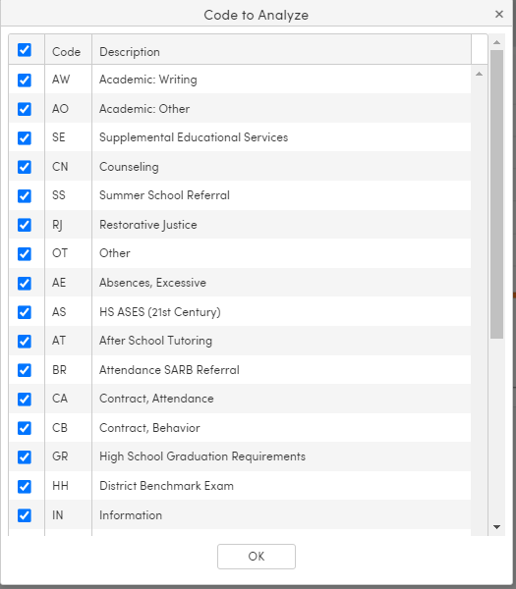
DYK-5 Dashboard Delights
Edit Codes Page
Notes:
Edit Codes - show truancy by student
No ability to export as an image
Return to PowerPoint
Review Steps for dashboard and Notes

Slide 23
DYK-5 Dashboard Delights
Steps for Using the Interventions Dashboard
Select Time Frame and Date Range Options
Edit Codes if desired
Select Referral Options
Select Intervention Codes Options
Click the Refresh Butto
Download to EXCEL if desired
Capture a Screen Shot of the Chart if desired
Notes:
After reviewing the notes let Elementary folks know the next 2 dashboards are all about high school stuff.

Slide 24
DYK-5 Dashboard Delights
Notes about the Interventions Dashboard
Users must have at least Read access to Interventions to view this page.
There should only be a value in one of these fields – Either the INV.RF or INV.SRF field. If you have a value in both fields, the dashboard may not give you the expected results.
See Intervention Details for more information on these fields.
The Hot List displays the top intervention values for each of the categories in the Analysis column. The Description column will indicate the top value for each category.
The Hot List also honors all of the other dashboard filters used to limit the data.
Get More Information in the following session
Session 591 – Intervention
Link to Documentation - Interventions Dashboard
Notes:
What is the CCI Dashboard
Looks at each measure and submeasure of the CCI Indicators
Displays Potential overall status and gives you some information about each data point

Slide 25
DYK-5 Dashboard Delights
CCI
Dashboard

Slide 26
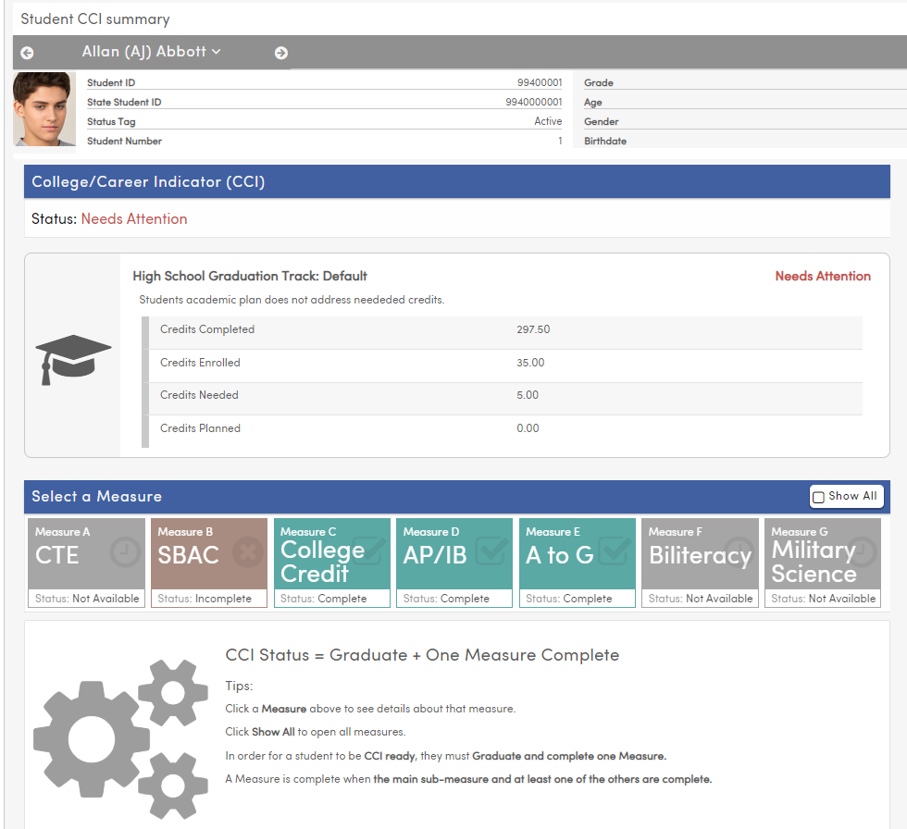
DYK-5 Dashboard Delights
CCI Dashboard
What is it?
The CCI Dashboard analyzes students' likelihood of completing each measure and sub-measure under California College / Career Readiness Indicators.
The page displays potential overall CCI Status and displays guiding information to users for each data point for better understanding of underlying data.
.
Notes:
What is the CCI Dashboard
Looks at each measure and submeasure of the CCI Indicators
Displays Potential overall status and gives you some information about each data point

Slide 27
DYK-5 Dashboard Delights
CCI Measures Included
Measure A – Career Technical Education Pathway Complete
Measure B – Grade 11 Smarter Balanced Summative Assessments in ELA and Mathematics
Measure C – College Credit Course (formerly called Dual Enrollment)
Measure D – AP/IB Exams
Measure E – A-G Completion
Measure F State Seal of Biliteracy
Measure G – Military Science Course Completion
Notes:
Review the info and then go to the high school

Slide 28
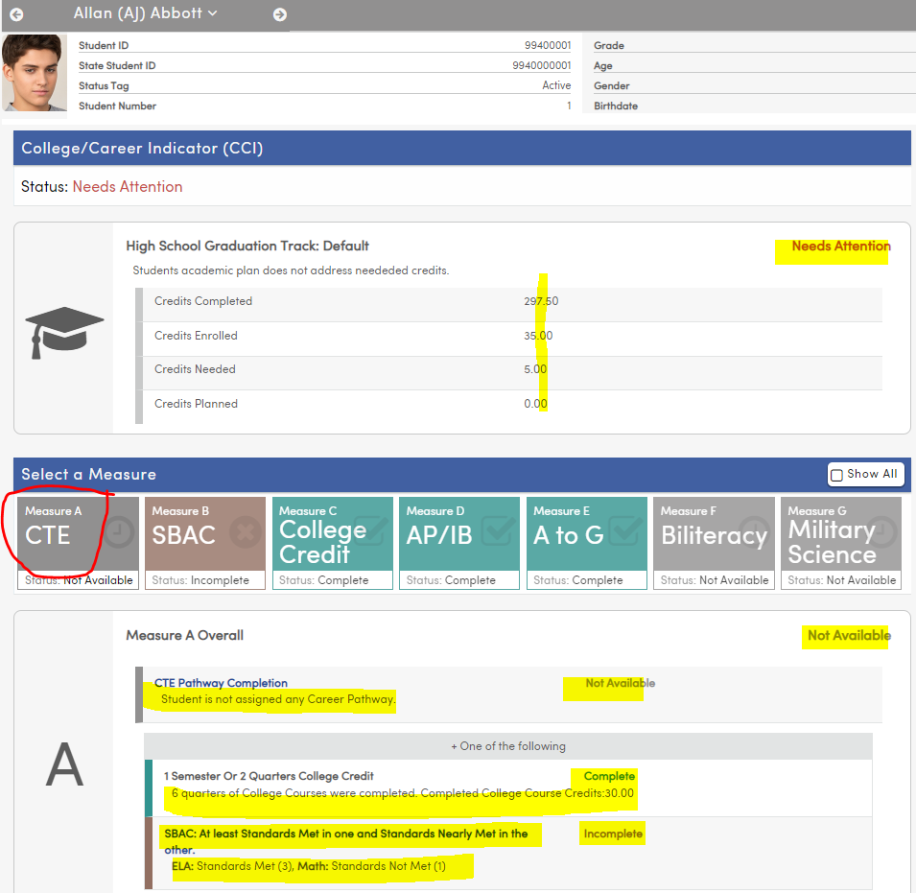
DYK-5 Dashboard Delights
How to Use the CCI Dashboard
Measure A – CTE Pathway Completion
Click on each Measure in the Dashboard to access more information
Notes:
Use Allan Abbott
Start at the bottom of the page – Tells you what CCI is all about
Review the high school Graduation Track information at the top
Credits Complete – from transcript (HIS)
Credits Enrolled – Classes – SEC
Credits Planned – Academic Plan
- Needs Attention – credit deficiency
Go to Grad Status – show deficiency in VAPA
Change Grade Track to CTA and World Language
Deficiency cleared
Returrn to CCI – note completion – look at Status window below each measure – now lets see what it’s reading to give us that info
Next page

Slide 29
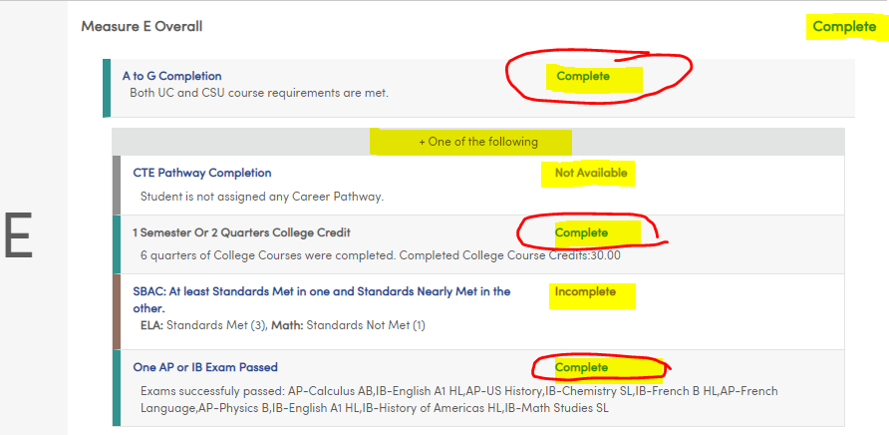
DYK-5 Dashboard Delights
Measure E – A-G Completion
How to Use the CCI Dashboard
Click on each Measure in the Dashboard to access more information
Notes:
Click on Measure A - Incomplete – no pathway – B – no Math
Measure C complete – college coursework completed
Measure D Complete – AP/IB – 2 many exams passed
Measure E complete – A-G courses completed
No info available for F or G
Return to PPT to view notes

Slide 30
DYK-5 Dashboard Delights
A Few Notes regarding the CCI Dashboard
The CCI process uses the transcript definitions from the student's most recent school enrollment and converts the terms in HIS, APC, and SEC to the common state term codes defined in the transcript definitions Term tab.
For Measure F, the ACT codes being used for State Seal of Biliteracy will also need to be identified on the CALPADS Extract form on the Other Options tab in order for the student's CCI page to also update correctly.
Please review this article: CALPADS Extracts - Other Options for additional information.
Get More Information in the following session
Session 615 – College and Career
Link to Documentation - CCI Dashboard
Link to Documentation for Security and Configurations - CCI S&C

Slide 31
DYK-5 Dashboard Delights
Graduation/College Readiness
Dashboard
Notes:
Found under Grade Reporting branch of the tree

Slide 32
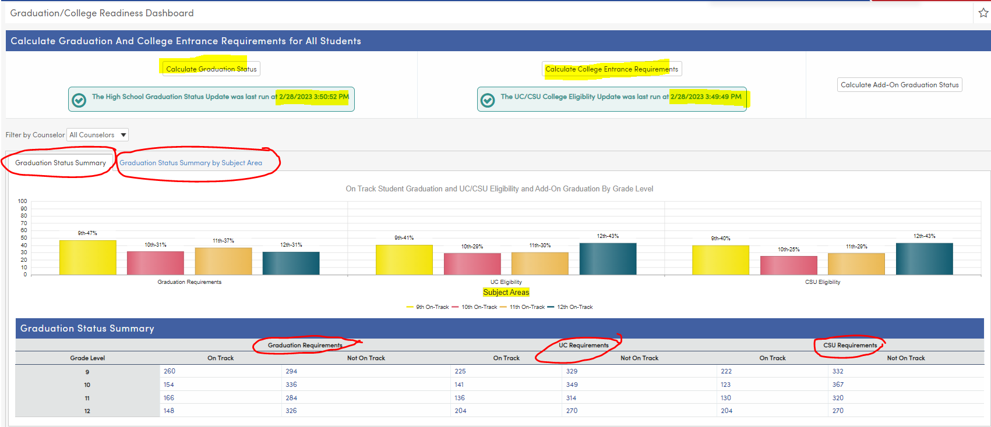
DYK-5 Dashboard Delights
Graduation and College Readiness Dashboard
What is it?
Used in conjunction with the IAP, the Graduation/College Readiness Dashboard is a page that displays in visual form the High School Graduation Status of multiple areas for all students at the current school
This page includes a Graduation Status Summary tab and a Graduation Status Summary by Subject Area tab to view
.
Notes:
The Graduation College Readiness Dashboard gives you so much information about graduation status, as well as college entrance requirement information
Includes 2 tabs –
- Graduation Status Summary
- Graduation Status Summary by Subject Area
What is it using to calculate
Courses Completed, Courses enrolled, courses planned

Slide 33
DYK-5 Dashboard Delights
Graduation/College Readiness Dashboard – What’s Included
Buttons to calculate Graduation Status and College Entrance Status
Button to calculate Add-On Graduation Requirement Status (Texas)
Filter for counselors
Graduation Status Summary Tab – Percentage of students on track for each grade level based on the counselor filter
Charts for Graduation Requirements
Chart for UC Eligibility
Chart for CSU Eligibility
Chart for Add-On Graduation Requirement (Texas)
Ability to turn on and off grade levels by selecting grade level legend at bottom of the chart
Table information for each of the areas above
On Track – Not on Track
By Grade Level
Links to list of students in each category – ability to Keep Students
Graduation Status Summary by Subject Area – Percentage of students on track for each subject area for each grade level based on counselor filter
Chart of each graduation subject area by grade level
Ability to turn on and off grade levels by selecting grade level legend at bottom of the chart
Table information for each subject area
On Track – Not on Track
By Grade Level
Links to list of students in each category – ability to Keep Students
Notes:
Back to High School –
Review the form
Buttons to calculate Grad Status, College Entrance, Add on
Filter for Counselors
Grad Status Summary Tab – uses the counselor filter to give percentage of students at each grade level on track for graduation
Charts for Grad Status, UC, CSU, Add on
Toggle to turn on or off grade levels
Table info at bottom – on track- not on track
links to students in each part of the table

Slide 34
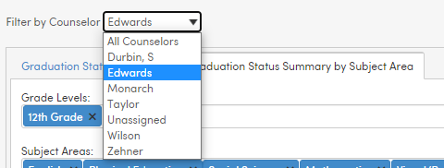
DYK-5 Dashboard Delights
How to Use the Graduation and College Readiness Dashboard
Step 1
Calculate the data
Use the Calculate buttons at the top of the screen to update the data
Step 2
Filter for Counselor if desired
.
Notes:
How do we use this?
Step 1 - Calculate the data
Step 2 - Filter for counselor if desired

Slide 35
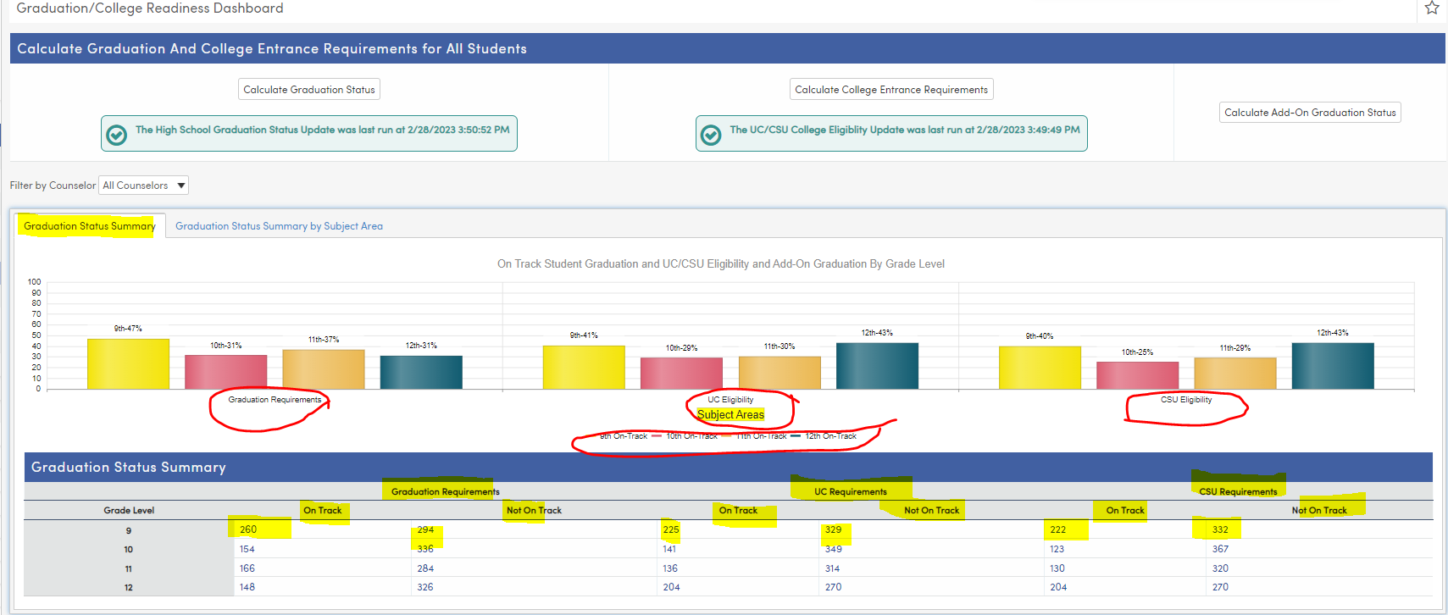
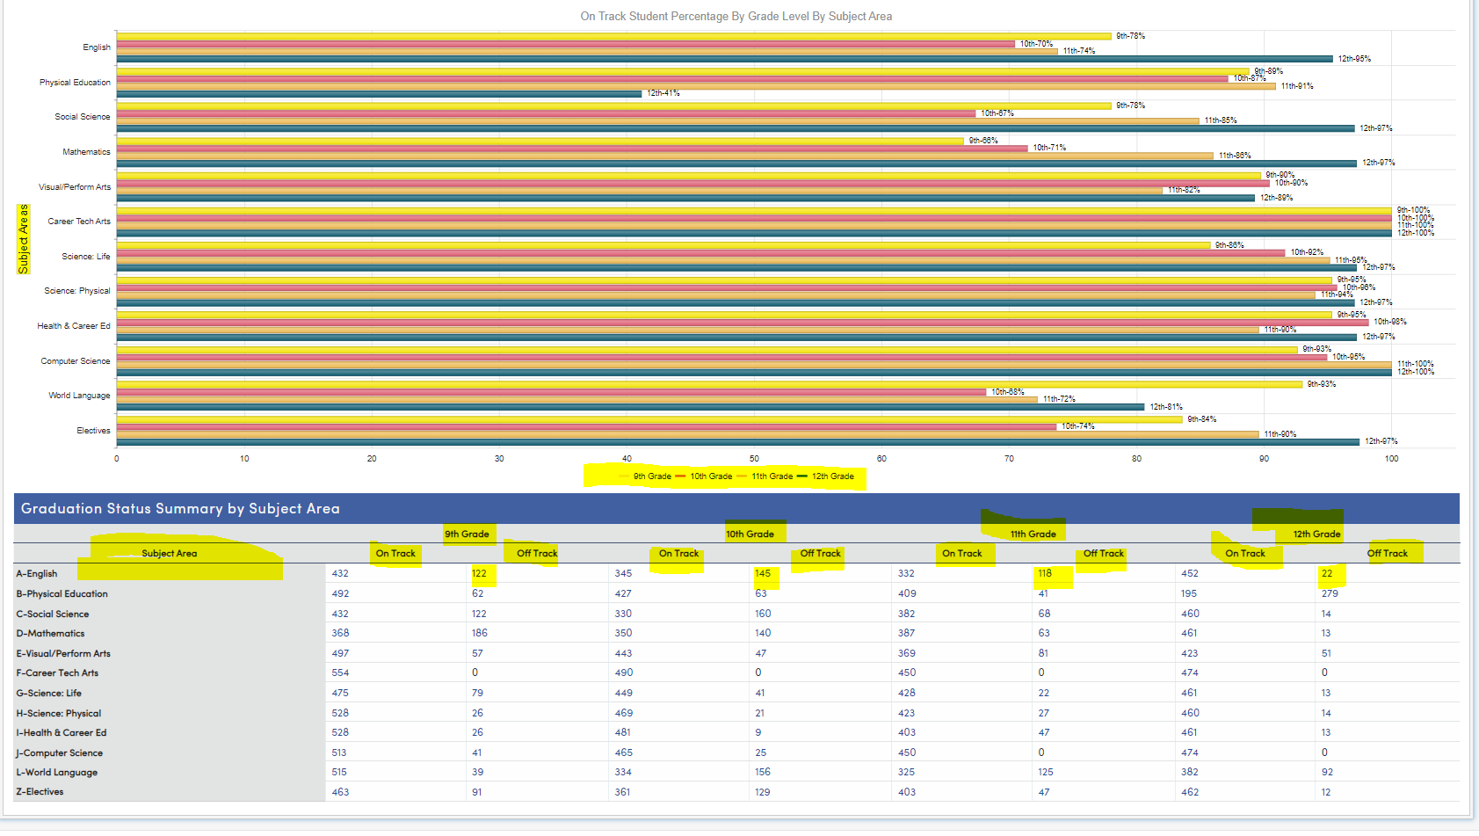
DYK-5 Dashboard Delights
How to Use the Graduation and College Readiness Dashboard
Step 3
Select the appropriate tab
Graduation Status Summary
Graduation Status Summary by Subject Area
Select Grade Levels – turn on and off grade level legend
Select Students – from the table chart
.
Notes:
Step 3 – Select the appropriate tab
Grad Status Summary Tab – uses the counselor filter to give percentage of students at each grade level on track for graduation
Charts for Grad Status, UC, CSU, Add on
Toggle to turn on or off grade levels
Table info at bottom – on track- not on track
links to students in each part of the table
Select 12th graders not on track for graduation
Also view UC/CSU infor
Graduation Status Summary by Subject Area – info by grade level and subject area
Toggle grade levels on or off

Slide 36
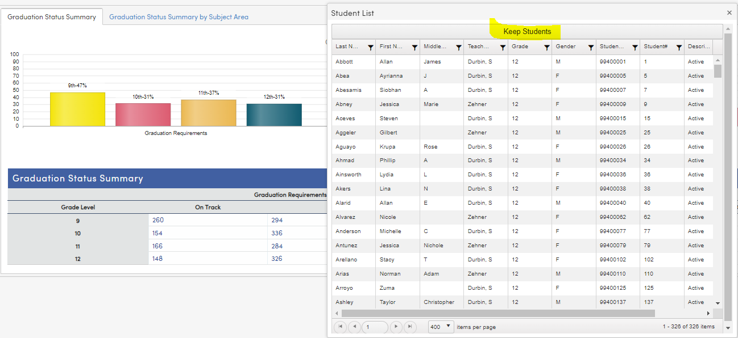
DYK-5 Dashboard Delights
How to Use the Graduation and College Readiness Dashboard
Step 4
View and/or Keep Students
Select the appropriate group of students from the chart and Keep if desired
Run other reports
as needed
.
Notes:
Show Keep ability
12th graders not on track for graduation
Run grad status report for a few
Return to PPT to finish

Slide 37
DYK-5 Dashboard Delights
Notes regarding the Graduation & College Readiness Dashboard
On track status is determined using courses in the Academic Plan, currently scheduled classes, as well as transcript data
Utilizing the Academic Plan will most accurately reflect the results of the calculations in the Graduation and College Readiness Dashboard.
Get More Information in the following session
Session 421-2 – Graduation Requirements
Link to Documentation - Graduation & College Readiness Dashboard

Slide 38
DYK-5 Dashboard Delights
Key Takeaways
Several preconfigured dashboards with important student data exist outside of Aeries Analytics
Get more information about these dashboards by attending the specific sessions about each of the contents or by checking out the documents and/or videos on the Aeries Support page
These dashboards are:
Attendance Data Dashboard
Discipline Dashboard
Interventions Dashboard
CCI Dashboard
Graduation and College Readiness Dashboard

Slide 39
DYK-5 Dashboard Delights
Check out these Sessions
610 – Academic Plan
581 – Assertive Discipline
541-1 – Did you Know Part 1
541-2 – Did You Know Part 2
541-3 – Did You Know Part 3
541-4 – Did You Know Part 4
615 – College & Career
605-1 – Career Pathways

Slide 40
THANK YOU!
Be sure to fill out the survey for this course. All of your feedback is reviewed and may be used to improve our presentations.

Slide 41
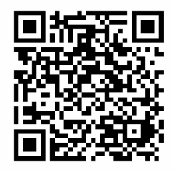
Share your Feedback:
http://surveys.aeries.com/s3/AeriesCon-Session-Feedback-Survey-Spring-2024

