Slide 1



702: CALPADS Basics –
Program Data Management
Jan Tokorcheck | Lead Business Analyst
March 06-08, 2024
Information shared throughout this presentation is the property of Aeries Software. Information or images may not be reproduced, duplicated, or shared without the prior written consent of Aeries Software.

Slide 2


702: CALPADS Basics: Program Data Management
Understanding general information about the California Longitudinal Pupil Achievement Data System
Error Free does not mean Accurate!
Entering various data required for maintaining student program data including 504 plans, Free and Reduced Meals-NSLP, Gate, Title 1, Homeless, Migrant Ed, Language instruction programs.
Expected Outcomes
Identifying relationships between the Student profile data and the programs/subgroups reported to CALPADS
If it’s green – Don’t Guess!
“Highlighting” the State reporting fields to assist with student data management and accessing CALPADS and Aeries Resources
Notes:
Some of the information, maybe be repeated, there may be folks in this session that were not on the other sessions.

Slide 3
Disclaimer
Aeries strives to stay abreast of changes with State reporting business rules as they are shared with SIS Vendors and our customers by FCMAT/CSIS, CALPADS and/or other State reporting agencies.
Aeries would like to emphasize it is ultimately the LEA’s responsibility to stay current with State reporting changes and Aeries Software revisions to ensure accordance with required reporting elements, and access to any new fields or processes in Aeries, as a result of State reporting requirement changes.
LEAs should not solely rely on the contents of these presentations related to CALPADS as the rules and regulations on the following topics have the potential to change at any time.
Notes:
Aeries takes pride in assisting customers with state reporting requirements, but it’s ultimately the responsibility of the LEA to manage, maintain and report their data.
Sign up for notices of changes in reporting – on the CALPADS communications page, via the “flashes” and other list serves for FCMAT, CSIS and other.
Aeries has “tools” to help assist with managing the data, and I’ll point them out as we go along.
CALPADS Data Guide describes all of the data that is required.

Slide 4
CALPADS SYSTEM LINKAGES
702: CALPADS Basics: Program Data Management
CBEDS-ORA
CDSS
Data Matches
OPUS-CDS
CALPADS
Local SIS
CARS
School Accountability Report Cards
Cal-SAAS
Local Control Accountability Plans
Assessments
Testing Vendors
CA School
Dashboard
Notes:
All other system linkages that pull data from CALPADS.
And how do we get all our data to CALPADS?
Aeries transports the almost all of the data to CALPADS!

Slide 5
702: CALPADS Basics: Program Data Management
Statewide Data Education System. Collects and maintains individual level data for State and Federal Reporting requirements and tracking of students over time. Reports enrollment data within 14 days of enrollment or withdrawal of your students.
Registration of students for statewide assessments (TOMS)
LEA funding for LCFF concentration and supplemental grants
Immediate information of CA transfer students (EL & SWD)
Eligibility for free and reduced lunch/Low Socio Status
Identification of foster/homeless youth
Identification of Graduates/dropouts/Career Tech Ed.
Calculation of the accountability metrics on the CA Dashboard
Monitoring/Reporting of FAPE and appropriate EL instruction
Monitoring by the CTC for appropriate credentials
Federal reporting requirements and ensuring federal funding
CAlifornia
Longitudinal
Pupil
Assessment
Data
System
Multiple files are required to be submitted on an ongoing basis.
Notes:
Highlighted bullets are all dependent upon these data reporting elements…
Once you “own” the student, then all other programs can be reported. Ownership on ‘Census Day’ with eligibility or participation start dates on or before this date will be counted in the Fall certification reports.

Slide 6

702: CALPADS Basics: Program Data Management
Student Profile records are required for each submission, an enrollment record (SENR) must be posted at CALPADS before any other additional record types can be submitted
Fall 1
SENR
SINF
Fall 2
SCSE
SCSC
SELA
SPRG
SPED
EOY 1
SCTE
EOY 3
STAS
SINC
EOY 2
SPRG
SIRS
SOFF
EOY 4
SPED
SSRV
PSTS
SPRG
PSTS
WBLR
SENR
SELA
SSRV
Error Free does not mean Accurate!
Fall 2 & EOY 1 require staff and/or course records types in addition to student profile data
Notes:
The Student profile data population is the basis for Fall 1 and its the building block for the rest of the data reporting requirements in CALPADS
Enrollment records must exist in CALPADS before any other files are submitted-enrollments – within 14 days… (SENR) starts the collection of all this data.
Overview of the files in different collections, but we are going to concentrate on where the data is collected for the programs (SPRG) submissions.
CLICK for the red arrows.

Slide 7
Student Subgroups Reporting
702: CALPADS Basics: Program Data Management
Active Enrollments
Migrant Ed.
Homeless
Tribal Foster Youth
Socio-Economically Disadvantaged (SED)*
English Language Acquisition Status (ELAS)
Direct Certification
GATE
Student with Disabilities
Foster Youth
Title III Eligible Immigrants
Data Sources:
SPED SSRV
Special Education & Student Services
SPRG
Student Program
SINF
Student Information
SELA
Student English Language Acquisition
CALPADS Weekly/Monthly CDSS Match
Online Manual Foster Match
*
SED is defined as:
Migrant Ed-135, Homeless-191, Foster, Direct Certification, Tribal Foster Youth - 193, NSLP-181 or 182, Enrollment in Juvenile Court School OR -
Parent Level of Education = 14
(not a high school graduate)
Notes:
These are the student sub-groups (buckets) that are reported for Fall 1 for all active enrollments, completers and dropouts.
This data is updated as data changes throughout the year. But for LCFF counts – it’s reflective of active enrollments on CBEDS day. – 1st wed. in October.
** Reminder, starting this year (23/24) Parent Education Level is being collected for all Parent/Guardian records submitted.
Student with Disabilities (SWD) is reported in the SPED and SSRV files.
GATE, Migrant Ed, Free and Reduced Price Meal, Homeless and Tribal Foster Youth are reported as program records, ELs as part of the Student English Language Acquisition records and Title III is reported based on fields in the student information records.
Foster youth counts are based on weekly matches available in CALPADS and now includes Voluntary Placement students. Boluntary placement agreement per AB 1055, will be including those students in CALPADS reports that display counts of “foster youth,”
Direct Certification counts come from the monthly matching done with CDSS
For Socio-economically subgroup, students qualified based on parent Ed level are reported in the student information file (SINF) and students qualified based on FRPM status are reported in the program record and other categories as follows:
Free or Reduced Price Meal (181-182)
Migrant Ed (135)
Homeless (191)
Foster Youth
Direct Certification
Parent Level of Education = 14 (Not a High School Graduate)
Enrollment in a Juvenile Court School
Note: NSLP program records through 10/31 would be included in the census counts. EL start date on or before census day are included

Slide 8
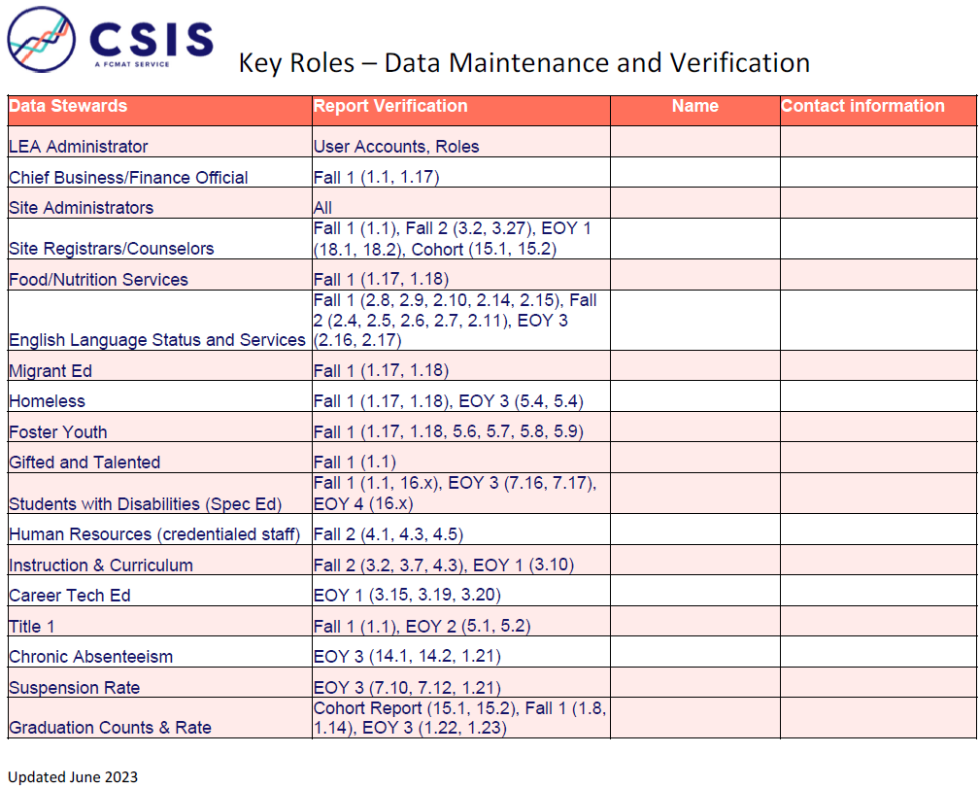
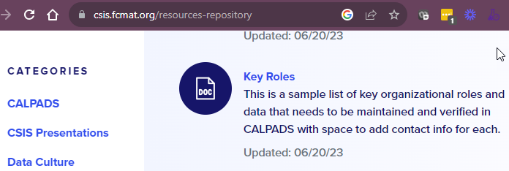
704: CALPADS Basics: Course Data Management
CALPADS Shared Responsibility, Data Steward Assignments
It takes a team to ensure accurate data is reported for your LEA
Ensure local Data Steward responsibilities are distributed to subject-matter experts
CALPADS has a great document to use: https://csis.fcmat.org/resources-repository
Error Free does not mean Accurate!
Notes:
It takes a team effort to collect and report this data.
Just because you are the one submitting the reports to CALPADS, it should not mean you are solely responsible for the accuracy of the data reports.
Gather a team of data stewards and ask them to review the relevant reports from the beginning of the data collection process, so they can be sure the data “makes sense” for your district and schools.

Slide 9
702: CALPADS Basics: Program Data Management
Collected in Fall 1
Collected in End of Year
Code | Program | Type
181 | Free Meal Program | Federal
182 | Reduced-Priced Meal Program | Federal
127 | Gifted and Talented Education (GATE) | Federal
135 | Title I Part C Migrant | State
191 | Homeless Program | Federal
193 | Tribal Foster Youth | State
185 | Transitional Kindergarten (Now taken from Grade Level) | State
Code | Program | Type
300 | LIP - Developmental Bilingual Program | State
301 | LIP - Dual-Language Immersion Program | State
302 | LIP - Heritage or Indigenous Language | State
303 | LIP - Newcomer Program (Various Models) | State
304 | LIP - One-Way Immersion Program | State
305 | LIP - Structured English Immersion Program or other predominantly English Language Instructional Models | State
306 | LIP - Transitional Bilingual Program | State
Codeo | Program | Type
122 | Title I Part A Basic Targeted | Federal
174 | Title I Part A Neglected | Federal
191 | Homeless Program | Federal
192 | Armed Forces Family Member | Federal
101* | 504 Accommodation Plan | State
108 | Opportunity Program | State
113 | California Partnership Academy | State
162 | Pregnant or Parenting Programs (formerly Cal-SAFE) | State
185 | Transitional Kindergarten (Now taken from Grade Level) | State
Student Program records should be regularly updated in CALPADS throughout the year regardless of the submission period.
Notes:
This slide lists all Program codes that are collected throughout the year. Although, some programs are collected in Fall 1 or in End of Year, it is important to report/update a student’s eligibility or participation in CALPADS as soon as the information is available.
There is an asterisk on Program Code 101 for 504 Accommodation Plans, because the data can come from either the Programs table (PGM) or the 504 page (FOF), depending on what your district uses to track that data.
Just a reminder, CALPADS used to collect program record 185, however that is no longer needed, as TK is now an official grade level reported to CALPADS, so it is not necessary to create these programs any longer.
If you do online enrollment or data conformation, don’t forget to review the survey audits. Homeless, Foster or Armed service… this affects the program records.
Go into Aeries to demo the Portal Options to set up, and show the Audit pages (Jan_TX database)

Slide 10
702: CALPADS Basics: Program Data Management
CALPADS automatically designates a program as either eligible or participating.
ELIGIBILITY Programs collected | PARTICIPATION Programs collected
Homeless | Title I Part A Basic Targeted
504 Accommodation Plan | Title I Part A Neglected
Armed Forces Family Member | Opportunity Program
Pregnant or Parenting | California Partnership Academy
Title I Part C Migrant
Free Meal Program
Reduced-Price Meal Program
Gifted and Talented Education (GATE)
Tribal Foster Youth
Eligibility means that a given student has met all of the criteria to receive services for an education program; however, the student may not necessarily be receiving services.
Participation means that a given student has met all of the criteria to receive services for an education program, and that student is receiving services.

Slide 11
Eligibility Dates
702: CALPADS Basics: Program Data Management
For students, whose enrollment overlap Fall 1 census day, the following eligibility dates will include the students in the LCFF report.
Met Eligibility | As of Inclusive date
Homeless | Open record with start date on or before Census day.
Migrant Ed | Open record with start date on or before Census day
Income/ Alternative Income Eligibility Form (Regular School, CEP, Provision 2/3) | NSLP Program Start date must be between 7/1 through 10/31 of the current school year to be counted
Foster Youth | Student must be active Foster Youth on Census day. Volunteer Placement included in Universal Pupil Count (UPC) used in determining LCFF
Tribal Foster Youth | Open SPRG record with start date on or before Census day.
Direct Certification (SNAP, TANF, MediCal Free, Medi-Cal Reduced) | Must be certified between 7/2/2023 to 11/2/2023
Notes:
UPC=Unduplicated Pupil Count
NSLP programs must have Eligibility Start Dates between 7/1 - 10/31 of the current school year in order to be counted. The Eligibility End date must also be either blank or dated AFTER 10/31.

Slide 12
Error Free does not mean Accurate!
702: CALPADS Basics: Program Data Management
Here are some things to be aware of when reporting NSLP eligibility.
Nuance | Local Lunches and/or Nutrition system | CALPADS | Possible Action
30 days carry over | Entered and tracked in lunch program system | NEVER report in CALPADS | Do not submit a SPRG record to CP until eligibility is established for Academic Year
Applications received by 10/31 & student found eligible prior to, on or after 10/31 | Entered and tracked in lunch program system | Report eligibility by submitting a Program 181/182 record FRPM eligible Results Reported on 1.17 for LCFF | Use Start date equal or prior to 10/31
Applications received after 10/31 and student found eligible after 10/31 | Entered and tracked in lunch program system | Report eligibility by submitting a Program 181/182 record using the true eligibility date NOT reported on 1.17 for LCFF (even if student enrolled on Census day) | Use start date equal to date application was received
Provision 2 and 3 or CEP Schools (Note: Base year requires collection from all students; succeeding years collection will only be from new students) | Entered and tracked in lunch program system | Report eligibility by submitting a Program 181/182 record FRPM eligible Reported on 1.17 for LCFF | Do not submit a SPRG record until eligibility is established for Academic Year
https://www.cde.ca.gov/fg/aa/lc/lcfffaq.asp
Notes:
Here are some nuances you should be aware of when reporting NSLP eligibility in CALPADS.
Districts may collect Alternative Income forms during the spring as part of the registration process for the next school year, as long as the USDA income eligibility guidelines have been released. However, the start date for the FRMP record MUST be dated on or after 7/1.

Slide 13
702: CALPADS Basics: Program Data Management
AERIES SUPPORT HELPFUL LINKS
Quick Access to Aeries CALPADS Documentation CALPADS Quick Links
Aeries page details - Special Programs Page
CALPADS Special Programs Chart - Special Programs Chart
Aeries page details - Free and Reduced Page
CALPADS Free and Reduced Meals CALPADS in Aeries
NSLP/FRE Management Guidelines and Nuances NSLP decision guide
SPRG FAQ’S
CALPADS Submission Chart: an overview guide that lists the extract name, file name
and frequency of submission - Submission Chart
CALPADS extracts web support folder that details various CALPADS files for
submissions and other CALPADS functions in Aeries: CALPADS Extracts

Slide 14




702: CALPADS Basics: Program Data Management
RESOURCES
https://support.aeries.com/support/solutions/14000072241
https://www.cde.ca.gov/ds/sp/cl/systemdocs.asp
https://csis.fcmat.org/resources
https://documentation.calpads.org
Notes:
Support-Aeries – quick links to CALPADS resources in Aeries.
CALPADS communications via “Flashes” are sent out to provide updates, which can be found on the CALPADS home page. CALPADS list serves etc.
Data Guide – Business rules, describes the required data
FCMAT CSIS – get your trainings
User Manual – updated more often than the data guide, quick search on report mapping.
Business Rules in the Data guide – describes the data required, quick search on report mapping.

Slide 15

Ownership” of the student in my LEA is when I have an SENR enrollment record posted in CALPADS for my LEA.
I need to have “ownership” of the student in my LEA before my program counts will be reflected. Programs are “reflective” of students enrolled on Census day
CALPADS automatically designates a program as either eligible or participating
Some programs are collected at the end of the year as well.
Data collected in Fall 1 is reflective of the Census day
It’s important to keep CALPADS updated with student programs on an ongoing basis.
Key Takeaways
If it’s green – Don’t Guess!
Error Free does not mean Accurate!

Slide 16
660-2
EL Data Process: Aeries to CALPADS
More CALPADS Sessions
700 / 701
CALPADS Basics: Overview CALPADS Basics: Students
We offer a variety of CALPADS sessions from beginner to advanced.
Remember, your virtual registration comes with access to ALL sessions!
715 / 716
CALPADS EOY: 1 & 4 CALPADS EOY: 2 & 3
717
CALPADS Year End Closing
730
CALPADS Update from CSIS

Slide 17





THANK YOU!
Be sure to fill out the survey for this course. All of your feedback is reviewed and may be used to improve our presentations.

Slide 18

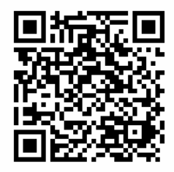
Share your Feedback:
http://surveys.aeries.com/s3/AeriesCon-Session-Feedback-Survey-Spring-2024

