Slide 1
310-2 Student Scheduling for Next Year
Scheduling Students
Presenter: Carole Williams

Slide 2
Related AeriesCon Sessions
Course Requests:
305-1: Managing Student Scheduling Course Requests
305-2: Student Scheduling Course Requests Using the Aeries Student Portal
Flex Scheduling:
325-1: Flex Scheduling - Traditional Bell Schedule
328: Elementary w/Primary Class (CA Only)
Scheduling:
310-1: Student Scheduling for Next Year: Building the Scheduling Master Schedule
310-2: Student Scheduling for Next Year: Scheduling Students
320: Master Schedule Building Theory
330: Scheduling Master Schedule Board (including the SMS Builder)
340: Student Scheduling – Scheduling Groups and Teams
Scheduling related:
456: Alternative School Scheduling
610: Individualized Academic Plan for Students
You
Are
Here
If you have never scheduled before, this session may help you get the concepts (did you go in Period 1?)
If you’re building the Scheduling Master Schedule, be sure to watch this session to learn more about the SMS Board (today P5; tomorrow P1)

Slide 3
Scheduling Students: Key Topics
Backup and Restore Scheduling Results
Reports to run before running the Scheduler (mass scheduling students)
Mass scheduling students
Schedule All Students page
Flex SMS Board/SMS Board
Course Requests page
Add/delete/modify course requests
Lock courses
Address scheduling conflicts/rejects
Schedule individual students
Use reports to guide building/modifying/finalizing the Scheduling Master Schedule
Copy existing sections, including sections with students
Where to go next
Running the Scheduler to mass add students to sections
Hand scheduling students to fix rejects

Slide 4
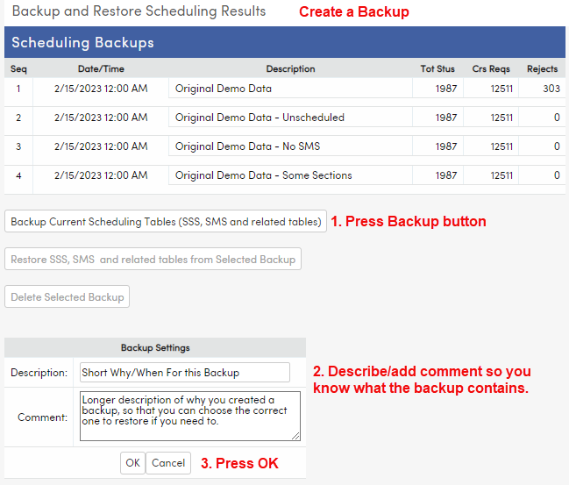
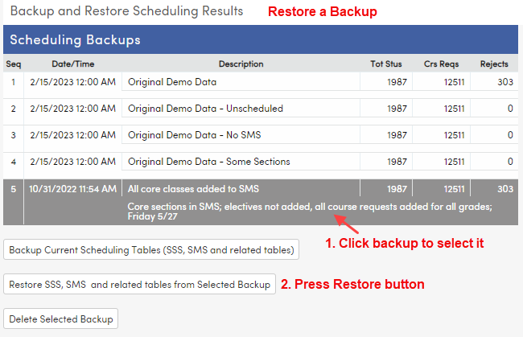
Backup and Restore Scheduling Results:
Create a saved backup of scheduling tables, including SSS (Course Requests) and SMS (Scheduling Master Schedule).
Backup often. Restore carefully! Existing data will be written over!

Slide 5
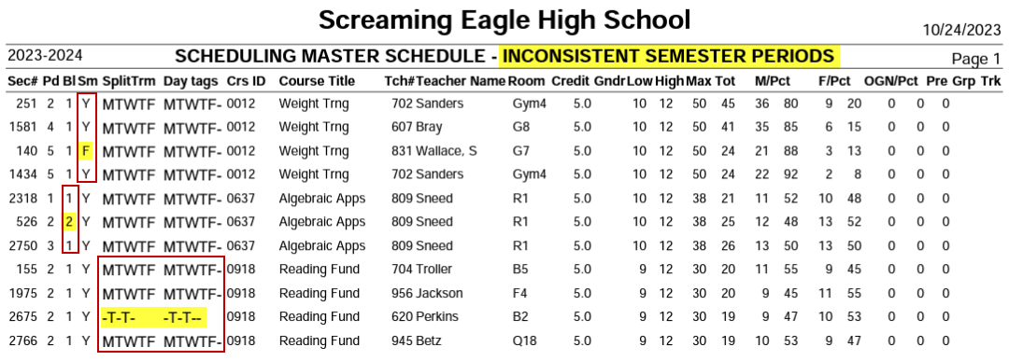
Reports to Run Before Scheduling Students: Scheduling Master Schedule Errors
Not applicable to Flex schools
If any of these errors exist, the scheduler will not run and an error message will display:
Find the section(s) and fix them
What is the problem?
Within the same Course, sections should have the same:
Block
Sm (term)
SplitTerm / Day tags

Slide 6
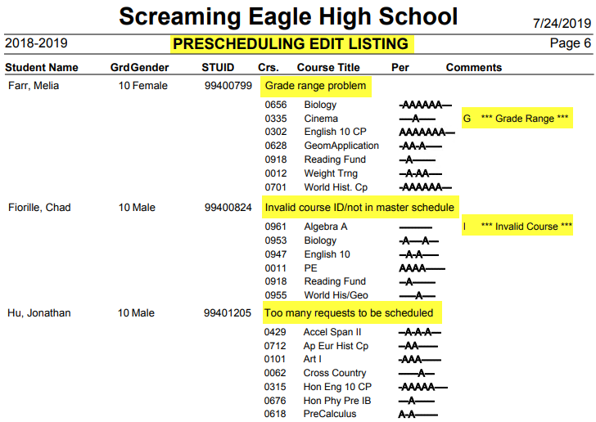
Reports to Run Before Scheduling Students
Prescheduling Edit Listing
Run after SMS built, but before scheduling
Predicts potential conflicts and rejects

Slide 7
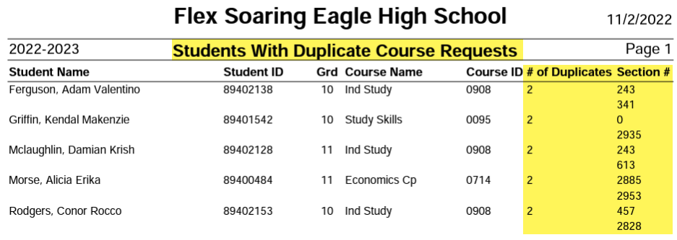
Reports to Run Before Scheduling Students
Students with Duplicate Course Requests
Should the student have two Course Requests and/or sections scheduled for the same Course?
For one student, delete the duplicate on Course Requests
Mass deletion on Delete Duplicate SSS Records

Slide 8
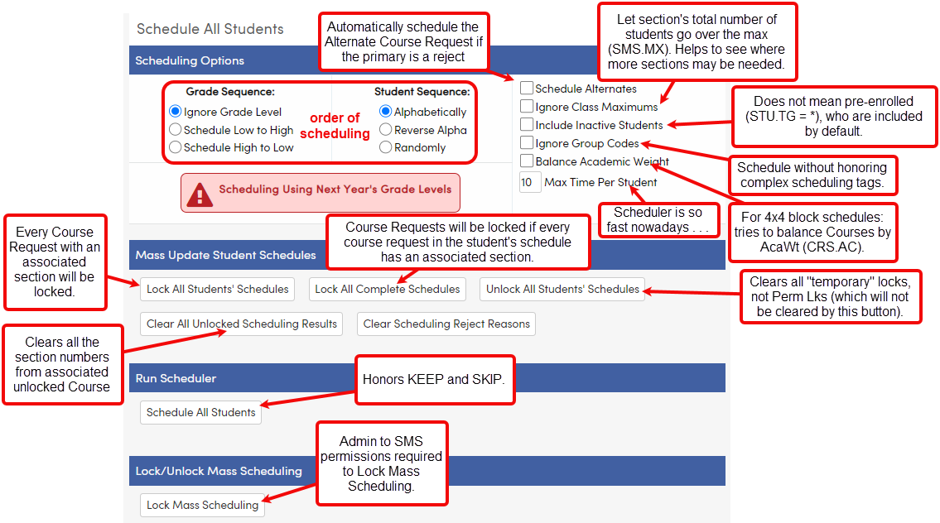
Schedule All Students: Mass Schedule
Mass lock/unlock scheduled sections
Run the Scheduler; run reports; move sections; repeat

Slide 9
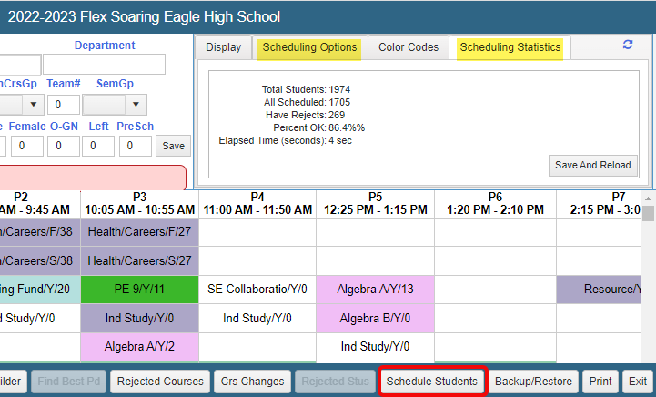
Flex SMS Board/SMS Board: Mass Schedule
Same options as Schedule All Students page, except you can’t mass lock/unlock scheduled sections here
Run the Scheduler; run reports; move sections; repeat

Slide 10
As the Scheduler runs:
Pre-scheduled (locked) sections first
Courses with fewer available sections are scheduled first (in other words, singletons first, then doubletons, etc.)
Sections with most empty seats are tried first
Scheduler tries to keep an empty seat in every section
So different maxes might cause effects you don’t expect
Core classes are scheduled before non-core classes
NCLB Core (CRS.NCC) and N/H (CRS.NA) fields

Slide 11
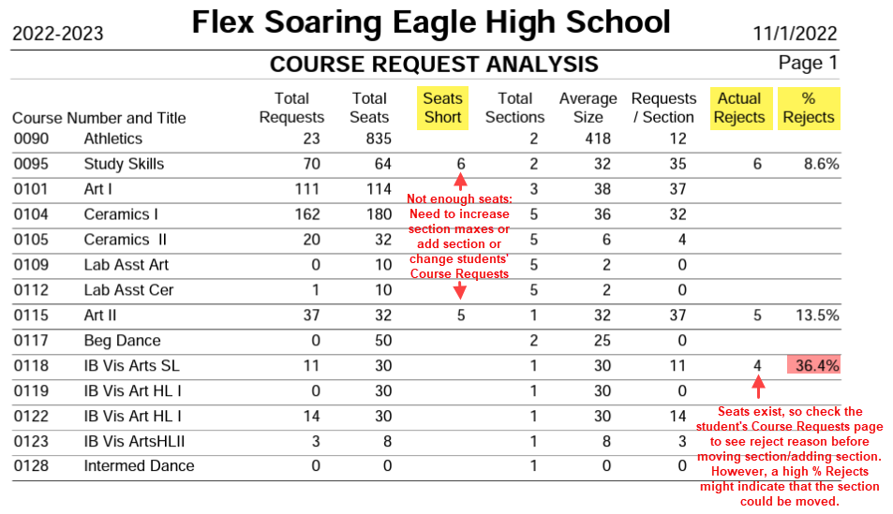
Do you need to add sections? Check the Scheduling Course Request Analysis report
Quickly see Seats Short: not enough sections for the number of students requesting the Course

Slide 12
Do you need to move sections? Check the Scheduling Class Load Analysis by Course and Period report
For each Course, Dev reflects the difference between the Total in one section vs. the Class Average of all the sections
Over the Class Average (too full) and under the Class Average (not full enough) are both issues to solve
We want balance: each section’s Total is equal to the Class Average (or near the Class Average)
Look at > 5 Dev (deviation). Add a section? Move a section?
Don’t move the singletons or doubletons!

Slide 13
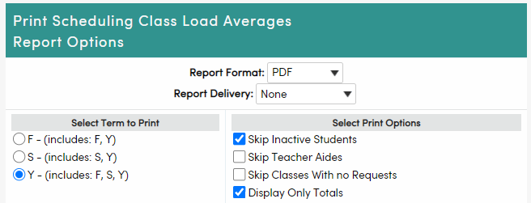
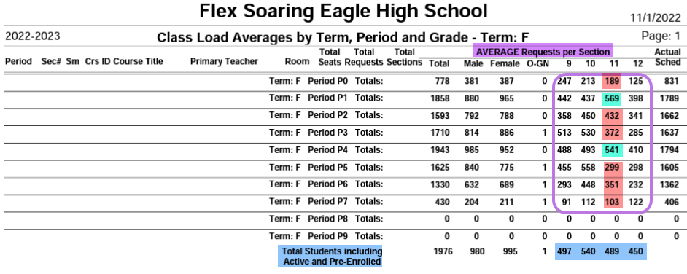
Do you need to move sections? Check the Scheduling Class Load Averages report
To print the Seat Counts, choose these Options:
Skip Inactive Students
Display Only Totals
Seat Count: the Total number of seats per period by Grade Level, if each SMS section contained the average number of students per Course
Compare Average Requests per Section to the Total Students
Much higher? Seats (sections) for that Grade Level could potentially be moved to another period
Much lower? Seats for that Grade Level are needed in that period
Don’t move singletons or doubletons!

Slide 14
Mass scheduling students:
Add/move sections
Run the scheduler
Run reports
Repeat steps 1 – 3 until:
Students are 100% scheduled, or
You have no other possibilities for adding/moving sections, or
You have run out of time

Slide 15
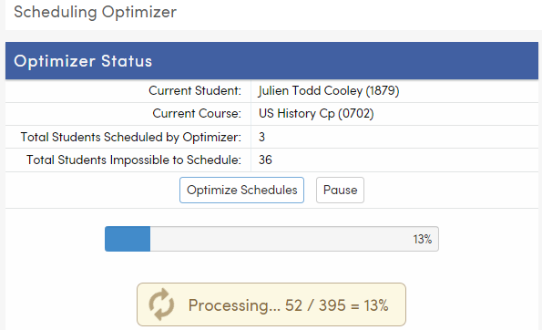
At some point, you are going to stop running the Scheduler:
After you stop mass scheduling:
Run the Scheduling Optimizer
Hand schedule students on the Course Requests page

Slide 16
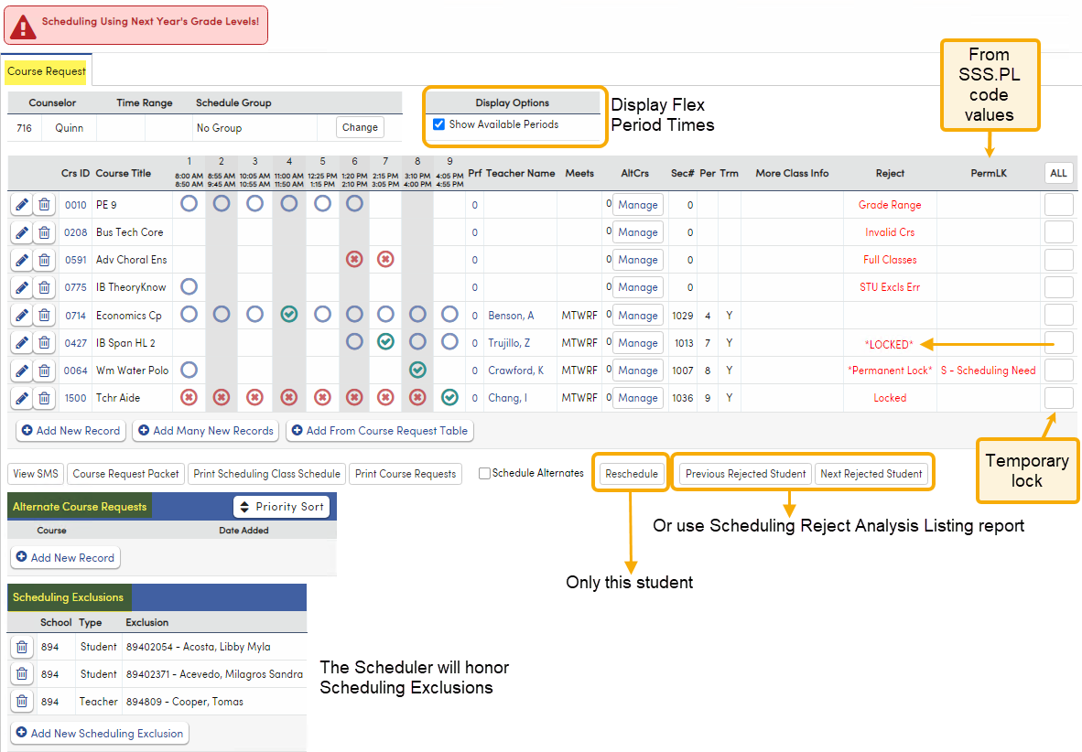
Hand Scheduling on Course Requests page: Flex Old Edit View
Display Options: view Flex Periods horizontally or vertically
Reject column: why the Scheduler didn’t put the student into a section
Temporary Lock:
Apply using button under All
Display as Locked in Reject column
Can be mass cleared on Schedule All Students page
PermLk set when editing the Course Request
Display as *Permanent Lock* in Reject column
More/different PermLk codes can be added on Update Code Table page for SSS.PL field
Can’t be mass cleared on Schedule All Students page
Alternate Course Requests can be added and associated with primary Course Requests
Scheduling Exclusions for Student, Teacher, or Period
Student can be added to the Wait List for a full section

Slide 17
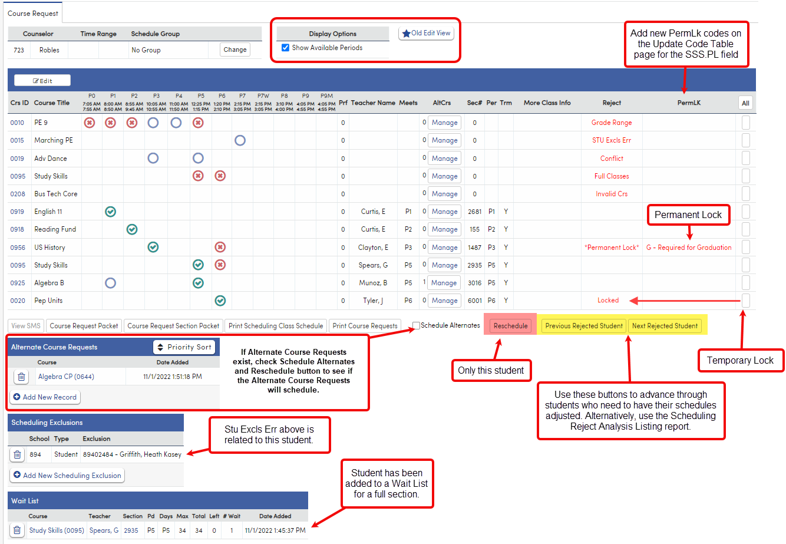
Hand Scheduling on Course Requests page: Flex New Edit View
Display Options: view Flex Periods horizontally or vertically
Reject column: why the Scheduler didn’t put the student into the section
Temporary Lock:
Apply using button under All
Display as Locked in Reject column
Can be mass cleared on Schedule All Students page
PermLk set when editing the Course Request
Display as *Permanent Lock* in Reject column
More/different PermLk values can be added on Update Code Table page for SSS.PL field
Can’t be mass cleared on Schedule All Students page
Alternate Course Requests can be added and associated with primary Course Requests
Scheduling Exclusions for Student, Teacher, or Period

Slide 18
Hand Scheduling on Course Requests page: Non-Flex Old Edit View
Reject column tells you why the Scheduler didn’t put the student into the section
Temporary Lock:
Apply using button under All
Displays as Locked in Reject column
Can be mass cleared on Schedule All Students page
Edit the Course Request to set PermLk
Display as *Permanent Lock* in Reject column
More/different PermLk values can be added on Update Code Table page for SSS.PL field
Can’t be mass cleared on Schedule All Students page
Alternate Course Requests can be added and associated with primary Course Requests
Scheduling Exclusions for Student, Teacher, or Period
Student can be added to the Wait List for a full section

Slide 19
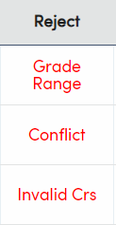
Course Requests page: guide to Reject reasons
Conflict could be one of the following:
A scheduled section is preventing sections of other Courses from being scheduled in the same Flex Period.
Too many Course Requests exist for the number of periods or Flex Periods available.
A Time Range or Period Range restriction is preventing available sections from being scheduled.
Full Classes: All sections of the Course are full.
Grade Range: All sections of the Course are set to a Grade Range that does not include the student’s Next Grade.
Invalid Crs:
No sections of the Course are offered.
In a Flex school, sections may be offered but are missing their Flex Period or Class Calendar.
StuGrp Restrict: The Scheduling Group code for the sections does not match the student’s Scheduling Group code (SMS.SG <> STU.SG).
Tchr Pref Err: The Pref value does not match any section’s Teacher (SSS.TN <> SMS.TN for traditional scheduling; SSS.PS <> SSM.ID for Flex scheduling).
Sex Restriction: All sections of the Course are restricted to a different Gender (SMS.GN).
Track Restrict: All sections of the Course are restricted to other Tracks (SMS.TR <> STU.TR).
ALTERNATE: An alternate Course was scheduled in place of the original Course Request.
Locked: The section is scheduled and temporary locked.
*Permanent Lock*: The section is scheduled and perm locked.
PD Excls Err: A period scheduling exclusion is preventing a section from being scheduled.
Tchr Excls Err: A teacher scheduling exclusion is preventing a section from being scheduled.
STU Excls Err: A student scheduling exclusion is preventing a section from being scheduled.

Slide 20
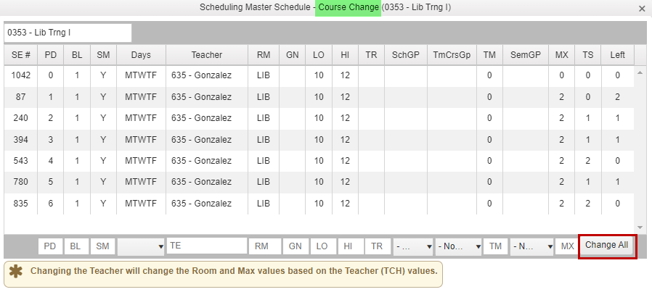
SMS Board/Flex SMS Board helpful buttons after you’ve scheduled students:
Rejected Courses button:
Which Courses have rejects and why
Use the SMS and STU buttons to drill down to sections or students
Crs Changes button:
See all sections at a glance
Change key information for all sections or selected sections
Rejected Stus button:
Same as STU column button on Rejected Courses
Students with rejects
Can remove the Course Request
Probably easier to manage these on Course Requests

Slide 21
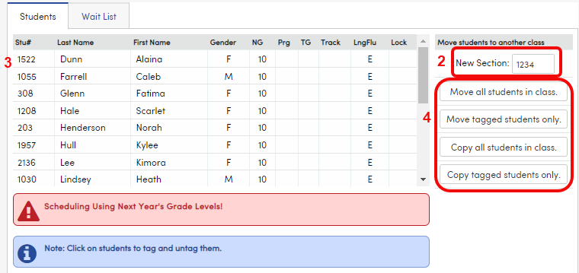
Mass Move/Copy Students on the Scheduling Master page
Select the section students will be moved/copied from.
Add the section number the students will be moved/copied into the New Section field on the Students tab near the bottom of the page.
If a subset of students should be moved/copied, tag them (click on the student names).
Press appropriate button based on whether all or tagged students should be moved or copied.

Slide 22
Wait Lists on the Scheduling Master page
Scheduling Setup: Allow Wait Lists
Scheduling Master Schedule: section must be full
Add Student to Wait List for the section
Change Priority Order of the students
Delete students from the Wait List for a section

Slide 23
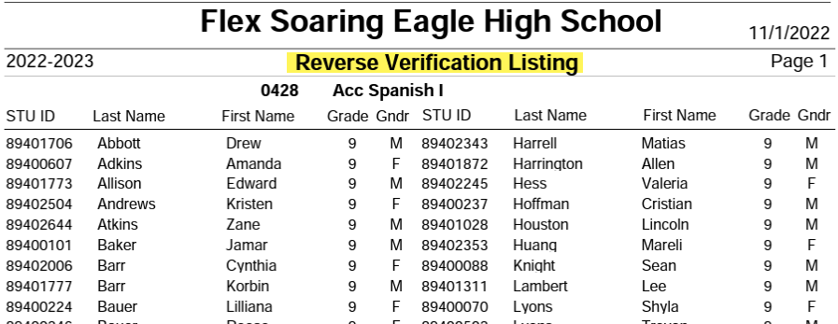
Scheduling reports: Scheduling Reverse Verification Listing
Lists the students who have a Course Request for the Course
Print for:
Advanced courses
Courses with grade or credit requirements
Courses with teacher approval or tryout or audition requirements
Give the report to the appropriate personnel (teachers or counselors or administrators) for approval
If denied, change the course request

Slide 24
Scheduling reports: Scheduling Master Schedule
Sort by options include:
Course and Period
Teacher and Period
Check data entry for the Scheduling Master Schedule:
Max and Grade Range (Low/High) and Teacher
Check complex scheduling section tags
At Flex schools, make sure all sections have a Flex Period and a Class Calendar

Slide 25
Scheduling reports: Scheduling Reject Analysis Listing
All students with rejected Course Requests
Look for patterns

Slide 26
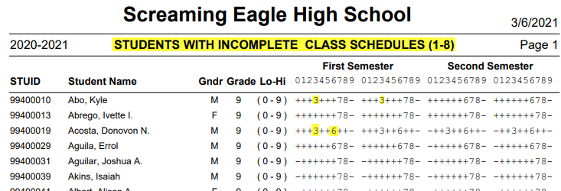
Scheduling reports: Students with Incomplete Schedules
Not applicable to Flex
Options:
Choose period range for your school
SMS/SSS
Find periods with no sections

Slide 27
Scheduling reports: Students with Double Periods
Not applicable for Flex Scheduling
Print for the SMS/SSS
Find two or more sections in one period

Slide 28
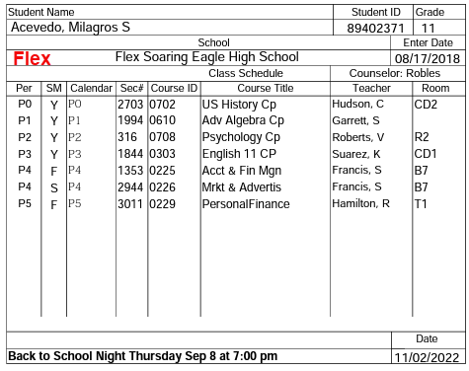
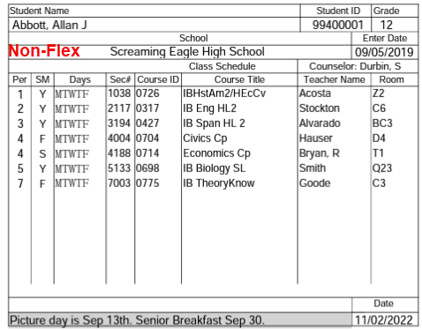
Scheduling reports: Locator Cards
Student Locator Cards
Print for SMS/SSS (or wait to print them from the MST/SEC)
Schedule typically handed out to students
Lots of options for what is included and how it prints

Slide 29
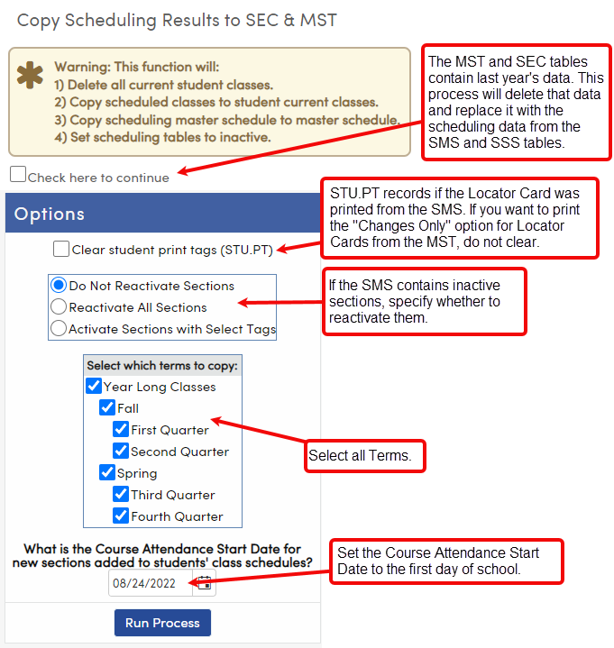
Copy Scheduling Results to SEC & MST
After New Year Rollover and after the Scheduling Master Schedule is finalized, but before school starts.
Copies the Scheduling Master Schedule to the Master Schedule; copies students’ Course Requests’ scheduled sections to Classes.
Check here to continue: you must acknowledge the warning before the rest of the options are displayed
Got inactive sections in the SMS, but you don’t know why? Run this query:
LIST SMS CRS SMS.SE CRS.CN CRS.CO SMS.STG SMS.STG? IF SMS.STG > ' '
After running this process, scheduling is over, so:
Use Master Schedule page (not Scheduling Master page) to modify sections.
Use Classes (not Course Requests) to modify students’ schedules.
The Flex SMS Board/SMS Board will be inactive (use the Master Schedule page instead).
Be aware that many reports have scheduling (SMS/SSS) versions and Master Schedule versions (MST/SEC). Choose the correct report for your needs.

Slide 30
Where to go for more information:
Documentation below is all from the Aeries support website:
https://support.aeries.com
Student Scheduling for Next Year category on support.aeries.com:
https://support.aeries.com/support/solutions/folders/14000116178
Session 310-1 Student Scheduling for Next Year – Building the Scheduling Master Schedule:
https://support.aeries.com/support/solutions/articles/14000079378-session-310-1-student-scheduling-for-next-year-building-the-scheduling-master-schedule
Session 310-2 Student Scheduling for Next Year – Scheduling Students:
https://support.aeries.com/support/solutions/articles/14000121287-session-310-2-student-scheduling-for-next-year-scheduling-students
Secondary Scheduling Videos (Flex and Non-Flex):
https://support.aeries.com/support/solutions/folders/14000128208
Got questions? Bring them to Open Forum!

Slide 31
Key Takeaways
Mass schedule students on the Schedule All Students page or the SMS Board
Use reports to refine and improve the Scheduling Master Schedule, so that more students successfully schedule
Use the Course Requests page or the SMS Board to fix students with scheduling rejects

Slide 32
We want your feedback!
Scan the QR code below, or visit the survey link at the bottom, to provide feedback on this session: 310-2 Student Scheduling for Next Year -- Scheduling Students.
http://surveys.aeries.com/s3/AeriesCon-Session-Feedback-Survey-Spring-2024

