Slide 1
Ask Aeries! Attendance Accounting and Reporting
August 10, 2023
Host: Lisa Golisano Presenter: Allison Lambson Moderators: Loretta Bishop, Adriana Quick

Slide 2
This is our first year using Flex scheduling. Are there any specific differences we need to be aware of when running attendance accounting procedures/reports for verification? Or is everything the same?

Slide 3
Flex Teacher Portal Attendance will look mostly the same Flex Classroom Attendance will look the same Flex Daily Student Attendance interface will look the same Flex Daily Attendance must be set up differently than traditional scheduling schools - https://support.aeries.com/support/solutions/articles/14000130190-elementary-primary-class-scheduling-school-options Flex Period Student Attendance will look different Aeries Demo Database – Flex Soaring Eagle HS (Flex Period) - https://www.aeries.com/solutions/demo Aeries Demo Database – Golden Eagle ES (Flex Daily) - https://www.aeries.com/solutions/demo Flex Attendance Reports will look and sometimes be different. Run the reports you normally ran in your traditional scheduling in our Demo Database Flex Schools to see if there are differences and what they are. Some reports are not available in Flex but have a replacement Flex Reports Listing - https://support.aeries.com/support/solutions/articles/14000114361-flex-scheduling-reports Monthly Attendance Report and Monthly Attendance Summary are the only reports recommended for balancing and reporting needs and will look the same

Slide 4
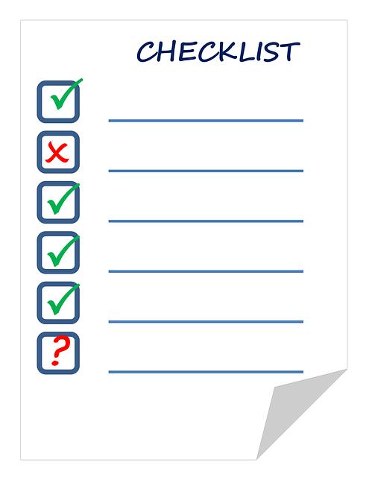
When teachers scroll down a long list of students in Post by the Month Attendance for daily positive attendance schools, will the headers (date band) stay visible the top?
No, the headers will not stay visible at the top. (The top pane does not freeze.)
Please create an Aeries Idea if this is something you wish to see enhanced in Aeries Next Gen - ideas.aeries.com

Slide 5
In a recent ticket, Aeries support said: "When Portal options are set to Post Attendance by Month, there is no way to Mass post present ATT code; The teacher must select each STU Present first, then can select mark Absent if not present." But, most Ind. Study students "Complete" work on the day, so could the process be changed to allow the teacher to select each student "Absent/NOT complete" which likely is fewer days, then can Select "Mark 'Present' if not absent" to fill in blanks/UNchecked days with the "Present/Complete" code? See Aeries idea: "Independent Study Attendance by Month-..." that I posted but it's not yet approved.
Post by Month Attendance affords the ability to post for a month-long time frame on one screen, but you cannot mass add the present code. If you need the ability to mass add the present code, you must use regular attendance and teachers may mass add the present code for each day. Aeries Ideas are evaluated on a strict criteria set and are approved or declined based on multiple factors, you will hear back either way.

Slide 6
In the Monthly Attendance Summary Analysis Report, is there a way to group two other separate groups, apart from Regular Program?
No, our testing determined that you cannot exclude Regular Program in to combine other non-regular program totals

Slide 7
On the Monthly Attendance Summary/Continuation Report, Max hours is 3 and Minute passing is 0. The site setup has 4 minutes passing time included in the flex Schedule. Do I want to put the 4 minutes that are included in the start and end time or do I leave it at Zero to get the Total Apportionment hours for ADA? Is the report , including or excluding the minutes?

Slide 8
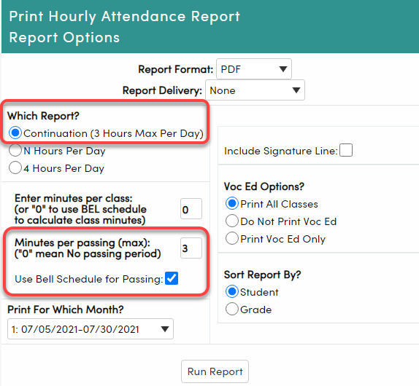
The 4 minutes should be reported via the report option to add passing minutes since continuation schools are paid for passing times.
https://support.aeries.com/support/solutions/articles/14000070593-alternative-school-configuration
Notes:
Continuation schools are paid for passing period.
If not all passing are the same then select the Use Bell Scheduler and add the different passing periods there and do not add the minutes per passing.

Slide 9
What is the main difference between Monthly Attendance Summary and Monthly Attendance Summary/ Continuation?
Monthly Attendance Summary/Continuation calculates hourly attendance. This report is only for Positive Attendance schools taking Hourly Period Attendance. All other schools use the regular Monthly Attendance Summary report

Slide 10
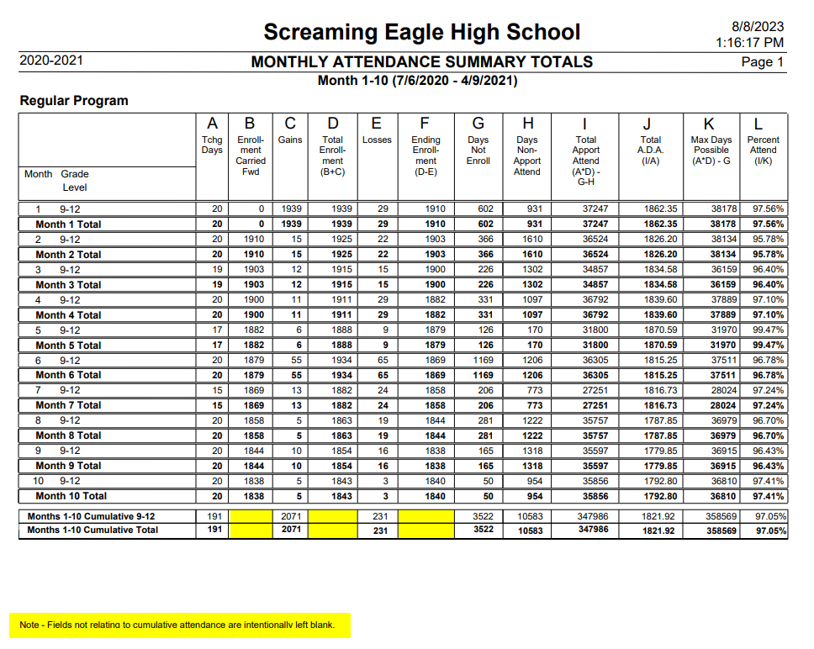
Why is it that the Monthly Attendance Summary Totals Report does not display the Enrollment Carried Forward and the Ending Enrollment numbers? It would help so much to see those totals.
The Totals Rows are only for cumulative records. Columns B, D and F are not cumulative totals as you would not add 1910 students for Month 1 with 1903 students for Month 2 – because enrollment is not cumulative, so they are intentionally left blank.

Slide 11
In Aeries, for students on the Home and Health Program, how is the ADA calculated? Is the student credited 1 Hour a day or the max three hours a day?
Notes:
Not a question for Aeries a question for CDE, they make the rules please contact them for more information.

Slide 12
**This is a question for the State** Here is the information we found on CDE’s website regarding Home Hospital ADA: https://www.cde.ca.gov/sp/eo/hh/hhprogramsummary.asp EC Section 48206.3 specifies that for attendance accounting, each clock hour of individualized instruction counts as one day of attendance. No student shall be credited with more than five days of attendance per calendar week or credited with more than the total number of calendar days that regular classes are offered by the district in any fiscal year.

Slide 13
I would like the link to access Aeries talk for additional collaboration.
Aeries Listserv is where you can post questions (about other districts' practices) to Listserv members who belong to other CA districts using Aeries.
You can apply for free membership at this link https://groups.io/g/AeriesTalk
and then you would have access to posting questions to all districts that are members.

Slide 14
Wrap Up
Articles:
CDE - https://www.cde.ca.gov/sp/eo/hh/hhprogramsummary.asp
Aeries Talk ListServ https://groups.io/g/AeriesTalk
Aeries Demo Databases – Flex Soaring Eagle HS (Flex Period) and Golden Eagle ES (Flex Daily) - https://www.aeries.com/solutions/demo Flex Reports Listing - https://support.aeries.com/support/solutions/articles/14000114361-flex-scheduling-reports
Flex Daily - https://support.aeries.com/support/solutions/articles/14000130190-elementary-primary-class-scheduling-school-options
Monthly Attendance Summary/Continuation Report - https://support.aeries.com/support/solutions/articles/14000070593-alternative-school-configuration

