Slide 1
Ask Aeries! CALPADS EOY Reporting
June 15, 2023
Host: Flaviola Cisneros Presenter: Suzette Kellar Moderators: Flaviola Cisneros, Stephen Burks

Slide 2
Question: What is the proper way to report 504 plans? Do we leave the end date blank or is it okay to populate with a date in the future?
https://support.aeries.com/support/solutions/articles/14000135653-504-plans-how-does-aeries-extract-504-plan-records-

Slide 3
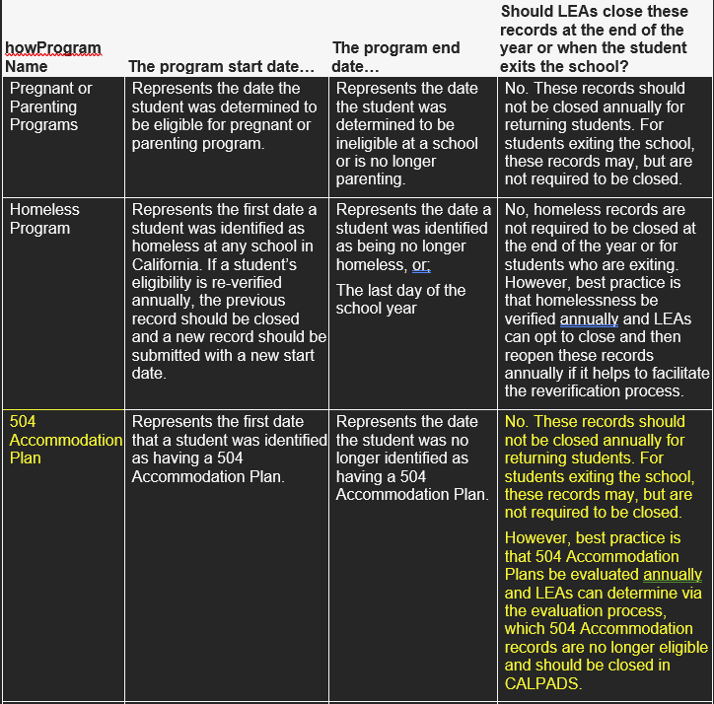
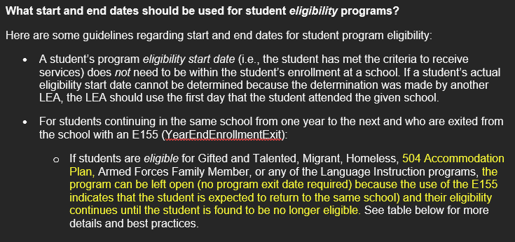
Per CALPADS Data Guide https://www.cde.ca.gov/ds/sp/cl/systemdocs.asp

Slide 4
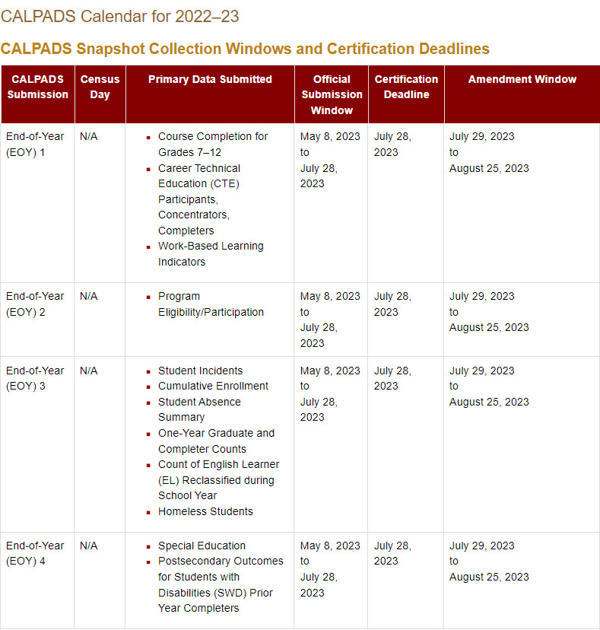
Question: What is the proper timeline to submit data to CALPADS?
https://www.cde.ca.gov/ds/sp/cl/systemdocs.asp

Slide 5
Question: What is the correct process for submitting data into CALPADS in preparation for EOY?
https://documentation.calpads.org/Training/EOYPrimer/

Slide 6
CALPADS Training Video:
https://youtu.be/7nfyL8hHF2I
?
?
?

Slide 7
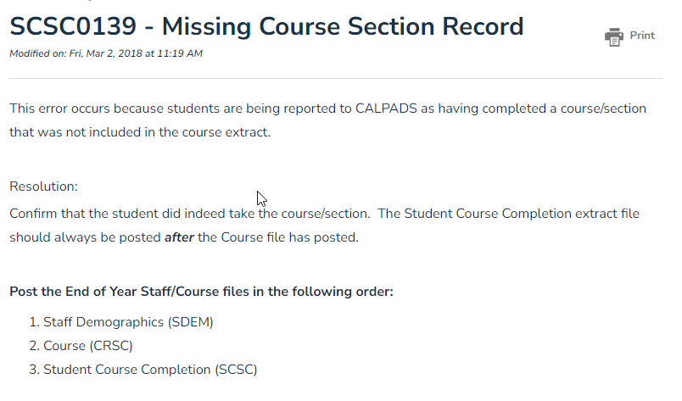
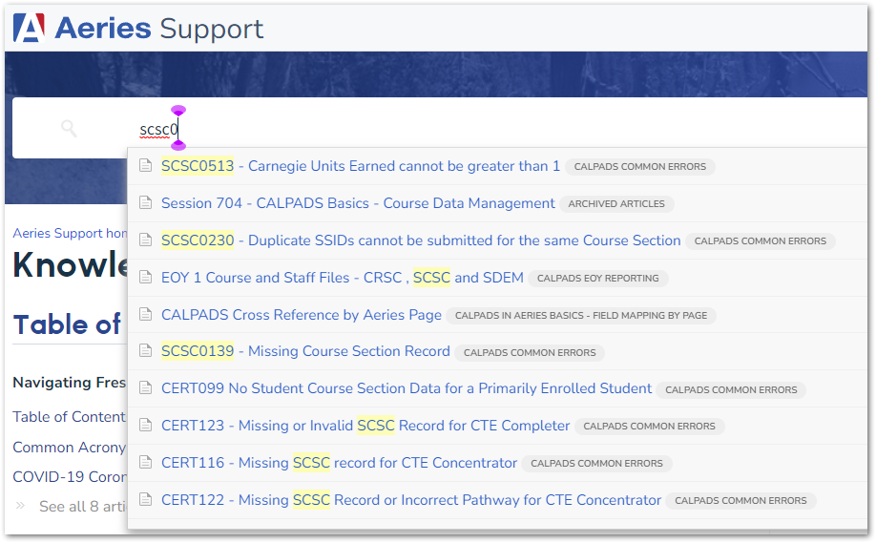
Question: The most difficult part of reporting is not knowing how to clear the errors. I have a difficult time knowing when and what files to re-upload to clear the errors. If you could make mention of those steps to help clear errors, that would really help me.
Our Support Knowledge Base has lots of great information on the CALPADS errors and what to look for to resolve it.

Slide 8
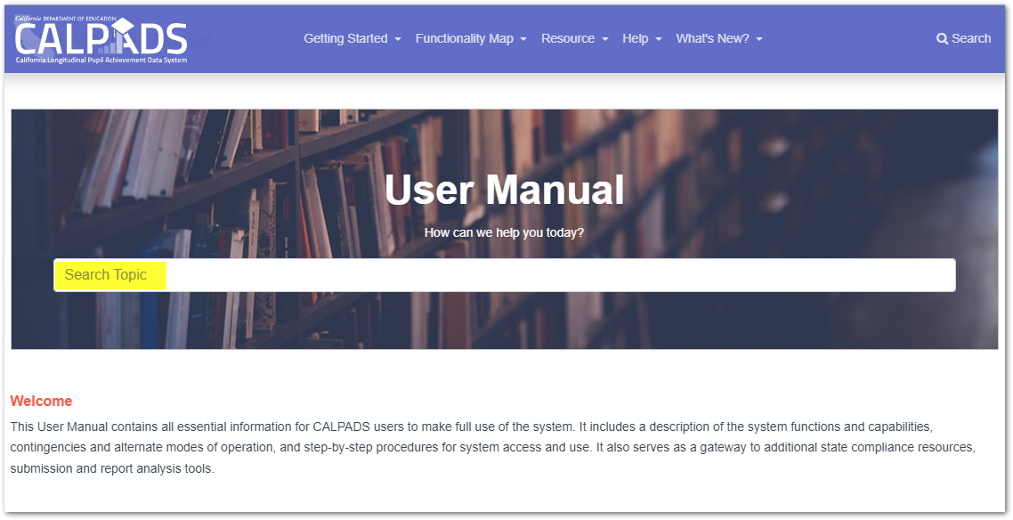
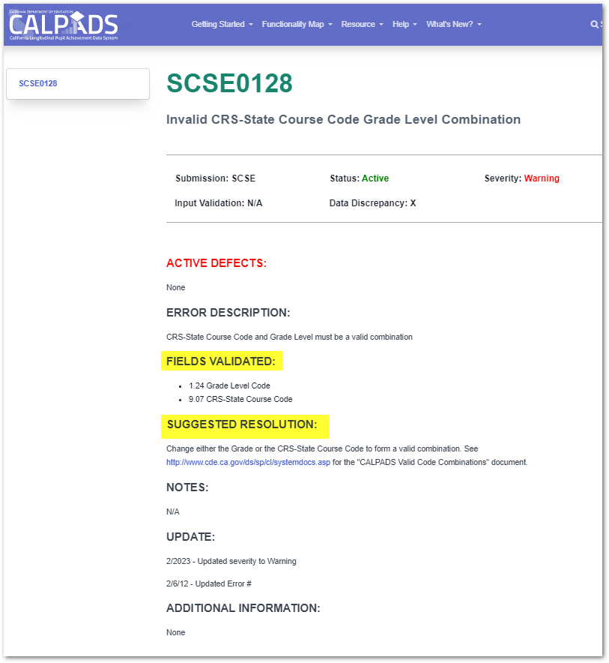
?
CALPADS User Manual: https://documentation.calpads.org/

Slide 9
Question: Can you please walk us through how to mark a suspension that becomes an expulsion. Also, when another school back dates their primary enrollment start date once it hits the 30 day mark, creating a CCE anomaly.

Slide 10
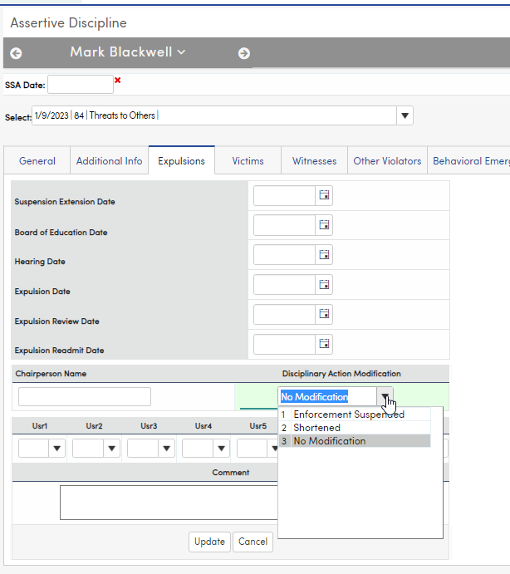
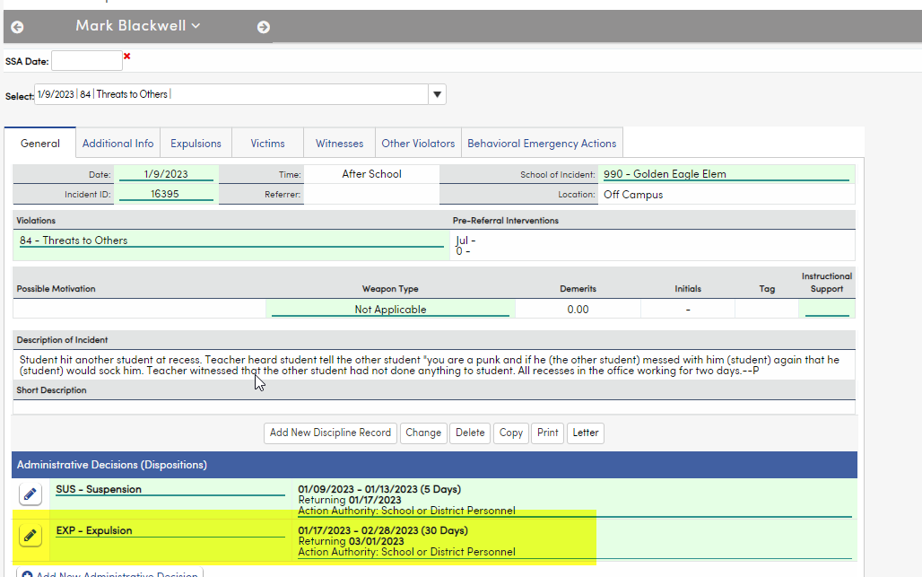
When a Suspension becomes an Expulsion, you need to add an Administrative Decision for the Expulsion and fill out the data on the Expulsion tab. Please note: The only field on the Expulsion tab that has to be filled in for CALPADS is the Modification field.

Slide 11
More Training Links:
FCMAT: https://csis.fcmat.org/calpads-support
CALPADS File Submissions: https://documentation.calpads.org/UploadViewSubmission/FileUpload/#replacement-processing
GMA CALPADS EOY Where Does the Data Go: https://support.aeries.com/support/solutions/articles/14000143374-calpads-eoy-where-does-the-data-go-6-1-2023

Slide 12
Wrap Up
Links:
504 Plans: https://support.aeries.com/support/solutions/articles/14000135653-504-plans-how-does-aeries-extract-504-plan-records-
CALPADS Documentation: https://www.cde.ca.gov/ds/sp/cl/systemdocs.asp
EOY Roadmap: https://documentation.calpads.org/Training/EOYPrimer/
EOY Training Video: https://youtu.be/7nfyL8hHF2I
File Upload: https://documentation.calpads.org/UploadViewSubmission/FileUpload/#replacement-processing
FCMAT: https://csis.fcmat.org/calpads-support
CALPADS File Submissions: https://documentation.calpads.org/UploadViewSubmission/FileUpload/#replacement-processing
Bridge Learning: https://learn.fcmat.org/learner/courses
GMA CALPADS EOY Where Does the Data Go: https://support.aeries.com/support/solutions/articles/14000143374-calpads-eoy-where-does-the-data-go-6-1-2023
CALPADS User Manual: https://documentation.calpads.org/
CALPADS Q&A Expulsion Days: https://www.cde.ca.gov/ds/sp/cl/calpadsfaqs.asp
Discipline Report in Aeries: https://support.aeries.com/support/solutions/articles/14000099631-suspension-attendance-listing-by-student-report
Notes:
From Customer: I had to look this up recently. It's on https://www.cde.ca.gov/ds/sp/cl/calpadsfaqs.asp under "How should the duration be determined for an expulsion? (Given that expulsions do not really have durations like suspensions, which have a specific number of days defined for which the student is not allowed to attend school.)"

Slide 13
Additional Links Aeries File Cross Reference: https://support.aeries.com/support/solutions/articles/14000100649-calpads-cross-reference-by-extract SCTE File Documentation: https://support.aeries.com/support/solutions/articles/14000082466-eoy-1-career-technical-education-file-scte Career Pathways: https://support.aeries.com/support/solutions/folders/14000115960 IMPORTANT Message from Aeries on closing out your EOY Programs: Certain program records must be closed out in the year they end (current year) or they will cause GERR0005 errors in the new year: Please check out the link below to see which records must be closed out yearly and during the current school year: https://support.aeries.com/support/solutions/articles/14000128136-sprg-faqs

