Slide 1
Good morning, Aeries!
Parent Data Confirmation – Part 3

Slide 2
Speaking today:
THERESA NICOLAOU | AERIES TRAINER
THERESAN@AERIES.COM
MODERATOR | LEENI MITCHELL

Slide 3
Good morning, Aeries!
Keep topics to 30 – 45 minutes
Show & Tell
Casual
Time for Q&A
PPT & Recordings Posted

Slide 4
WHAT IS THE ADL KIT?
Parent Data Confirmation
Office Staff Process
Once parents have completed the Parent Data Confirmation (PDC), staff will need to monitor who has completed the process.
This chat will discuss office staff procedures and will include a discussion of reports available and the process for survey responses.

Slide 5
NEED TO KNOW
Income Survey results need to be pulled from Query – no canned report Survey Audits need review to generate Program records Data Confirmation Status Report Options when parents unable to complete
Parent Data
Confirmation:
Part 3

Slide 6
NICE TO KNOW
Do not give permission if you are not using the surveys to PRS (Parent Response to Survey) Income Survey permission is FRE Query tag from report to distribute data
Parent Data
Confirmation:
Part 3

Slide 7
Security
Information Confirmation
Log (ICL) Staff
Parent Response
To Survey (PRS) Parent
Special Program (PGM) - Staff

Slide 8
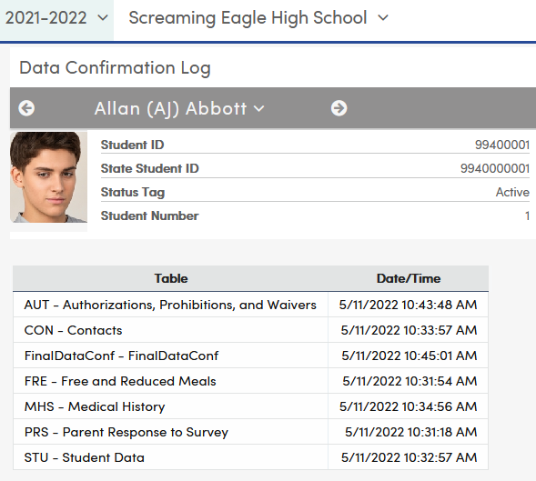
Data Confirmation Status Report
Only shows data for tables
Parent Portal group has
been given permission to
Data Confirmation Log
Displays results for an
Individual student

Slide 9
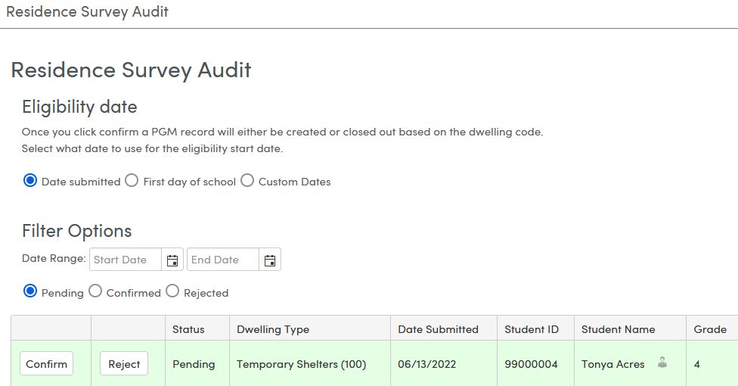
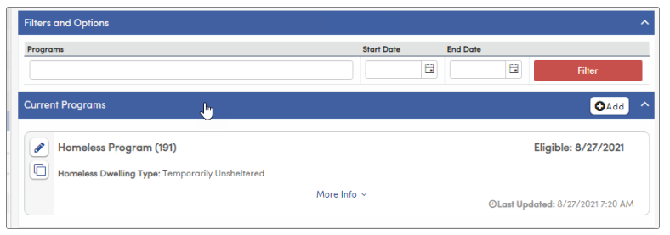
Residence Survey
Audit
Eligibility Date
Filter Options:
Date Range
Status
Warning if duplicate record

Slide 10
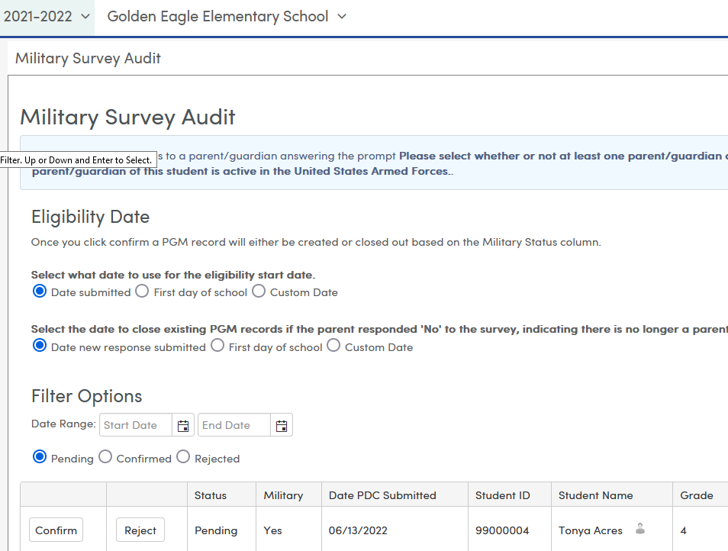
Military Survey Audit
Eligibility Date:
Start Date/Exit Date
Filter Options:
Date Range Status

Slide 11
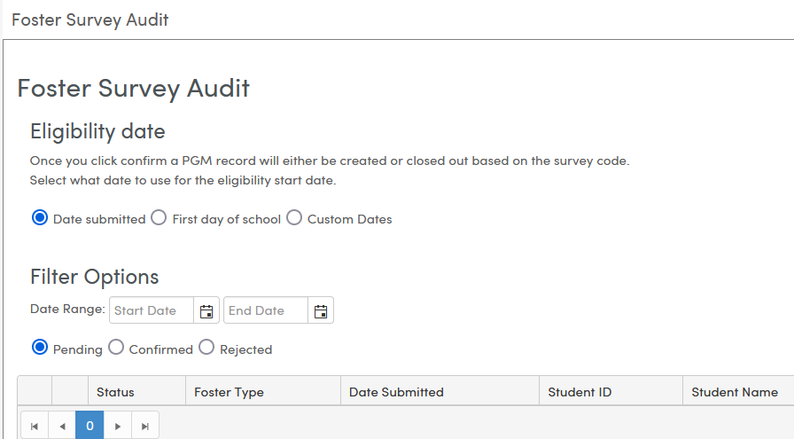
Foster Survey Audit
Eligibility Date
Filter Options:
Date Range Status

Slide 12
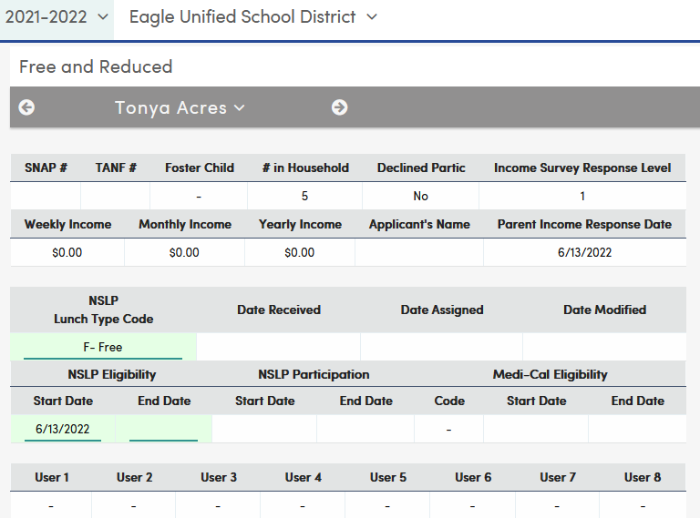
Income Survey
Automatically Generates
FRE Record

Slide 13
Income Survey Query
Pulls data from FRE records – replace with a date:
Run at District Level
Or
School Site Level
Pulls from PDC records:

Slide 14
Watch for more upcoming webinars!
Parent Data Confirmation – Part 4 – Portal Documents
Thursday, May 11 @ 9 am PST (11:00 am CST)
Did you know?
Monday, May 15 @ 9 am PST (11:00 am CST)

Slide 15
Thanks for joining us!
Where to Go
Data Confirmation Process for Office Staff
Aeries Demo Data
Parent Data Confirmation Videos
Good Morning, Aeries! Freshdesk Articles

Slide 16
We value your feedback!
Please take a few minutes to complete our survey and let us know how we can better serve you in the future! Have a great rest of your day.
Good-Morning-Aeries-Survey

