Slide 1
Speaking today:
PRESENTER | Sandy Madrid
Aeries Trainer
PRESENTER | Leeni Mitchell
Aeries Trainer

Slide 2
This webinar will identify the necessary programs that will need to be managed for the end of the year. We will focus on programs that relate to CALPADS reporting.

Slide 3
Demonstration of Program management areas in Aeries, including the SPRG process
Close or Not to Close...That is the question?

Slide 4
Programs Collected
Fall 1
Fall 2
End of Year
Code | Program | Type
181 | Free Meal Program | Federal
182 | Reduced-Priced Meal Program | Federal
127 | Gifted and Talented Education (GATE) | Federal
135 | Title I Part C Migrant | State
185 | Transitional Kindergarten | State
Code | Program | Type
300 | LIP - Developmental Bilingual Program | State
301 | LIP - Dual-Language Immersion Program | State
302 | LIP - Heritage or Indigenous Language | State
303 | LIP - Newcomer Program (Various Models) | State
304 | LIP - One-Way Immersion Program | State
305 | LIP - Structured English Immersion Program or other predominantly English Language Instructional Models | State
306 | LIP - Transitional Bilingual Program | State
Code | Program | Type
122 | Title I Part A Basic Targeted | Federal
174 | Title I Part A Neglected | Federal
191 | Homeless Program | Federal
192 | Armed Forces Family Member | Federal
101 | 504 Accommodation Plan | State
108 | Opportunity Program | State
113 | California Partnership Academy | State
162 | Pregnant or Parenting Programs (formerly Cal-SAFE) | State
185 | Transitional Kindergarten | State
NAME OF THE PRESENTATION
Student Program records should be regularly updated in CALPADS throughout the year regardless of the submission period.

Slide 5
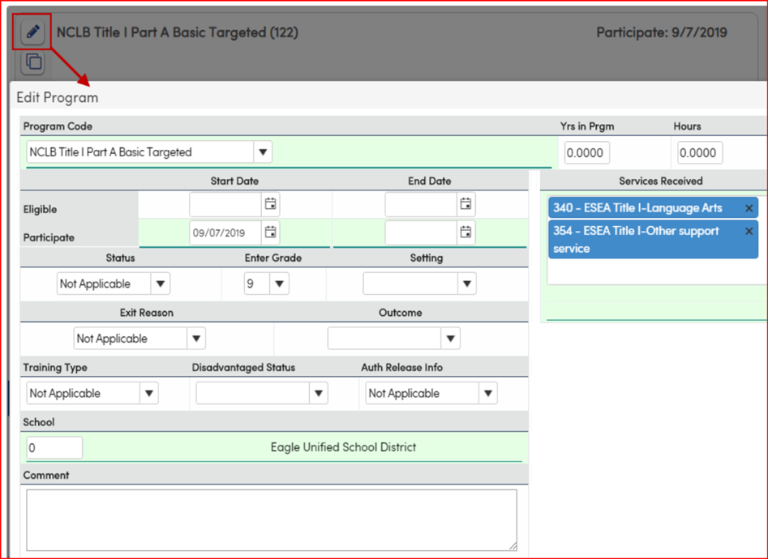
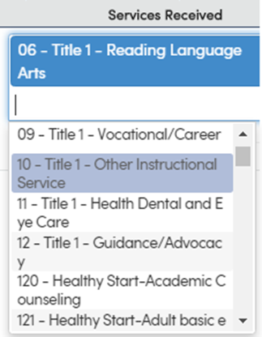
The Special Program (PGM) table contains the majority of CALPADS reportable student programs.
What does your Program Management Plan look like?
Do you communicate with all LEA offices on expected data management to help meet CALPADS reporting and reduce your error validations
Considerations for setting data maintenance standards for the year...
Coordinate data processes and procedures:
Who will enter the program data on the Special Programs Page – Identify the owner of this page
How will this data be maintained – Identify what validation looks like in your LEA
Student withdrawals and program end dates. Will you end-date upon withdrawal?
Note: Program Services are now stored in a new table: PGS. Existing data in the PGM.SR field has been converted to populate PGS. Existing queries utilizing the PGM.SR field will need to be revised.
You may consider populating School Zero in the School Field if you have high student movement between schools.
Link to full Program Chart Information:
https://support.aeries.com/support/solutions/articles/14000084898-sprg-calpads-special-programs-chart
Verify with Aeries Query and Reports
https://support.aeries.com/support/solutions/articles/14000081710-eoy2-program-queries-and-reports

Slide 6
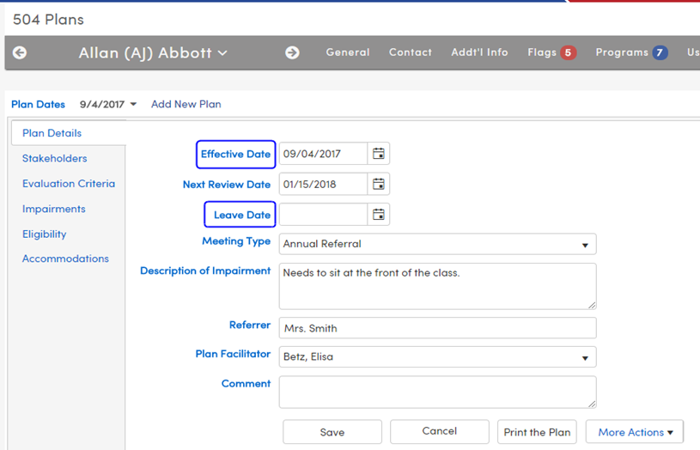
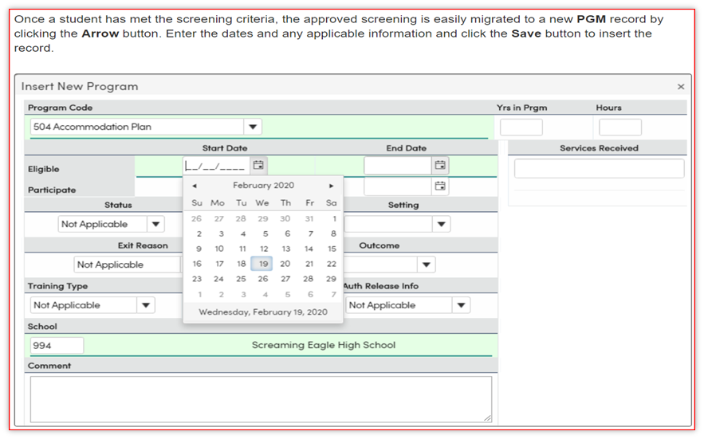
504 Program Data
The 504 Plan Area(FOF)
Special Programs (PGM)
Data entry can be entered on either table Per School…but should not be kept in both FOF and PGM to avoid potential of data errors
504 plan data is based upon Eligibility, you can define your Data Standards for your LEA to determine closing of program 504
Again… consider students who have withdrawn but are now back months or years from original enrollment.
What program data is being copied forward and is the program data still valid?
Close or not to close, as a student withdraws (this can also be from school A to school B withing the year)
Link: https://support.aeries.com/support/solutions/articles/14000070436-calpads-in-aeries-basics-504-plans
Link: https://support.aeries.com/support/solutions/articles/14000070397-calpads-in-aeries-basics-special-programs
https://support.aeries.com/support/solutions/articles/14000135653-504-plans-how-does-aeries-extract-504-plan-records-/preview

Slide 7
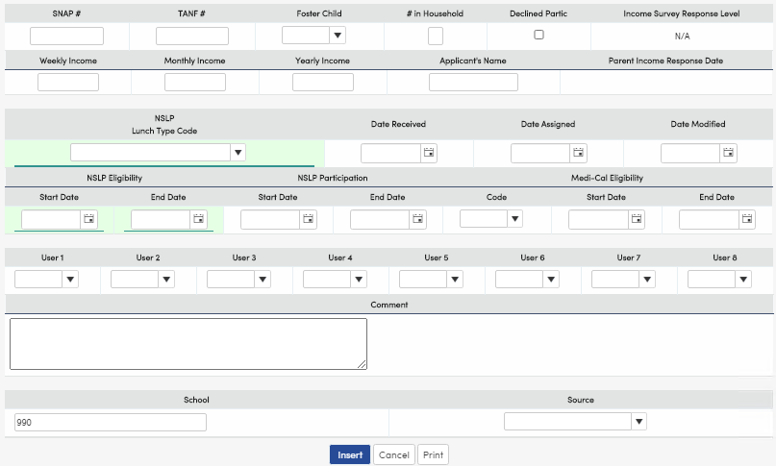
Free and Reduced (NSLP)
Entering the Free and Reduced Meals data below will create a Program record with a Code of 181 - Free or 182 - Reduced.
The highlighted CALPADS fields are the only required fields. All of the others are informational. Drop down values are stored in the Code table
For more information on managing this page reference following link:
https://support.aeries.com/support/solutions/articles/14000114405-free-and-reduced-meals
The FRE (NSLP/Free and Reduced Meals) table is a multi-record table and needs to be managed carefully. If there are multiple records for a student, you must have proper Start and End dates.
The Eligibility Date fields are required to extract in the SPRG Student Program file. Only FRE records with current year dates will be extracted. FRE records without any Eligibility Dates will not be extracted.
Aeries will auto-convert a code of F to 181 and a code of R to a 182 when reporting to CALPADS
No eligibility from Previous School Year is to be reported to CALPADS during the 30 day carry-over period to establish meal eligibility. Eligibility end dates should be populated for previous year’s records.

Slide 8
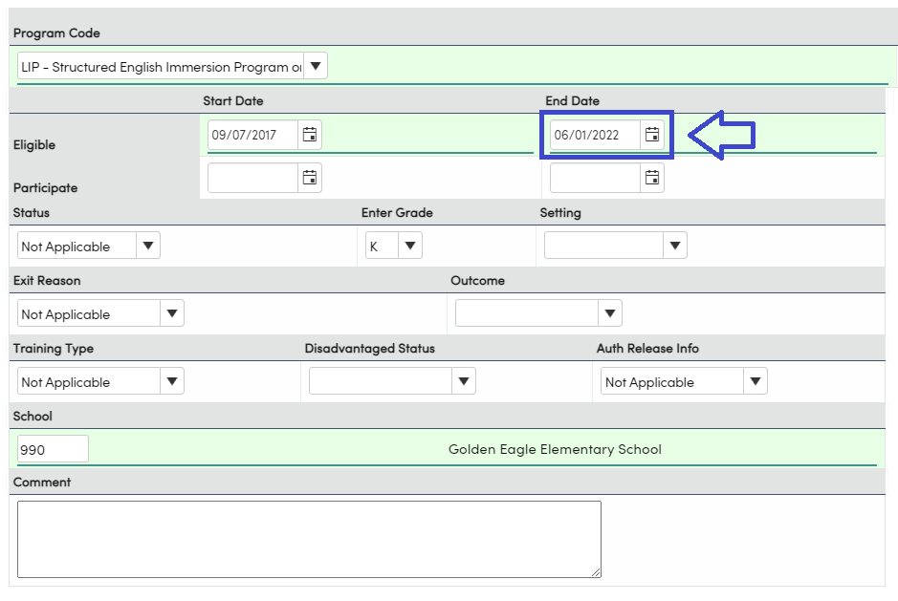
Closing LIP Program Records
Closing LIP Program Records for students that are Reclassified before the end of the year will prevent EOY CALPADS Errors

Slide 9
SPRG Reconcilliation
Per CALPADS, the SPRG ODS file is a snapshot as of 10:00pm the previous day.
Therefore, once the SPRG ODS file has been downloaded from CALPADS, we recommend that no modifications be made to enrollment or program data in Aeries or CALPADS until the SPRG Reconciliation process is complete.
Please keep in mind that since the SPRG ODS file is a snapshot as of 10:00pm the previous day, any enrollment update files (SENR, SINF and SPRG) that have been posted, need to be in complete status the previous day before downloading the SPRG ODS file.
NOTE: Extracting 10 years of records will ensure that all open and closed program records with membership dates on or in between the date range will be returned in the extract.
PROGRAM DATE NOTES
Participating Programs (Membership Category - 3) – Program dates will be extracted unless the program dates are out of the school enrollment ranges. If the program dates are out of the school enrollment ranges, the school enrollment dates will be extracted.
Eligibility (Membership Category - 1) – Program dates will be extracted.
The program start date can be before the enrollment date, but the end date has to be within the enrollment date range.
If the student’s school enrollment exit date is before the program date, the exit date will be extracted.
Eligibility programs can have overlapping records if the School of Attendance is different.
For FRE (NSLP/Free and Reduced Meals) - Only FRE records with current year dates will be extracted. FRE records without any Eligibility dates will not be extracted.
https://support.aeries.com/support/solutions/articles/14000082206-calpads-extracts-sprg-ods-reconciliation

Slide 10
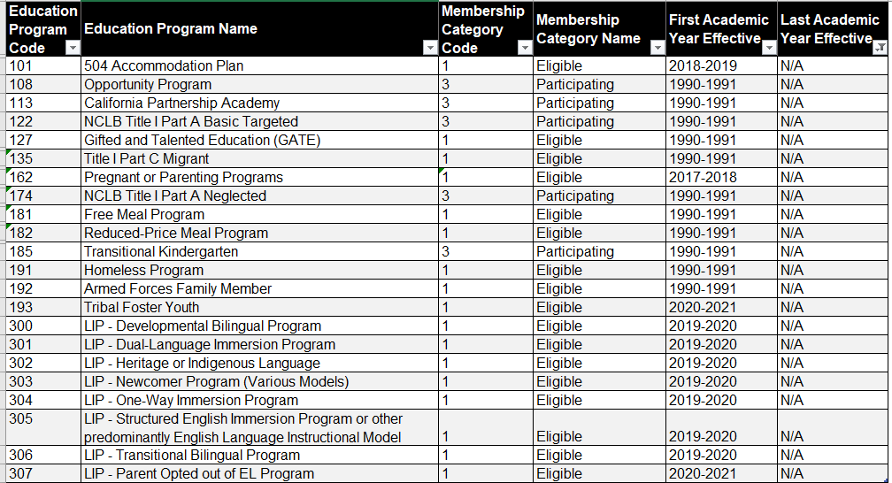
Nice to Know
Maybe a Need to Know
Program
Categories

Slide 11
Upcoming GMA sessions
Graduation/College
Readiness Dashboard
Career Pathway Management
https://aeries.com/events/
Dual Enrollment
Transcript

Slide 12
Thanks for joining us!
Info and links
Aeries support documents:
https://support.aeries.com/support/solutions/folders/14000116075
CALPADS support documents
https://documentation.calpads.org/
Survey link:
Good-Morning-Aeries-Survey
Aeries Events Calendar
https://aeries.com/events/

