Slide 1
Good morning, Aeries!
Grade Reporting Process Dashboard - Secondary
A discussion of the various forms and reports that can be accessed through Grade Reporting in Aeries focusing on Grades for Secondary schools.

Slide 2
Speaking today:
Presenter – Terry Scott | Aeries Trainer
terrys@aeries.com
Moderator – Jaime Perez | Aeries Trainer
Moderator – Leeni Mitchell | Aeries Trainer

Slide 3
Good morning, Aeries!
Short & sweet… only 30-45 minutes
Show & Tell
Casual Setting
Time for Q&A
Power Point and Recordings Posted to Aeries Support Home Page

Slide 4
How to configure Valid Marks, including default gradebook Final Marks
The cyclical nature of the Grading Process by Term
How to configure Graduation Requirements
Need
To
Know
How to Print Report Cards – Report Card History

Slide 5
Using Grading Periods
How to configure Transcripts
Configuring for teacher “Grading Window”
Nice
To
Know

Slide 6
Quick Start Guide to Grade Reporting
Grade Reporting Overview and Setup
Grade Reporting Queries
Where To
Go

Slide 7
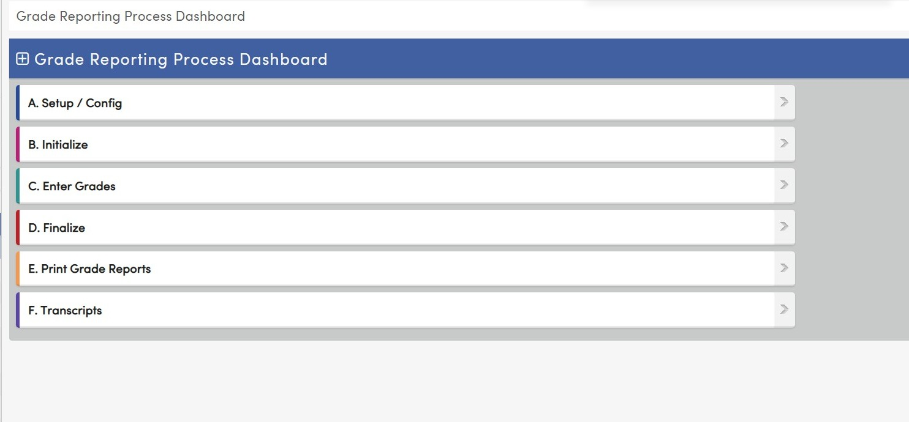
Grade Reporting Process Dashboard
A Sequential Checklist of functions and reports for Grade Reporting
Different from Standards Based Grades Process Dashboard

Slide 8
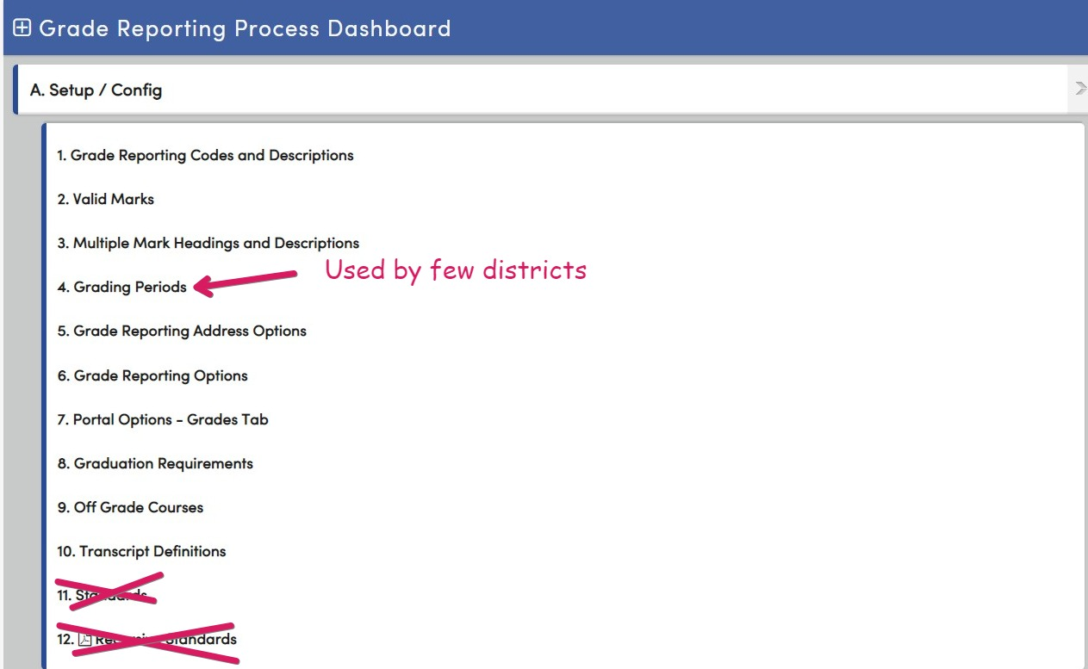
Configuring Grade Reporting
A to F type grading
Or
Secondary Standards Based Grade Reporting

Slide 9
Summary of steps in Grade Reporting, once setup is complete.

Slide 10
Upcoming - GOOD MORNING AERIES!
State Testing – Accommodations, State ID Cards Report, 1/25
Attendance Dashboard, 1/26
CALPADS Fall 2 - Q&A 1/31
Physical Fitness Testing, 4/1
Advanced Query, 2/2
Elementary w/MST Scheduling, 2/7
* For a complete list go to Good Morning, Aeries!
Watch for more GMA webinars!
Note: All webinars start @ 9 am PST/ 11 am CST and are 45 minutes.

Slide 11
Thanks for Joining Us!
We Value Your Feedback…
Please take a few minutes to complete our survey; let us know how we can better serve you in the future. Have a great rest of your day!
Good-Morning-Aeries-Survey

