Slide 1
Good morning, Aeries!
Custom Reports

Slide 2
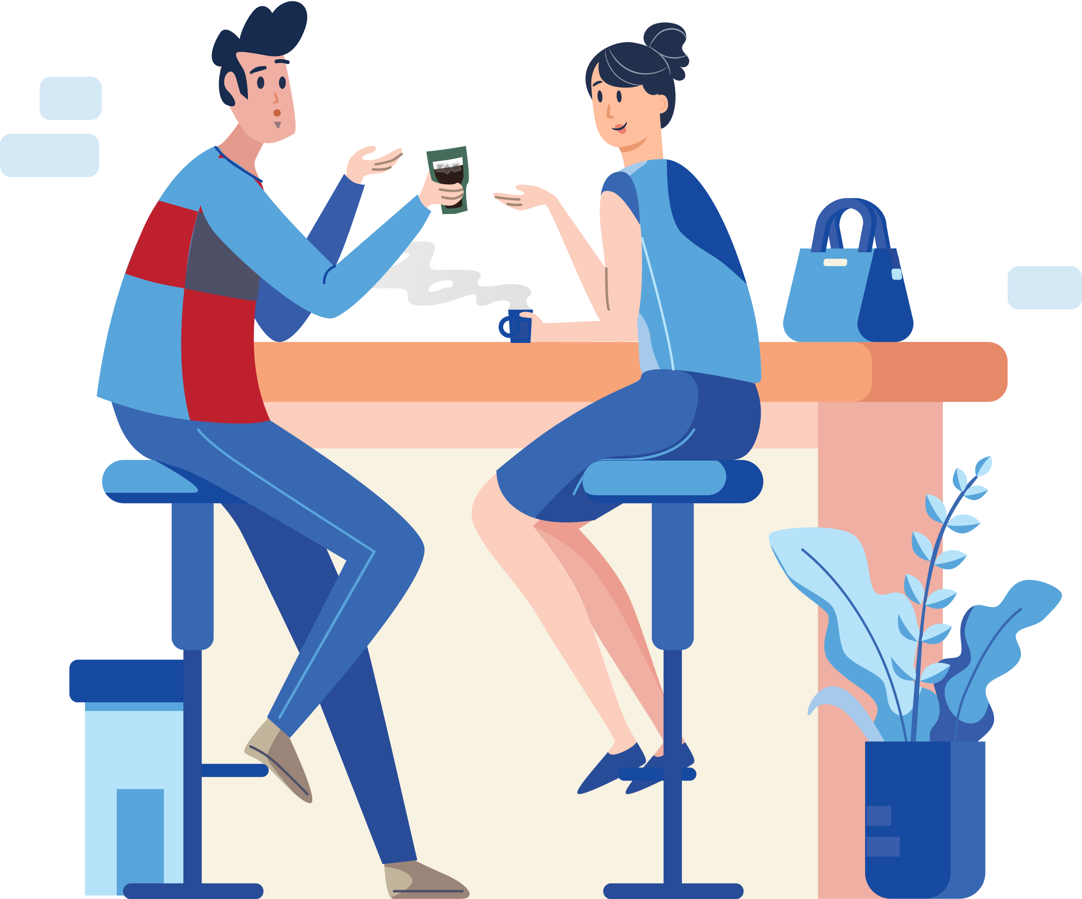
Speaking today:
Athina Firman | Training Specialist
athinaf@aeries.com
Moderators | Deb McConnell – Aeries Trainer

Slide 3
Good morning, Aeries!
Keep topics to 30-45 minutes
Show & Tell
Casual Setting
Time for Q&A
Power Point and Recordings Posted

Slide 4
Navigating to Custom Reports
Creating & Editing Custom Reports
Creating Custom Report Items
Printing Options for Custom Reports
Need
To
Know

Slide 5
How to add Color Layouts to Custom Reports
Security Settings for Custom Reports
Nice
To
Know

Slide 6
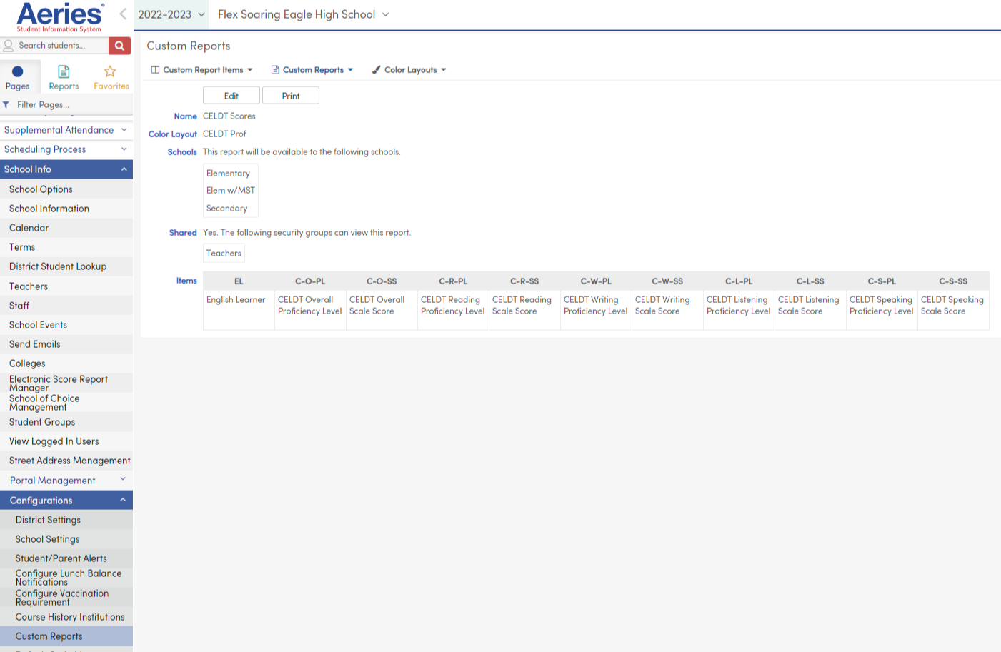
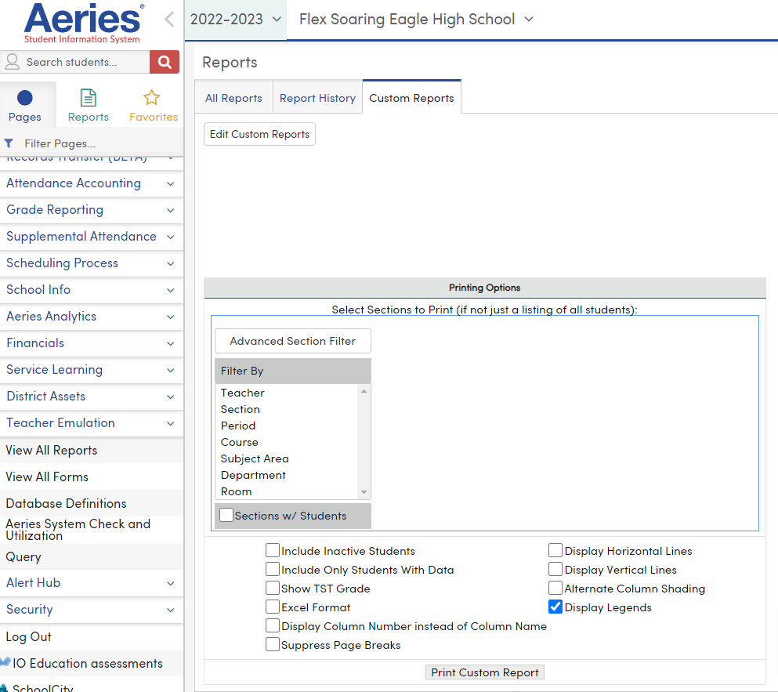
Navigating to Custom Reports
- From the Navigation Tree:
School Info
Configurations
Custom Reports
OR
View All Reports
Custom Reports Tab

Slide 7
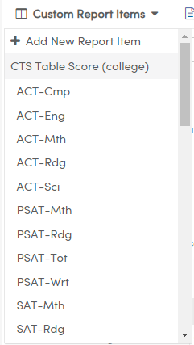
Creating Custom Report Items
Custom Report Items are a list of Tables and Fields.
If there is not the appropriate selection in the Available Items, you can create a new item by navigating to Custom Report Items – Add New Report Item

Slide 8
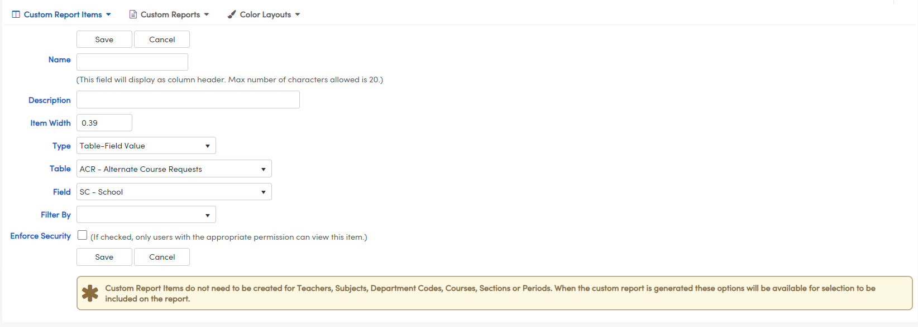
Creating Custom Report Items
Name (Column Header)
Description (Legend)
Item Width
Type
Table
Field
Filter By
Enforce Security

Slide 9
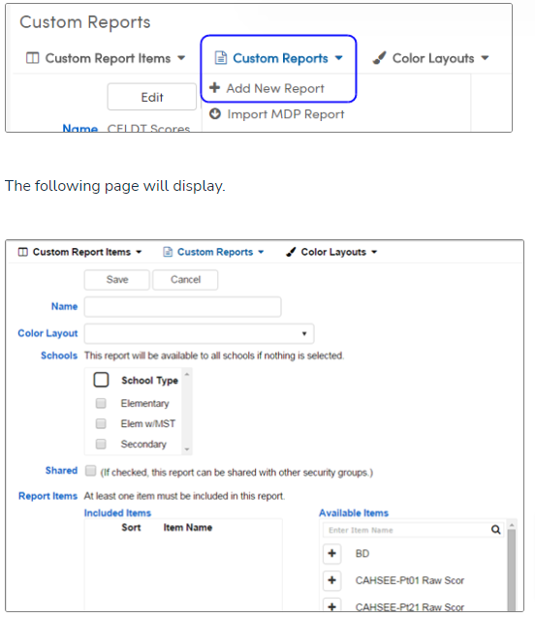
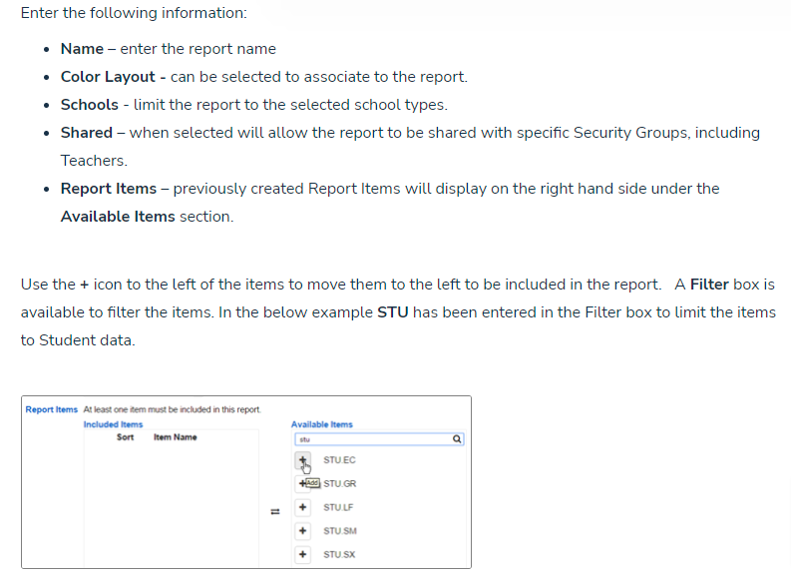
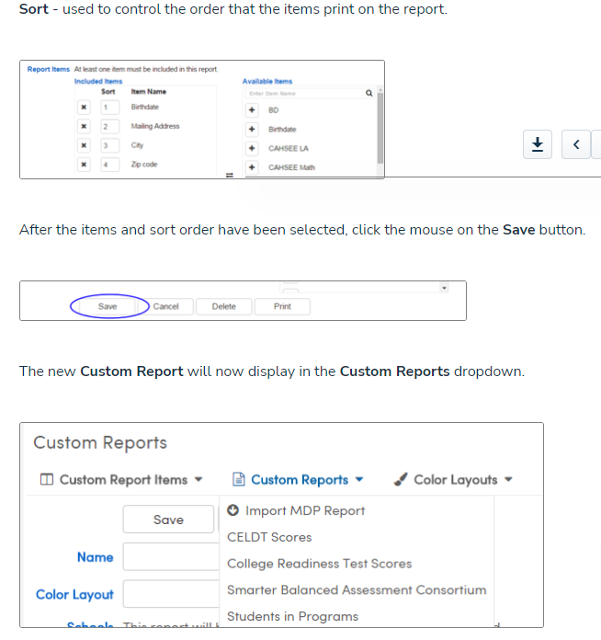
Creating & Editing Custom Reports

Slide 10
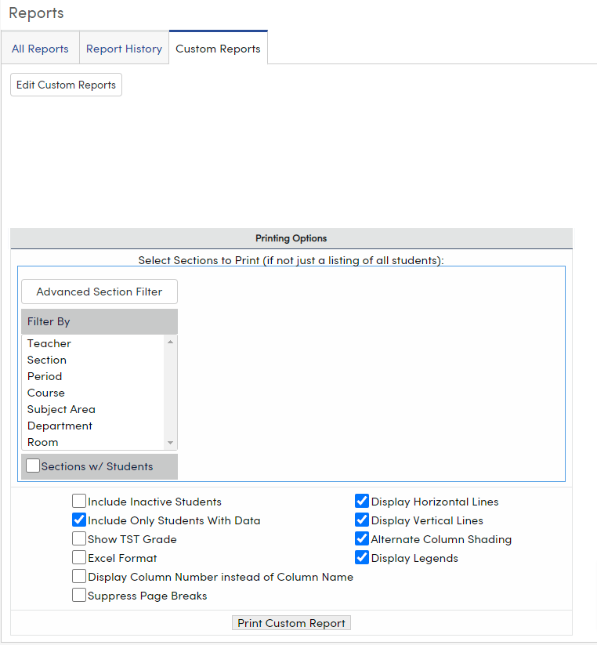
Printing Options for Custom Reports

Slide 11
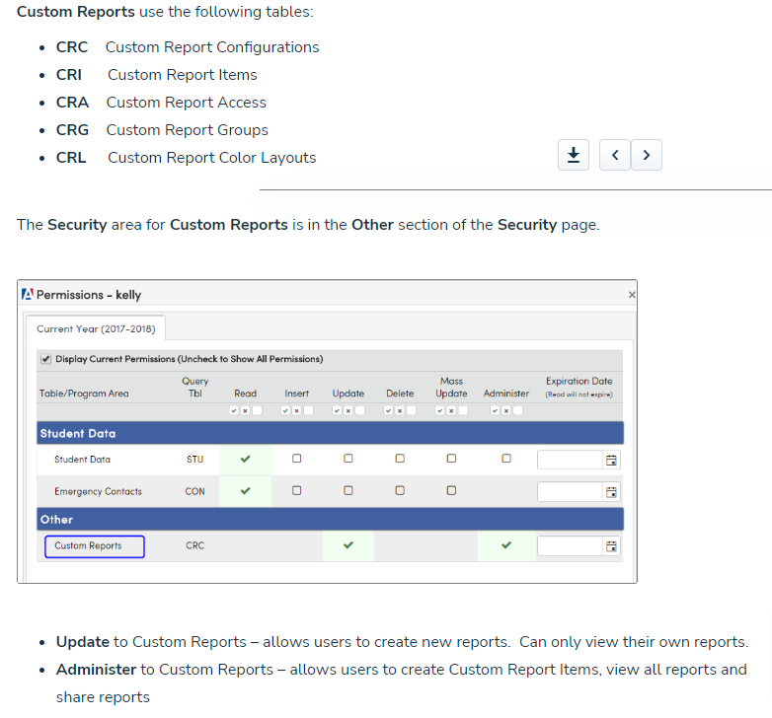
Security and Permissions for Custom Reports

Slide 12
Scheduling Process Dashboard
Setting up SMS
Class Link
Grade Reporting Process – GRD
State Testing – Accommodations
Attendance Dashboard
CALPADS Fall 2 Q & A
So Many More!!
Watch for more upcoming webinars!

Slide 13
We value your feedback!
Please take a few minutes to complete our survey and let us know how we can better serve you in the future! Have a great rest of your day.
Good-Morning-Aeries-Survey

Slide 14
Thanks for joining us!
Where to Go
Custom Reports Video Series
Custom Report Builder - Overview
Custom Report Builder – Tables and Security

