Slide 1
Good morning, Aeries!
Alternative Ed Scheduling

Slide 2
Speaking today:
Sandy Madrid | Aeries Trainer
sandy@aeries.com
Athina Firman | Aeries Training Specialist
athinaf@aeries.com

Slide 3
Alternative Ed Scheduling Is this right for your scheduling needs

Slide 4
Scheduling placeholder courses…
Will Teachers be allowed to issues grade marks, credits and post to Transcript

Slide 5
Let’s Start
Setup
School Settings
School Options Page
Courses

Slide 6
School Settings
Keep in mind the school setting to Alternative Ed Scheduling will need to be turned on before you start your School year. This is a per school setting.
If you are in an Alternative School, the likely setting will be for the Entire School to use the Alt Ed feature.
The logic of using this feature is to allow for the creation of placeholder courses to avoid the need to create a section of multiple courses that are needed to meet the students course recovery.
This setting can also be turned on for just individual sections when choosing not to turn this feature on for the entire school.
*You can only choose one setting or the other, both cannot be selected.
This will turn on the Alt Ed Sched field to enable individual section of the Master Schedule to contain a place holder course and actual course name be used

Slide 7
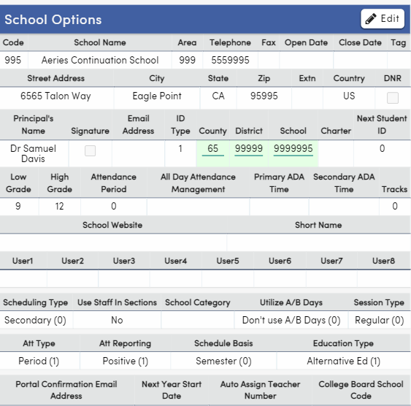
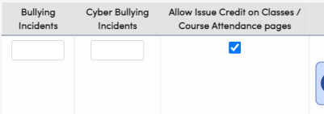
School Options
Attendance options
Continuation School of Period Attendance
Use Alt Ed Scheduling
Allow Issue Credit on Classes/Course Attendance pages

Slide 8
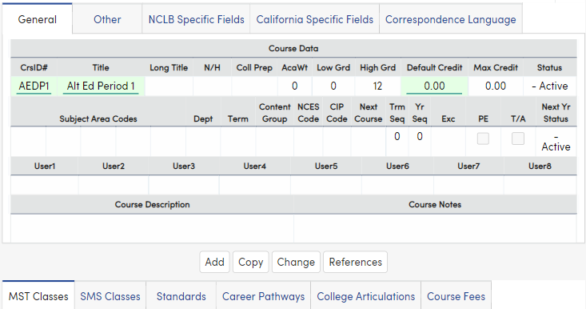
Courses
Create Placeholder Courses
These are just placeholder course so need to add any of the definitions
These courses will be added to the Master Schedule
Create Course Packets of the placeholder courses
With the packet created you can add the place holder courses quickly as student enroll in classes

Slide 9
Scheduling
Master Schedule
Class Schedule

Slide 10
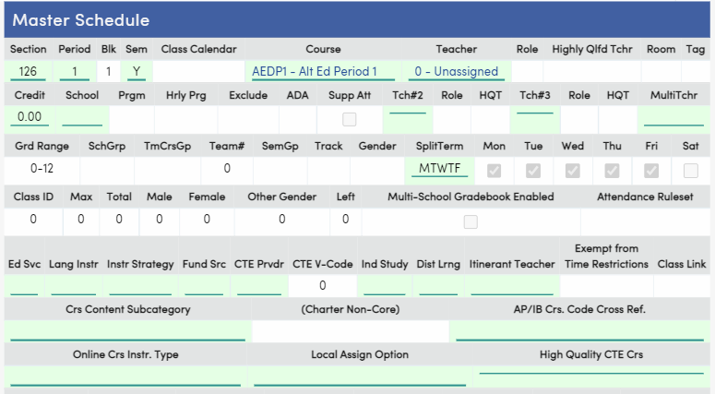
Master Schedule
Add the place holder courses to your Master Schedule and Teacher assignments.
The actual course name will be used in lieu of the placeholder name along with the attributes from the actual course for CALPADS reporting
Consider the Course Attributes of the following types of courses
Independent Study
CTE courses
Online Courses
Do you have courses that support these various attributes? If so, you do not have to create placeholder sections. If not, consider creating a placeholder for these types of instruction and set the attributes accordingly

Slide 11
Course Attributes for CALPADS reporting
Populate the appropriate fields for the section including the following fields:
Education Service - MST.ESR
Language Instruction - MST.LI
Instructional Strategy - MST.INS
Funding Source - MST.FS
CTE Provider - MST.TEP
Independent Study - MST.ISI
Distance Learning - MST.DLI
NOTE: If any of the section information does not apply to all students in the section, separate sections may need to be created. Ex: Several sections may need to be created for different Education Service codes for CALPADS reporting.

Slide 12
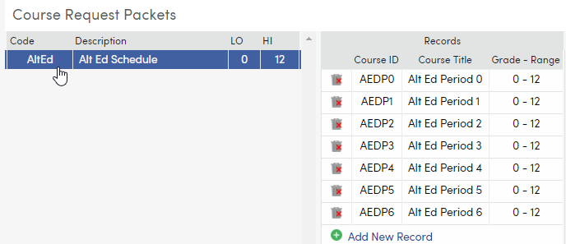
Course Packets
A way to quickly add the placeholder set of courses to a student if to create a Course Packet.
Create a Section for each teacher and each period in the school. If the school is using section staff, add the Staff to the section for each Alt Ed placeholder course created

Slide 13
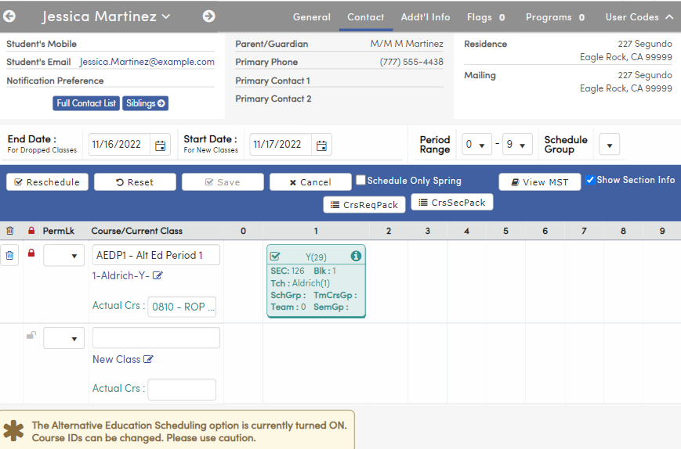
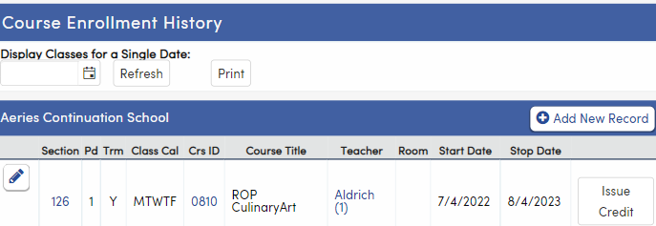
Class Schedule
Add the place holder course sections to schedule the students into classes. Use the “actual course” field to identify the correct course subject for that student for grades and credits.
The actual course name will be used in lieu of the placeholder course. Once again, the actual course attributes will be reported for CALPADS.
The Classes and Course Attendance (CAR) pages will reflect the correct Courses, Start Dates and End Dates. The student's schedule is complete.

Slide 14
Grades and Transcripts
School and Portal Options
Teacher Permissions

Slide 15
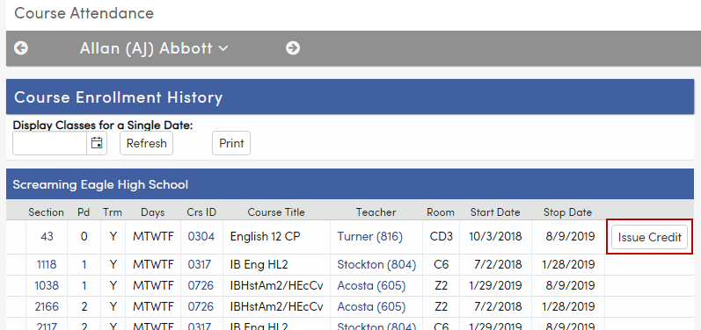
Grades/Transcripts
School options setting
Grading Reporting window needs to be open
If Grade Reporting at end of term, the normal process will update Transcripts
If Grade Reporting happens throughout the term, consider allowing for the Teacher to issue Grades and Credits
If you have traditional Grade Mark reporting times then you manage as you would regular grading.
Another consideration is allowing the Teacher to copy grades to the student transcripts. If doing so, the permissions will need to be updated for your teacher group

Slide 16
Thanks for joining us!
https://support.aeries.com/support/solutions/articles/14000091309-quick-start-guide-for-alt-ed-scheduling
Copying Grades and Transfer Credits for Individual Student
https://support.aeries.com/support/solutions/articles/14000092620-copying-grades-and-credits-to-transcripts-for-individual-students
Info and links
Shared links for more information aeries.com/aeriescon

