Slide 1
Good morning, Aeries!
Data Validation in Aeries

Slide 2
Speaking today:
Hannah Rhinebeck | DBA 1

Slide 3
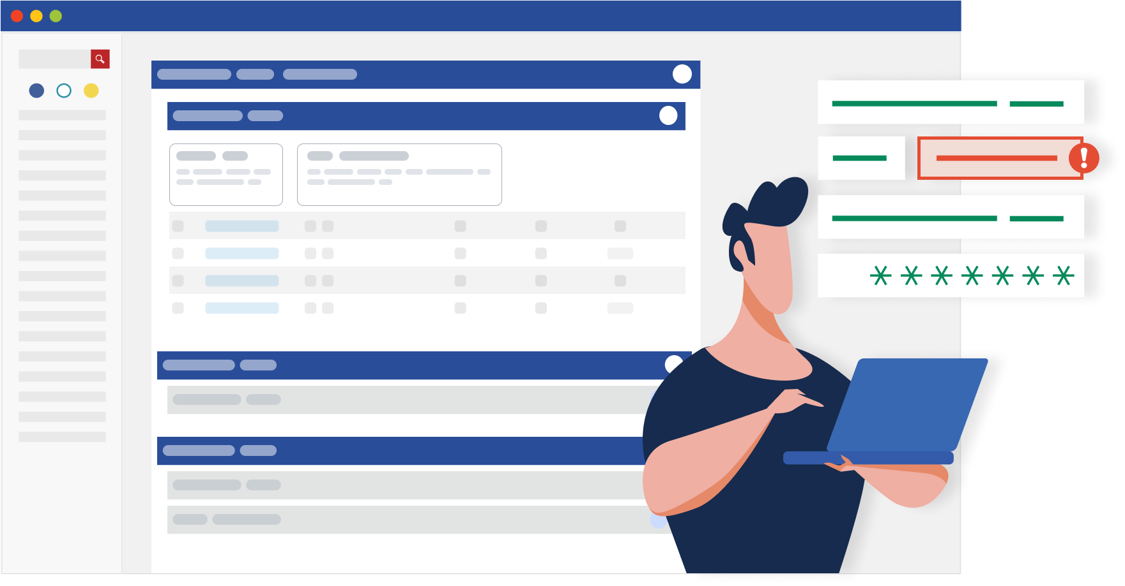
We all need good, usable data
Intro title
Sub-title of two lines or less

Slide 4
Data Validation Process
Data input validation
ensuring only properly formed data is entering the database
Post-input Validation
checking the accuracy and quality of data after it has been saved

Slide 5
Examples of Data Input Validation
Drop-down menus (both hard-coded and local) – an error message will appear if a value is entered in a field that does not appear in the dropdown
Data type field recognition – prevents the input of invalid characters in the field; for example, only numbers can be entered into date fields.

Slide 6
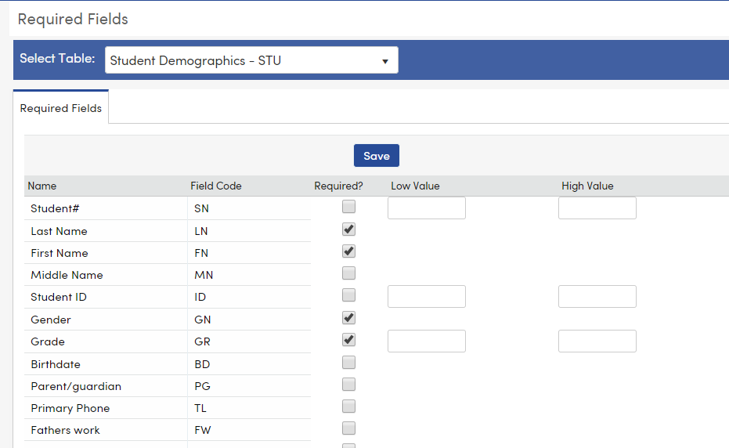
Examples of Data Input Validation
Define Required Fields
Mandate that certain fields be required in order to add or update a record
When a field is set as required, it will be highlighted in turquoise when in edit mode
Limited to specific tables

Slide 7
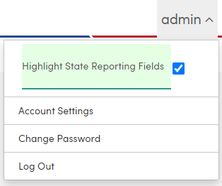
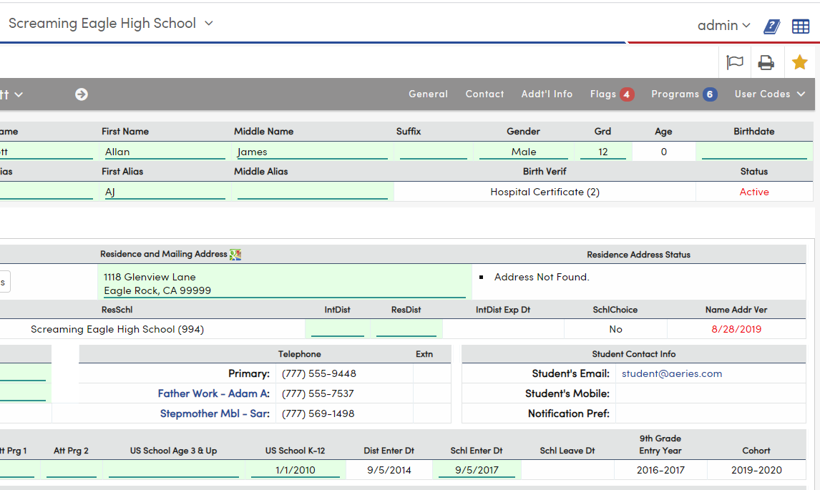
Data Input Validation
Highlight State Reporting Fields – when enabled, all fields that are extracted for state reporting will be highlighted in green

Slide 8
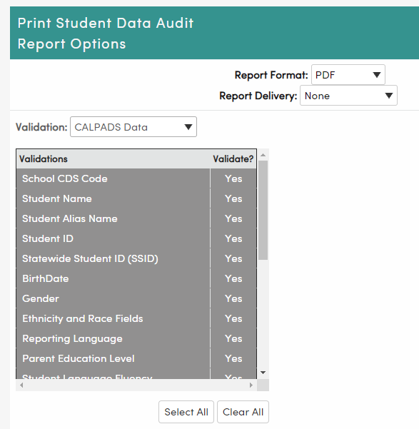
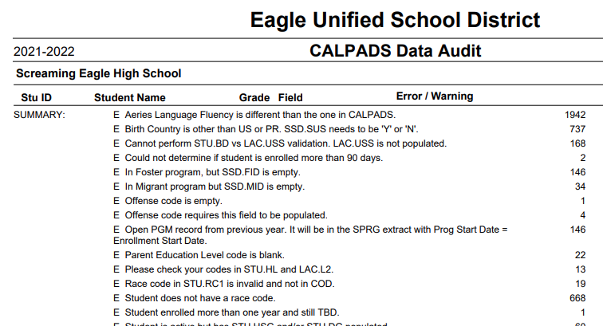
Post-Input Validation
Reports – many reports in Aeries help find data inconsistencies
Aeries Query – create and customize queries to identify bad data in any table
SQL Query – create and customize queries, including those that are too complex for Aeries Query

Slide 9
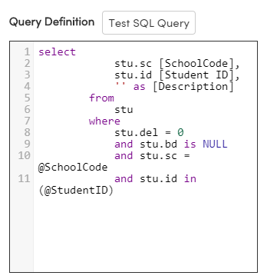
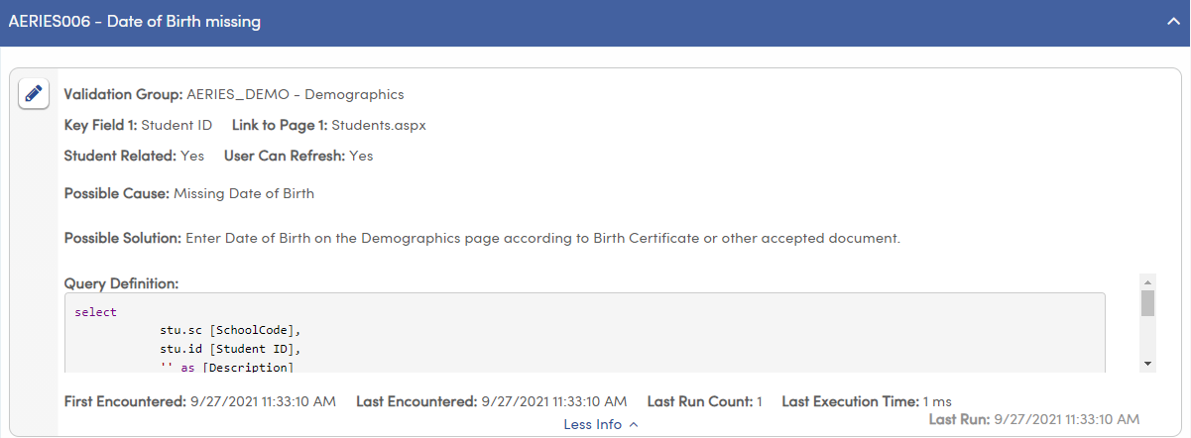
Post-Input Validation – Data Validation
Define rules for any criteria that are run automatically or on demand, and report data anomalies to the appropriate staff
Run SQL queries within the Aeries interface and generate a user-friendly list of results

Slide 10
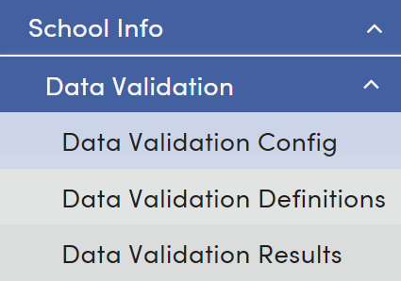
Post-Input Validation – Data Validation
Data Validations can be found in the School Info category and contains 3 pages:
Data Validation Config
Data Validation Definitions
Data Validation Results

Slide 11
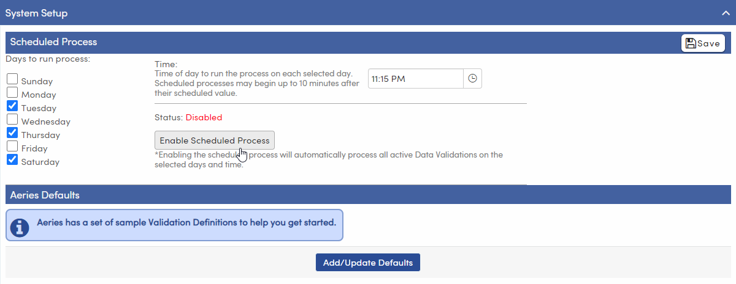
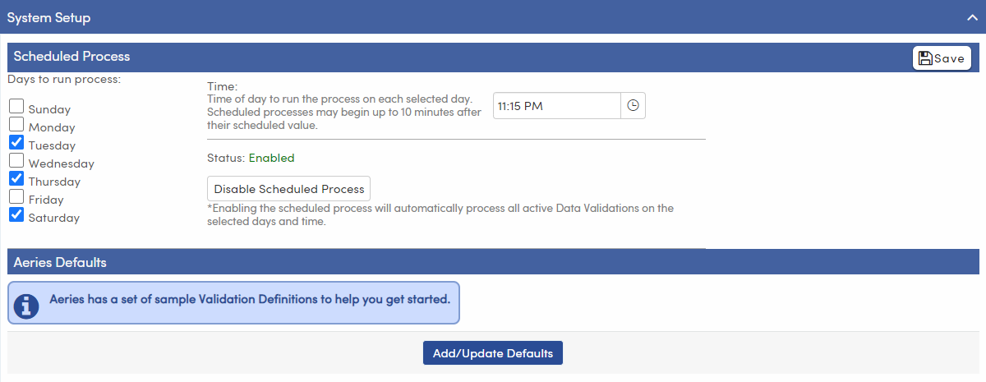
Data Validation Config – System Setup
Scheduled Process – select the start time and days at which the Data Validation process will run.

Slide 12
973-1 Intro to Data Validations
Data Validation Config – System Setup
Aeries Defaults – Click “Add/Update Defaults” to install the Aeries default validation definitions

Slide 13
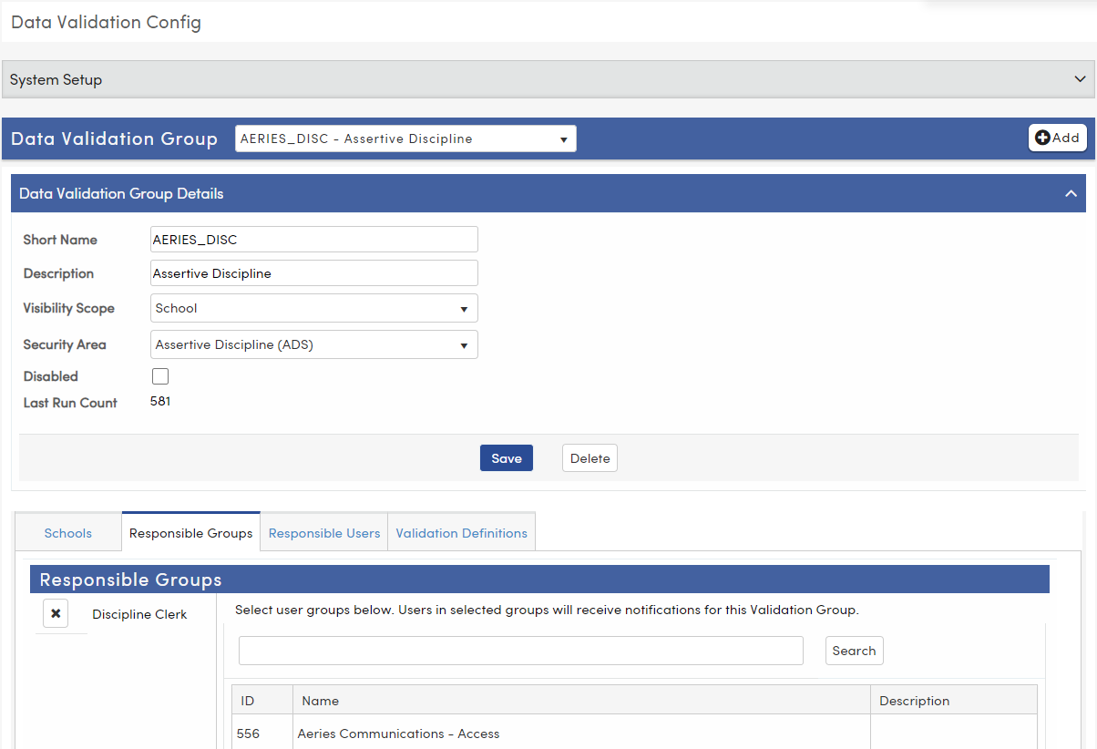
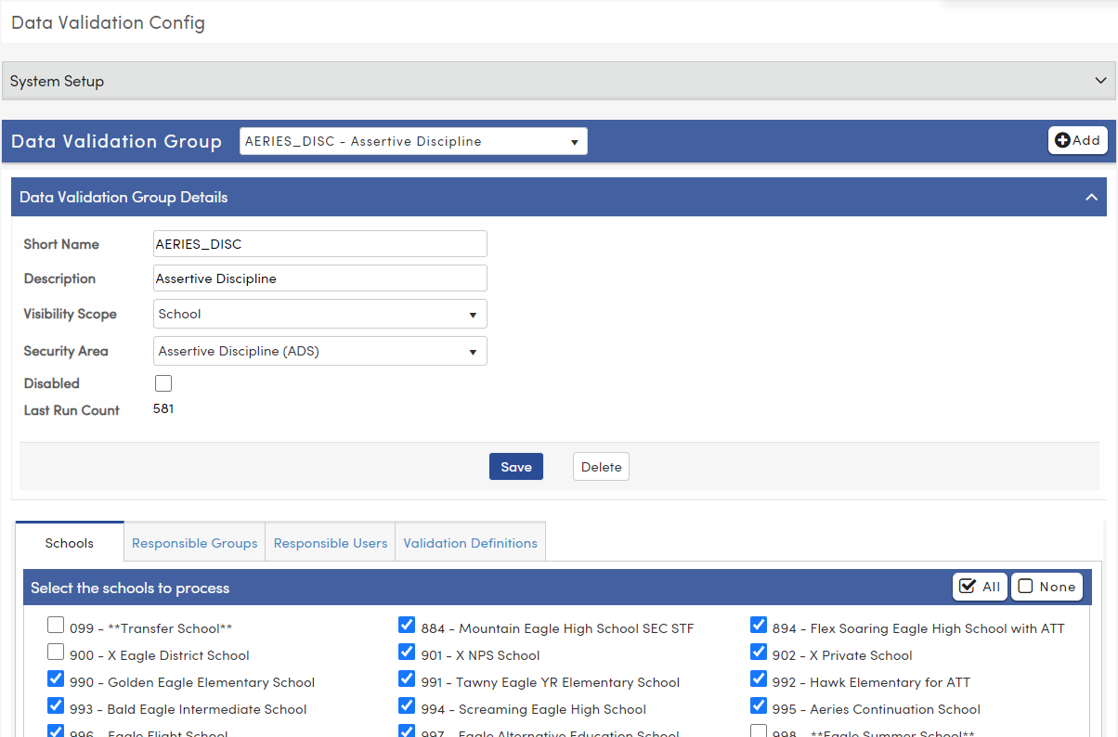
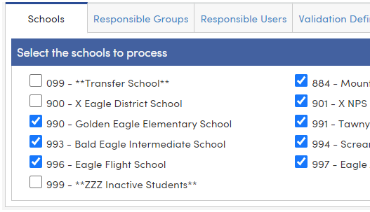
Data Validation Config – Data Validation Groups
Select Data Validation Group
Select schools where data validations in this group should be run
Select Responsible Groups/Users (from UGN)

Slide 14
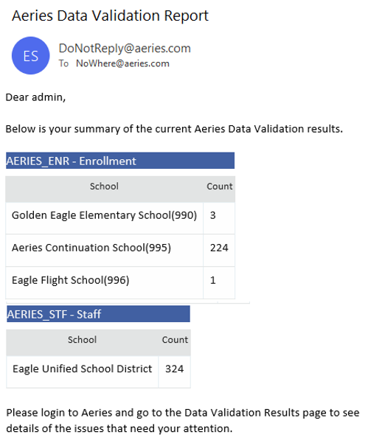
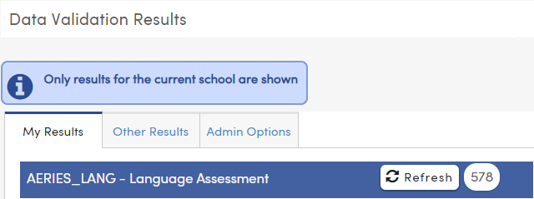
973-1 Intro to Data Validations
Data Validation Report
Each Data Validation Group’s responsible users will receive an email summary at the time specified in the scheduled process.
These results will display on the My Results tab on the results page
Users may be able to refresh their results

Slide 15
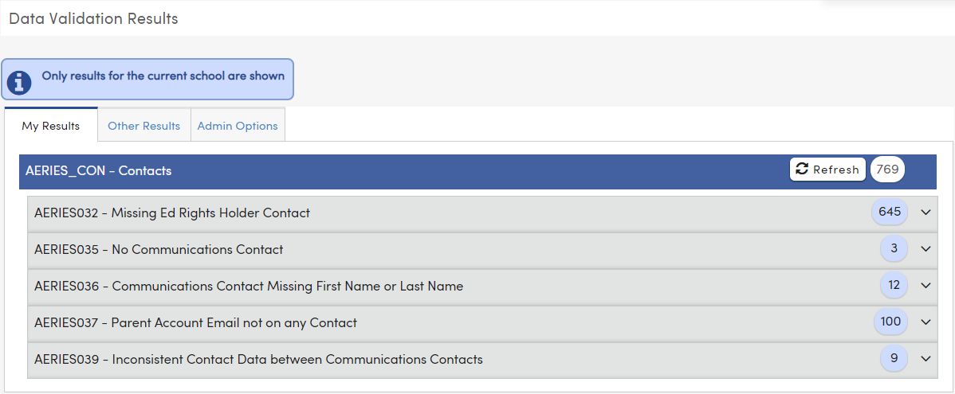
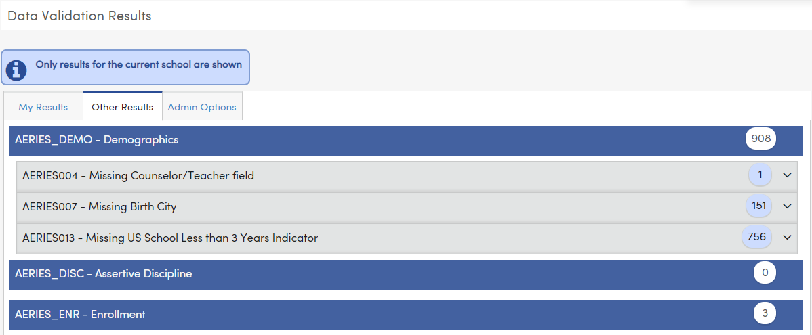
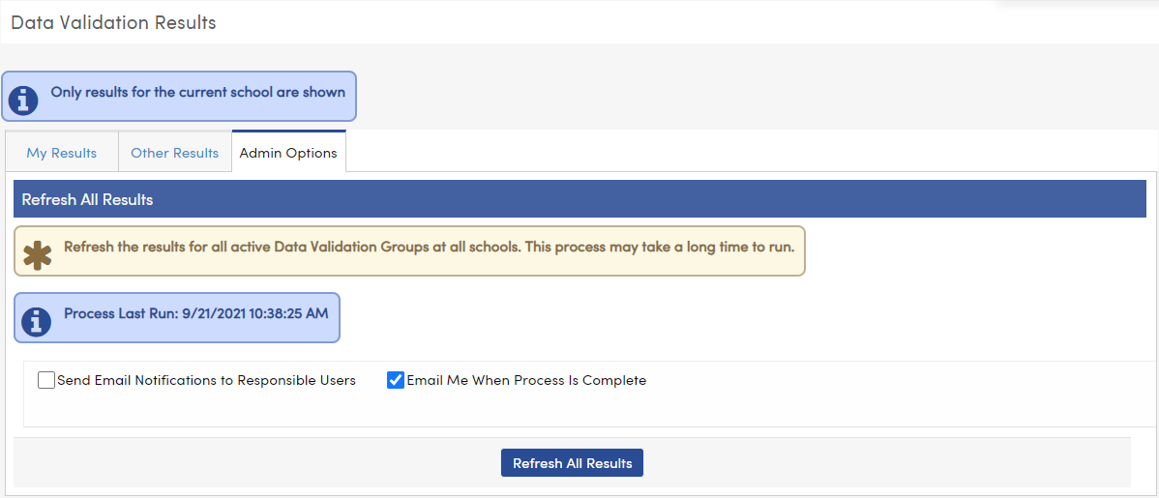
973-1 Intro to Data Validations
Data Validation Results
The Admin Options tab allows admin users to refresh the results on demand
The My Results tab displays the current user’s errors
The Other Results tab displays all other errors the current user has access to

Slide 16
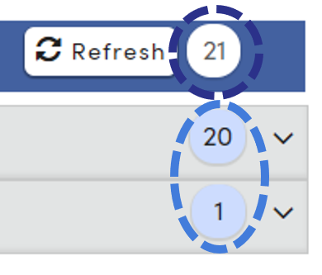
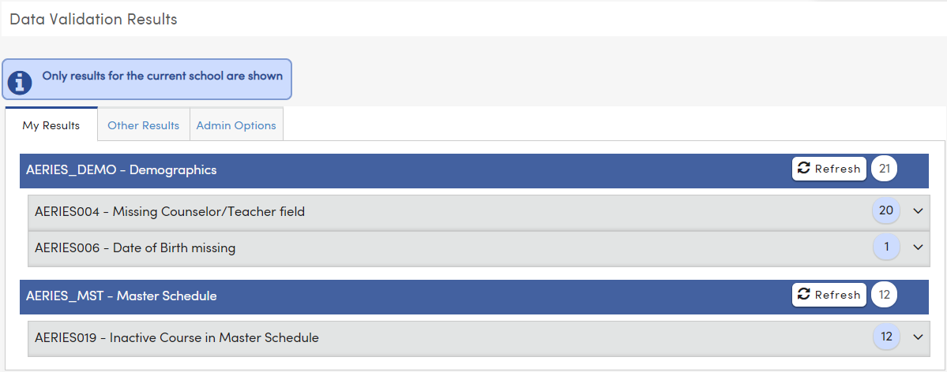
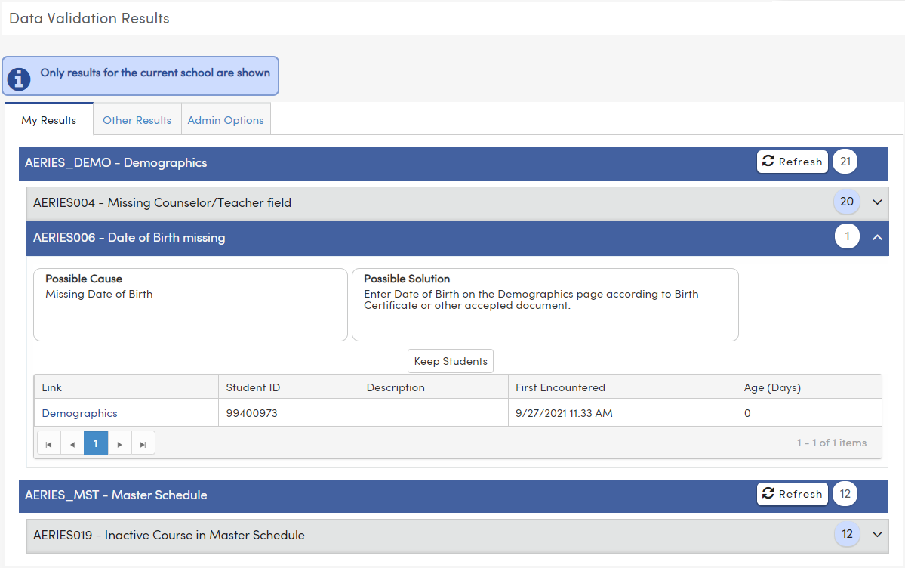
Data Validation Results
Results display by Validation Group
Number of results display by group & by individual rule
Click on any header to view details and resulting records
Click the link to be taken directly to the record that needs correcting

Slide 17
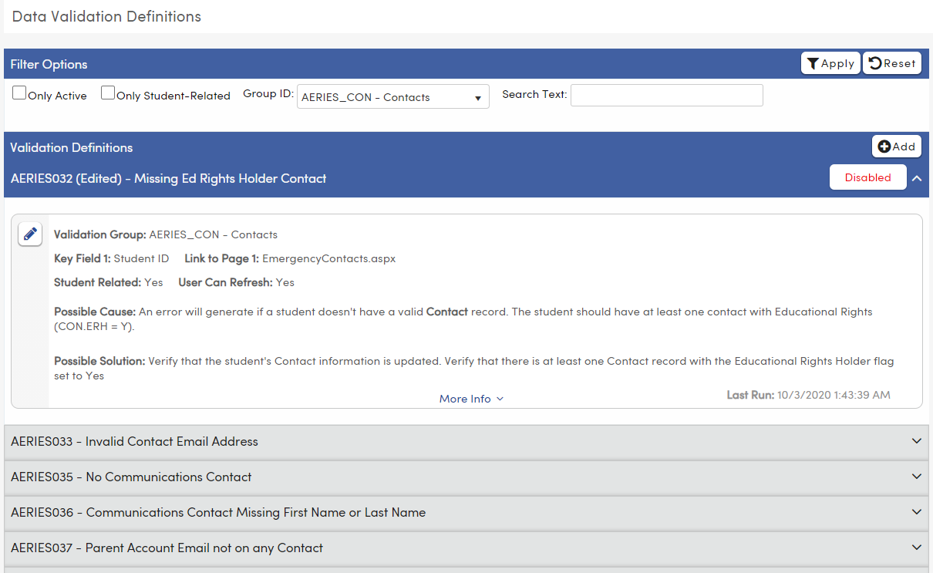
Data Validation Definitions
View and edit existing Data Validation Definitions
Create custom Data Validation Definitions
* Multi-factor authentication must be enabled to access this form.

Slide 18
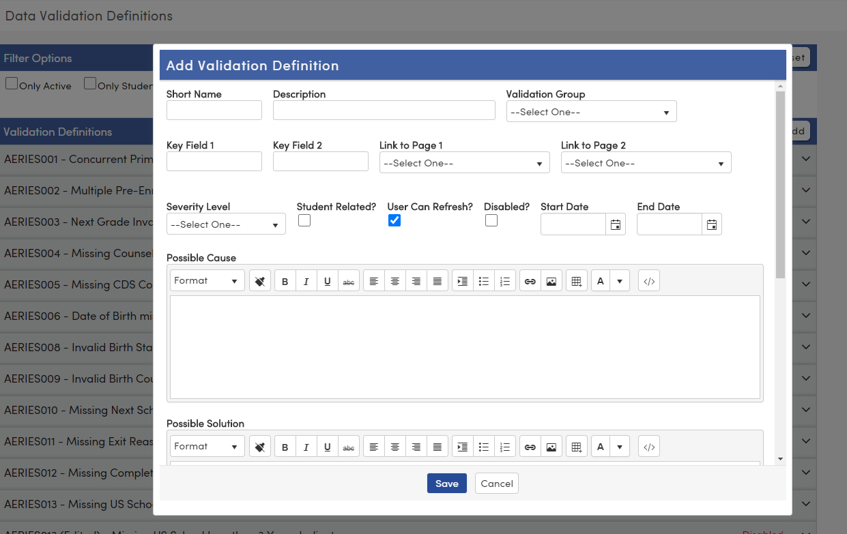
973-1 Intro to Data Validations
Data Validation Demo
Adding a custom data validation definition

Slide 19
Make sure they can be cleared
If your definition generates ‘errors’ that cannot be cleared, people will ignore them altogether
What makes a good definition?
Use Deep Linking
Many Aeries pages support “deep linking” to specific records. Make use of them to streamline data correction efforts.
Documentation
Be thorough in your descriptions of the problem and solution. Link to internal and/or Aeries documentation as appropriate.
Write Fast Queries
People love instant gratification. Write fast queries so that they can be allowed to “Refresh” their results immediately after correcting the errors. (< 200ms)

Slide 20
SQL Syntax Notes
@SchoolCode – This variable must appear in School-scoped definitions
@StudentID – For student-related definitions, this should be included somewhere in the WHERE clause.
District-scoped: will be replaced with “SELECT ID FROM STU WHERE DEL = 0”
School-scoped: will be replaced with “SELECT ID FROM STU WHERE DEL = 0 AND SC = @SchoolCode”
Key Field 1 – Required to be populated. The SQL output must contain a column with the same name. Key field 2 is optional, but if populated, a column with the same name must appear in the SQL output.
Description – SQL output is required to have a column named “Description”. This is used in the display on the results page.

Slide 21
Deep Linking
Using the “?”– when a “Query String Params:” text area shows up underneath a selected page, you can use deep linking to target the specific record needing attention

Slide 22
Questions?
Thank you!

