Slide 1
Good morning, Aeries!
Supplemental Attendance

Slide 2
Speaking today:
Athina Firman | Training Specialist
athinaf@aeries.com
Moderators | Theresa Nicolaou – Aeries Trainer

Slide 3
Good morning, Aeries!
Keep topics to 30-45 minutes
Show & Tell
Casual Setting
Time for Q&A
Power Point and Recordings Posted

Slide 4
What are some scenarios for using Supplemental Attendance
Supplemental Attendance User Securities
Supplemental Attendance Programs
Supplemental Attendance Sessions
Need
To
Know

Slide 5
Supplemental Attendance Teacher View
Supplemental Attendance Reports
Supplemental Attendance Configuration/Linking to Attendance
Nice
To
Know

Slide 6
Supplemental Attendance Scenarios:
After School Sports or Activities
CCLC
ASES
ASSETs
Tutoring Classes
Saturday School

Slide 7
Supplemental Attendance Overview:
Supplemental Attendance enables schools to track positive attendance programs in a negative attendance school
Sessions can be created in any type of school – High School, Elementary, Middle Schools and Continuation Schools with positive attendance
The session calendars are not tied to the school calendars. Saturday school and everyday tutoring sessions can be created
Attendance can be submitted in the Teacher Portal
Attendance can be scanned in using bar code scanners in Aeries or the Teacher Portal
Grade reporting is available for sessions. Teachers can give grades to students in their sessions. The grades will print on the secondary report cards (Not SBG)
Students can be in enrolled multiple sessions at one time
Student’s classroom attendance is completely separate from the Supplemental Attendance session attendance (Unless linked)

Slide 8
Supplemental Attendance Checklist
Define Security Permissions
Define Supplemental Attendance Codes
Create Supplemental Attendance Programs
Create Supplemental Attendance Sessions
Add Calendars
Link Staff to Sessions
Add Students to Sessions
Select Grade Reporting Options (Additional Steps Required)
Update Attendance Portal Options

Slide 9
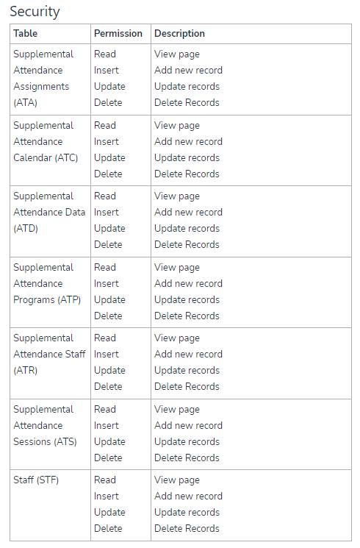
Supplemental Attendance User Security

Slide 10
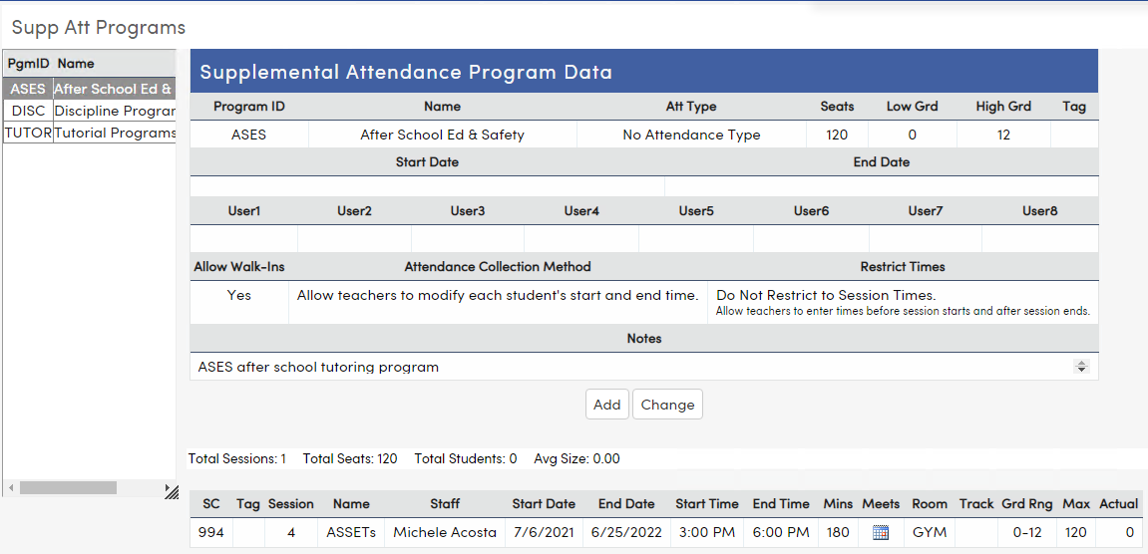
Supplemental Attendance Programs are District owned and include basic data and a few options. The options will apply to all sessions for the program.
To add a Program, use the Add button on the page. Enter all the program information and use the Insert button to save when completed.
Supplemental Attendance Programs (ATP)
Link to Aeries Support Document

Slide 11
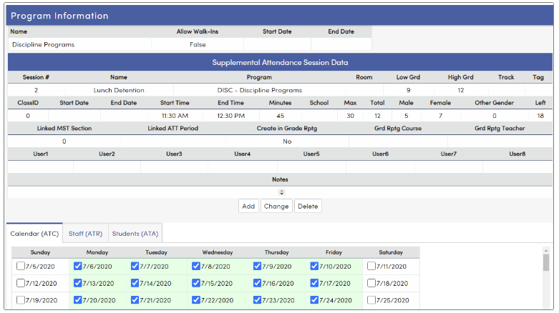
Supplemental Attendance Sessions (ATS)
The Supplemental Attendance Sessions are School owned and include more in-depth information including room assignment and session start and end times.
There are three tabs on the Sessions page for the Calendar(ATC), Staff(ATR) and Students(ATA).
This page also has a Print Supplemental Attendance Room Student Self Sign in Sheet that can be printed to allow for students to sign themselves into sessions.
Link to Aeries Support Document

Slide 12
Supplemental Attendance Audit Report
Supplemental Attendance Class List
Supplemental Attendance Class Roster
Supplemental Attendance Summary
CCLC/ASES and ASSETs Supplemental Attendance Report
Supplemental Attendance Sign in Scan Sheets
Supplemental Attendance Reports

Slide 13
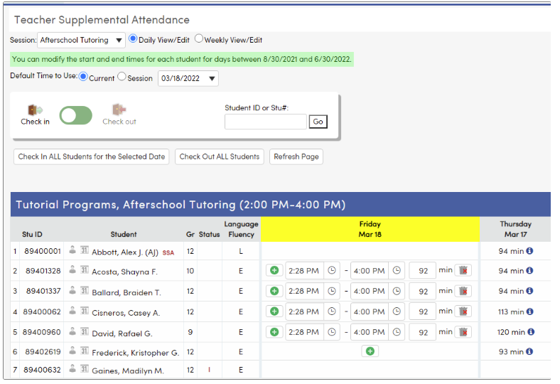
When the teachers log into the Teacher Portal, Supplemental Attendance will be listed in the navigation tree.
Two views are available for teachers – Daily View/Edit and Weekly View/Edit
Supplemental
Attendance Teacher View
Link to Aeries Support Document

Slide 14
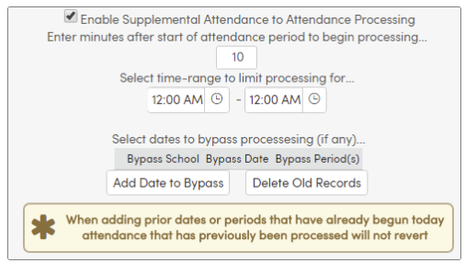
A scheduled process is available to keep period attendance data updated based on linked Supplemental Attendance data.
In some situations, it may be appropriate for Supplemental Attendance to link to regular period attendance.
Supplemental Attendance Configuration/ Linking Supplemental Attendance to Attendance
Link to Aeries Support Document

Slide 15
Intro to Analytics/LCAP Dashboards
Attendance Refresher
Set up SMS for Second Semester
Alternative Ed Scheduling
Intro to Transcripts
Transcript Processes
Texas Transcript Definitions
What I Wish I Knew on Day One…
So Many More!!
Good Morning Aeries Link
Watch for more upcoming webinars!

Slide 16
We value your feedback!
Please take a few minutes to complete our survey and let us know how we can better serve you in the future! Have a great rest of your day.
Good-Morning-Aeries-Survey

Slide 17
Thanks for joining us!
Aeries Demo Data
Aeries Academy
Supplemental Attendance Checklist
Supplemental Attendance Overview
Supplemental Attendance Configuration
Where to Go

