Slide 1
Good morning, Aeries!
Grade Reporting Process SBG
September 20,2022

Slide 2
Speaking today:
Elena Lohr | Customer Advocate
elena@aeries.com
Athina Firman | Training Specialist
athina@aeries.com

Slide 3
Good morning, Aeries!
Keep topics to 30-45 minutes
Show & Tell
Casual Setting
Time for Q&A
Power Point and Recordings Posted

Slide 4
Report Cards are for each Grade level – District Wide. Report Card Types are available for different types of students per Grade Level, for example Limited English Proficient or GATE
Proper Terms need to be set up – this will impact Updating SBG Attendance Totals.
Define your Terms 1,2,3 – School Options page
Verify Absence Codes – print on Grades
Canned Report – to verify missing Marks
Create the SBG Grading table and enter window dates into your Portal Options – Grades Tab
Portal Options/Gradebook Options will impact your Teachers
Support Standard Based Grade Reporting enabled – Portal Options. This will allow your Teachers to attach the Standard to the assignment
Once the Standards Based Grade Report table has been created and marks have been submitted, changes should not be made to the Standards or Report Card Set Up
Need
To
Know

Slide 5
SBG only – if you recreate the SBG Cycle a second time – you will not lose data.
Teachers may print out SBG Report Cards
Easy option to copy the current mark to SBG History
Update for just one Student
Review SBG Options – before you create Grading Cycle
Translations can be entered for the Standards, Mark Types, Valid Marks and Filler/Headers with text for up to 6 Correspondence Languages.
The Teacher Portal can also be used to enter grades. A Load From Gradebook process is available to teachers.
Nice
To
Know

Slide 6
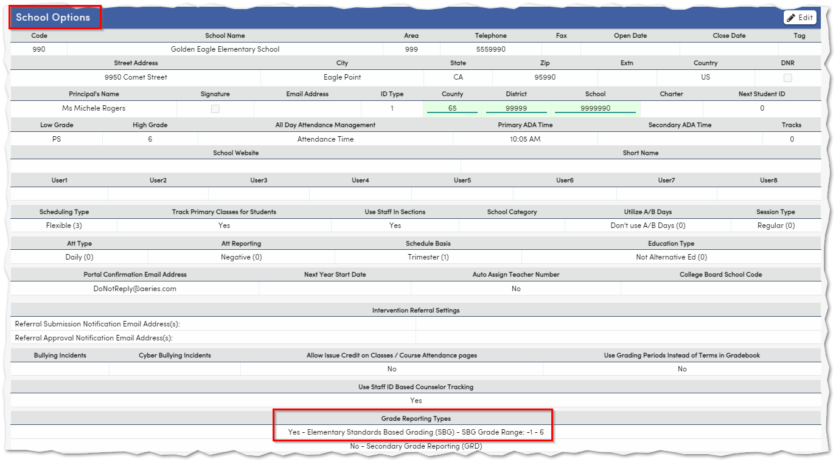
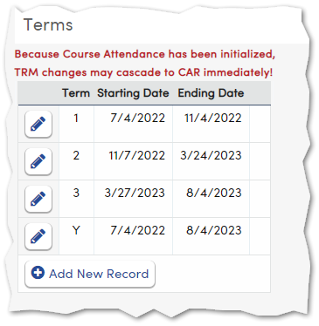
School Options & Terms
Key Fields

Slide 7
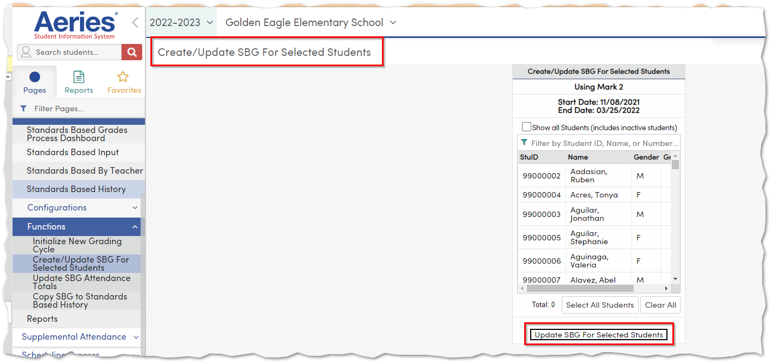
Initialize New Grading Cycle – School Wide
Option to Create for one or more Students
Email will be batched once the process has been completed

Slide 8
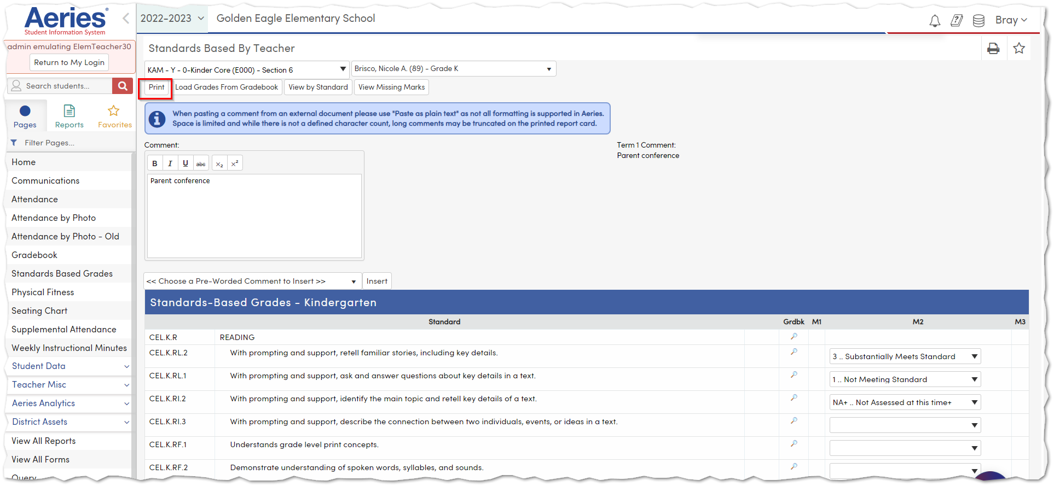
Portal Options
School Based
Populate Window Dates
Print Option enabled for Teachers
Support SBG Reporting – assignment

Slide 9
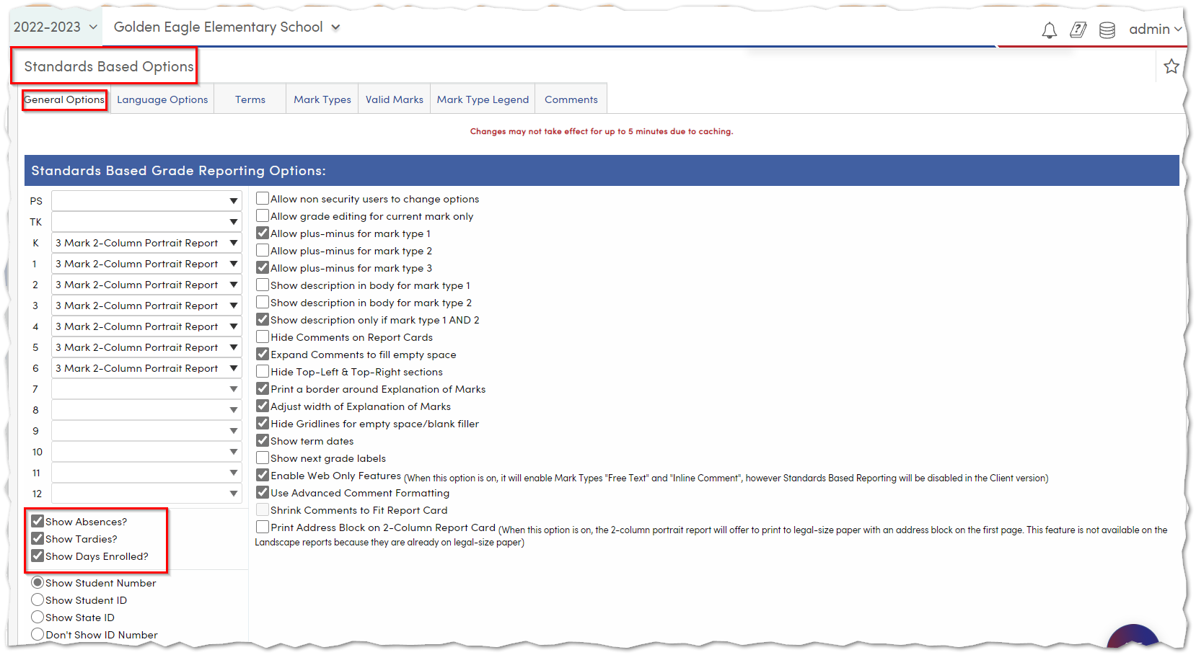
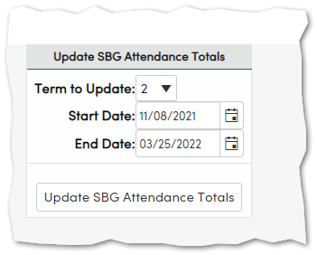
Standard Based Options
Options Enabled
Show Absences?
Show Tardies?
Show Days Enrolled?

Slide 10
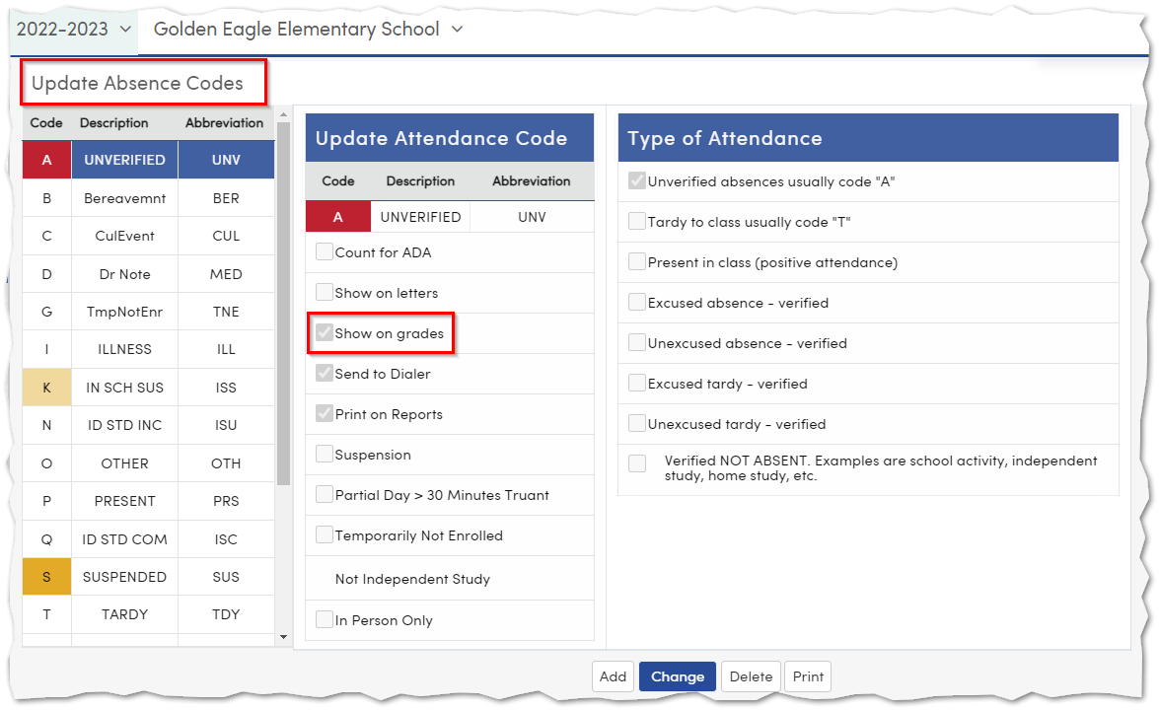
Absence Codes
Enable option to Show on grades
Defined codes will count towards the Absence totals

Slide 11
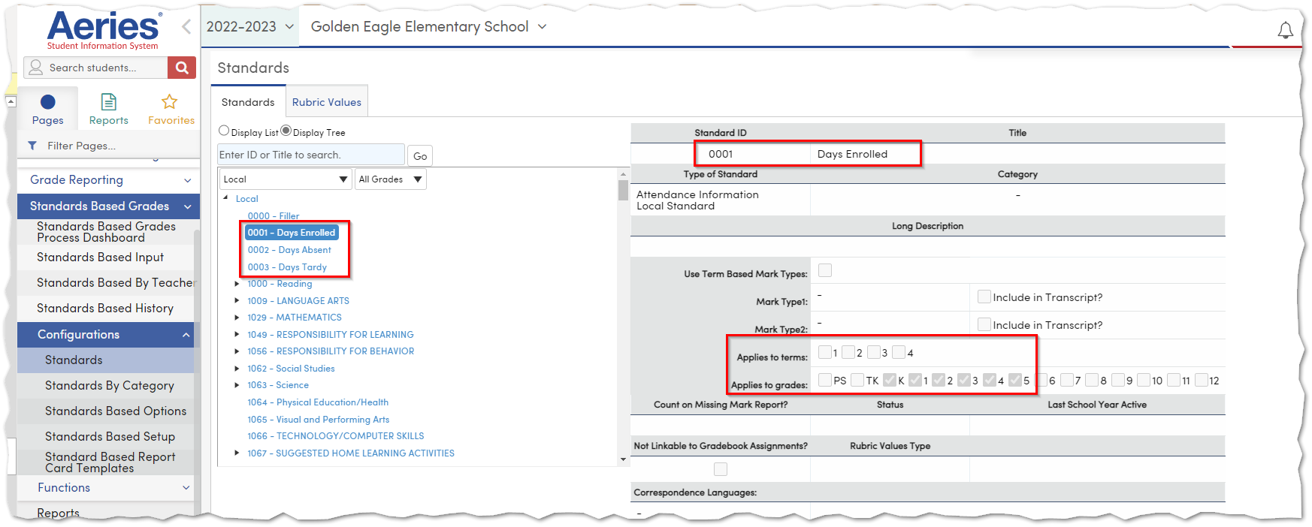
Standards Set up
Days Enrolled
Days Absent
Days Tardy
Local Standards
Applies to Terms
Applies to Grades

Slide 12
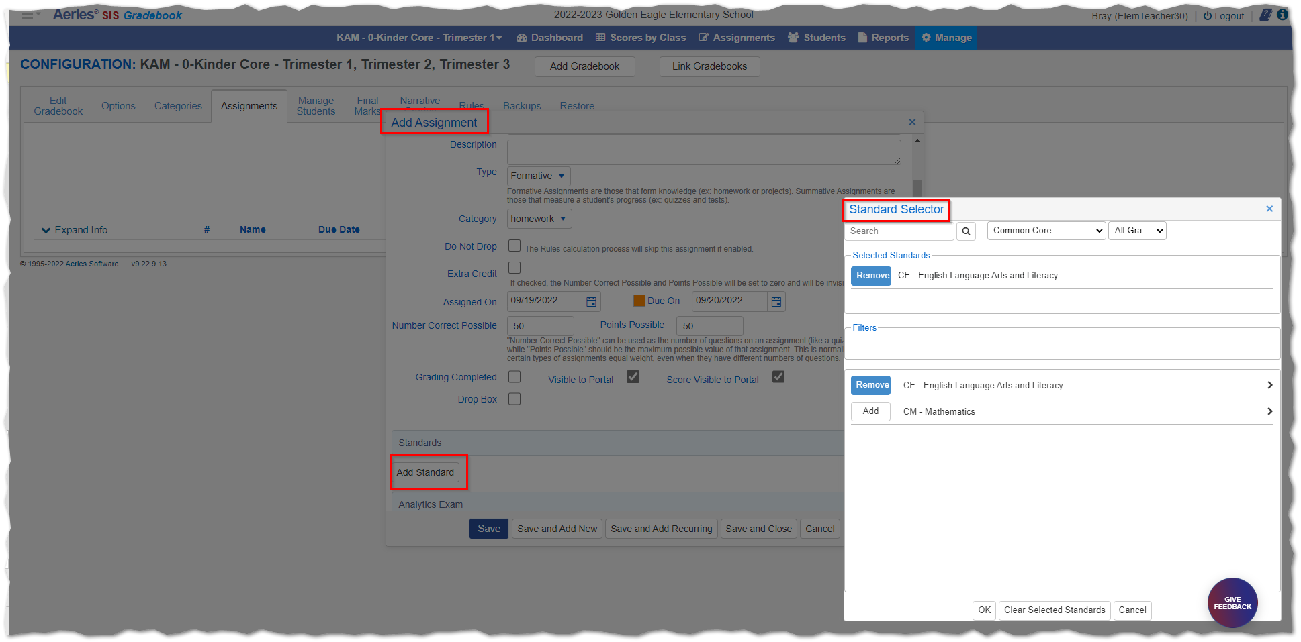
Standards maybe added to assignments
When the Standard is added it will pull when using the option to Import SBG Grades from Gradebook

Slide 13
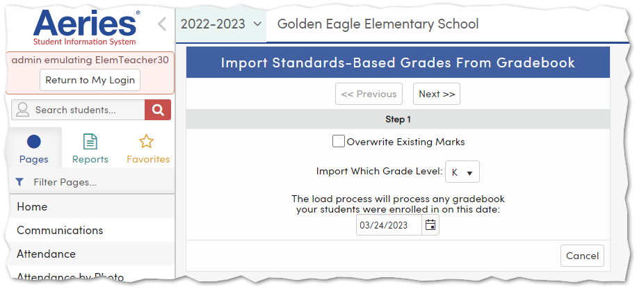
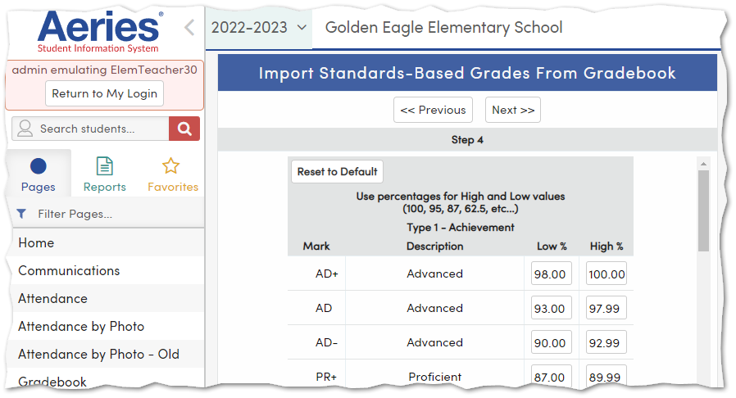
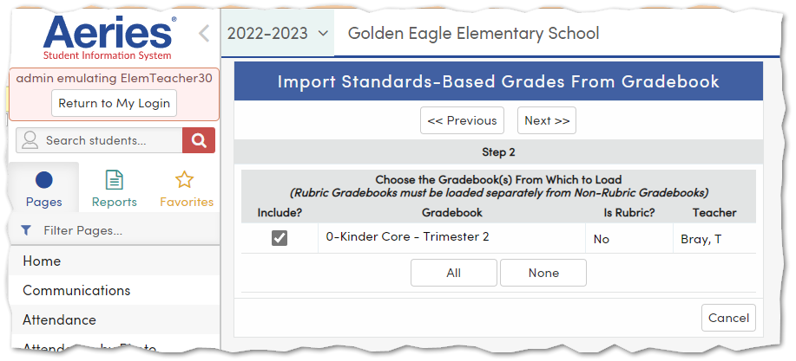
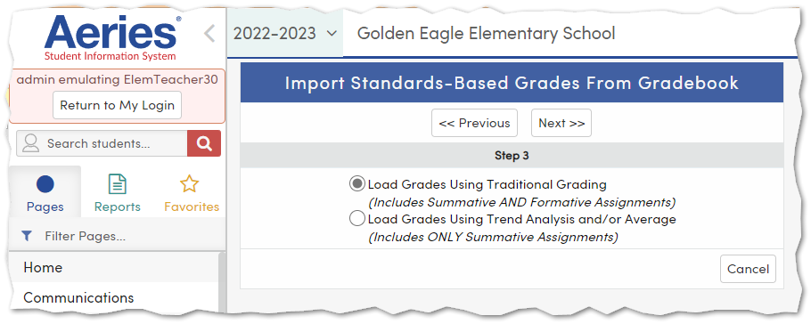
Import Standards Based Grades From Gradebook
Steps 1 - 5

Slide 14
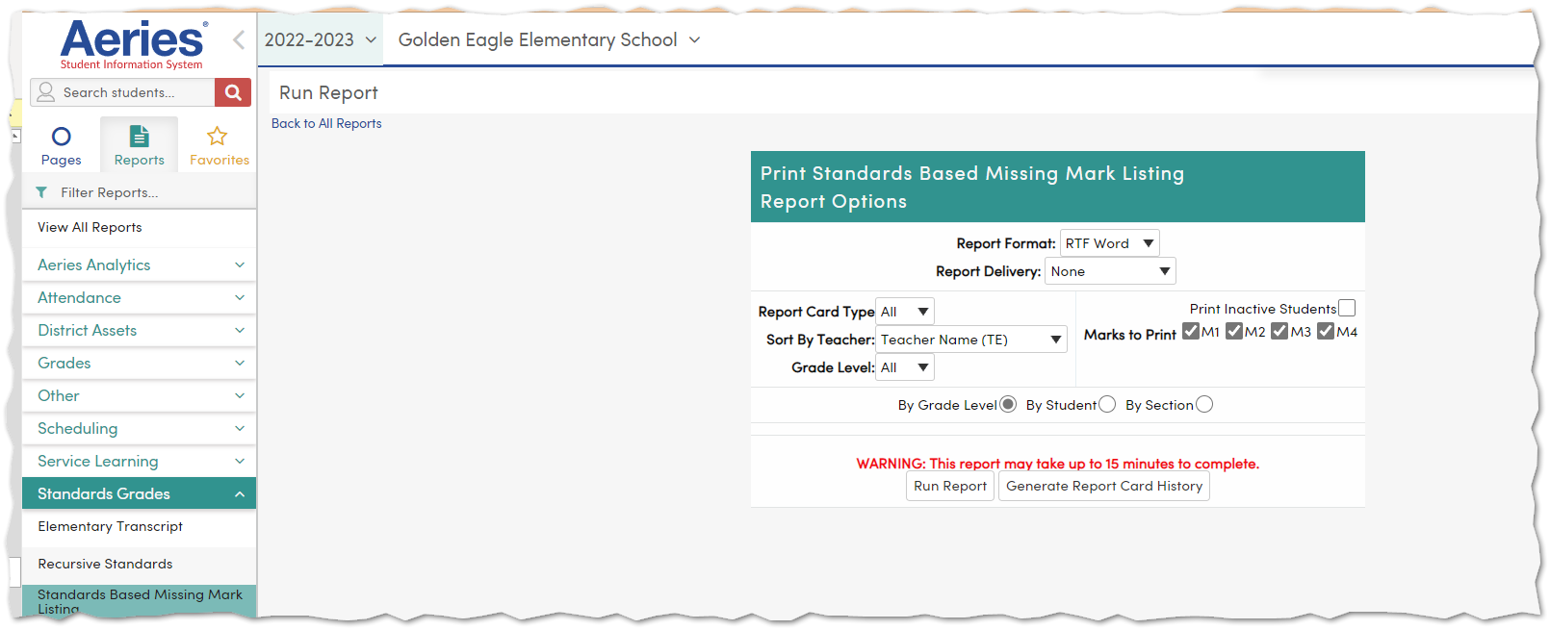
Missing Mark Listing
Canned Report

Slide 15
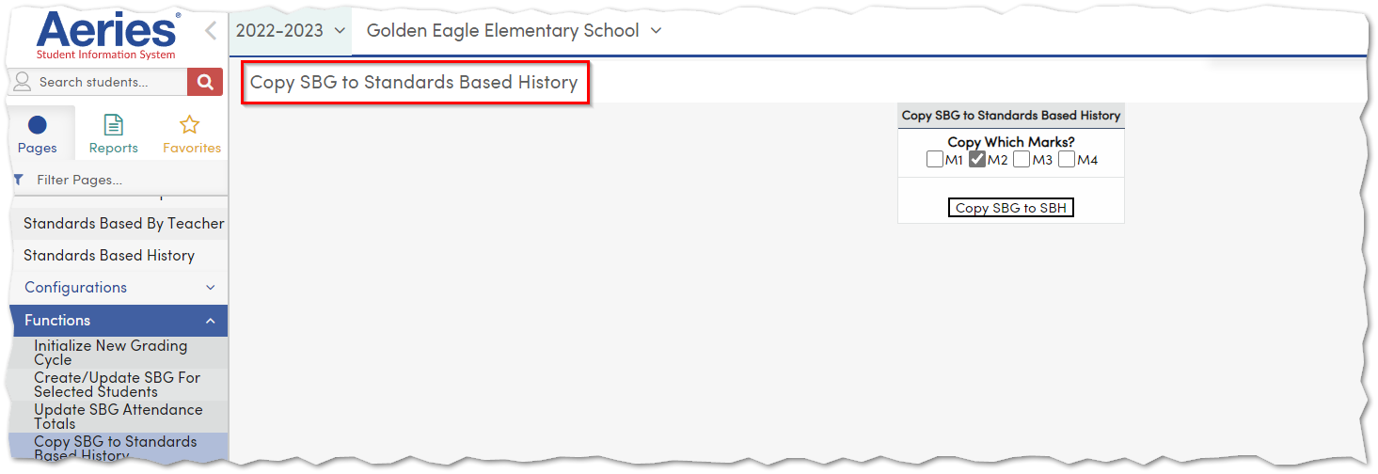
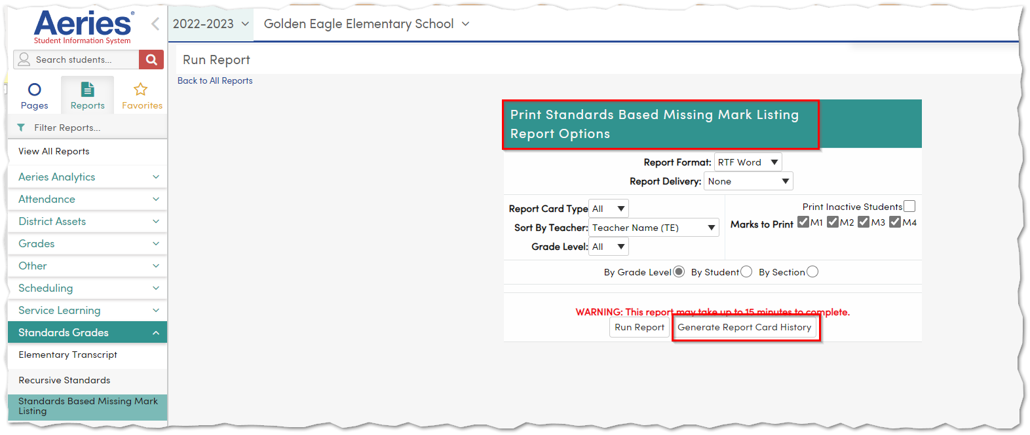
After all Grades have been entered
Run the Missing Mark Listing
Copy SBG to SBH
Generate Report Card History

Slide 16
We value your feedback!
Please take a few minutes to complete our survey and let us know how we can better serve you in the future! Have a great rest of your day.
Good-Morning-Aeries-Survey

Slide 17
Grade Reporting Process GRD
Fall Aeries Con/Virtual
November 7-10th - early Registration until 9/30th
Spring 2023 In Person March 6-8th
See you back in Ontario
So Many More!!
Watch for more upcoming webinars!

Slide 18
Thanks for joining us!
Where to Go
Standards Based Grade Reporting Folder
Aeries Events
Aeries Academy

