Slide 1
Speaking today:
PRESENTER | Sandy Madrid
Aeries Trainer
PRESENTER | Susan Prow
Aeries Trainer

Slide 2
A brief discussion on attendance process tasks for schools taking Daily Attendance

Slide 3
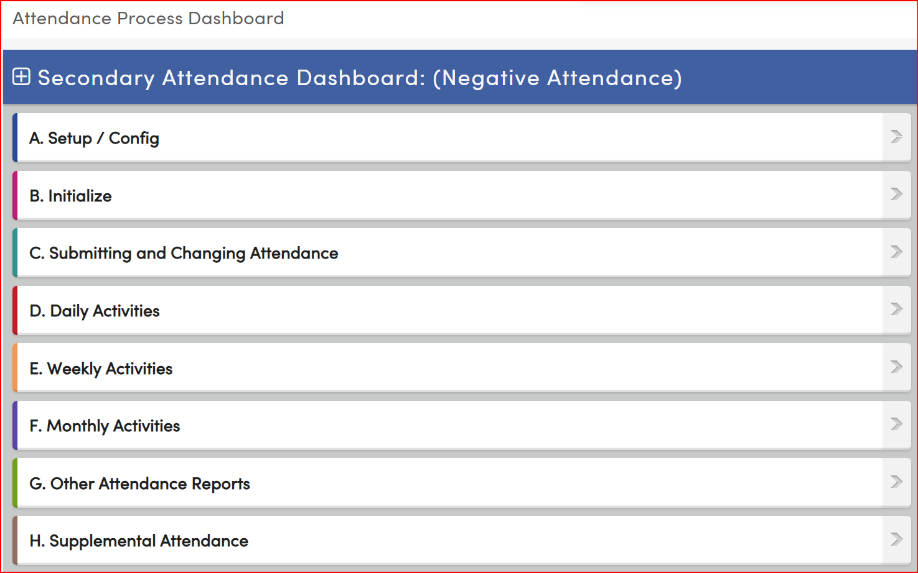
An Aeries demonstration of key Period Attendance management areas

Slide 4
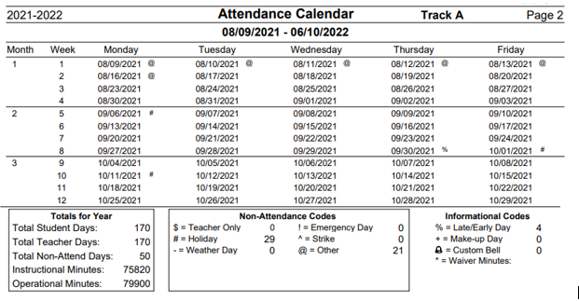
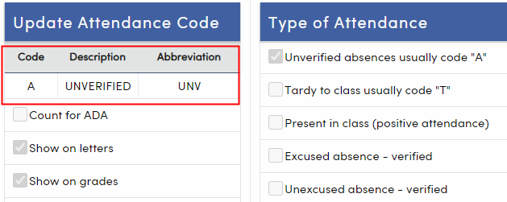
Need to Know
P1 is the full month prior to 12/31
P2 is full month prior to 4/15
*Always defer to your Fiscal Office for your Dates, but be ready and knowledgeable about your work product timelines
Setup
Not all users will be responsible for the setup areas for Attendance. But all can access two key areas for attendance accounting:
Calendar
Absence Codes
If you are the Attendance Data manager. These two areas will assist with your audits.
Calendar defines the 20-day month. Allowing you to set your self-audit timelines. Prepare at the beginning of the year for your year
It’s important for those who work with the attendance data to be aware of Absence Codes and how they are defined.

Slide 5
Need to Know
Some Key areas and functions
Initialize ATT/CAR
Attendance Enrollment page
Course Attendance page
Once Attendance has been initialized (meaning all student are enrolled as “active”) correct management of dates are now needed.
Managing the dates:
Student Enrollment data
Enrollment Attendance Page
Changes to Students Attendance Program (STU.SP)
Demographics page – Prog field
Course Enrollments or Changes
Course Attendance Page (when change occur to attendance class)
Understanding the “Red Text” warnings:
These warning will appear if the dates differ between dates on the Student Demographic Page and the Attendance Enrollment Page and/or the Course Attendance Page

Slide 6
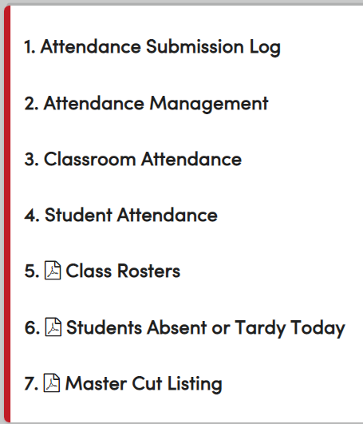
Need to Know
Changing/Submitting
Daily Activities
These two areas of the Attendance Process Dashboard show the user pages most used when working on student absence data
Button C and D page links differ slightly
More common is button D – Daily Activities to keep you on tasks preformed each day
Notes on Daily Activities
#1 Will show and report on teachers who have not submitted attendance for today or date range. This also tracks Attendance Submitted if you are going to apply for Electronic Signatures
#2 Attendance Management is a digital version of your call log
#3 Entering absence data via Classroom Teacher view. Used when a Substitute Teacher is taking the class
#4 Managing absence data on a per student basis
#5-7 The most common reports run each day

Slide 7
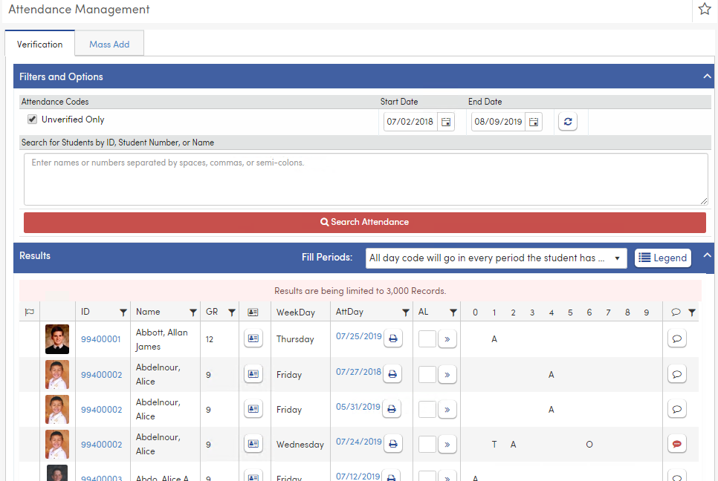
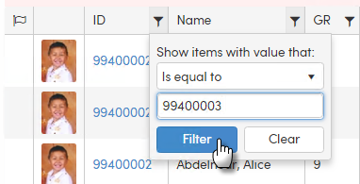
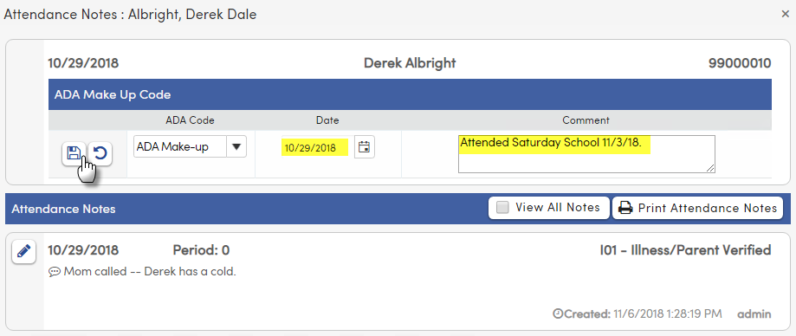
Need to Know
Attendance Management Page…Let’s look:
Unverified absences
By default, identifies all absences that have not been verified each day or by date range.
Good to also use to run final audit for a timeframe.
Data Entry in a roster format
Searchable and Filterable page
View Contact data
Can add Notes
Can View All Absence codes
Can Mass Add absence code and notes to a select group of students
Consider Saturday School for data entry on this page

Slide 8
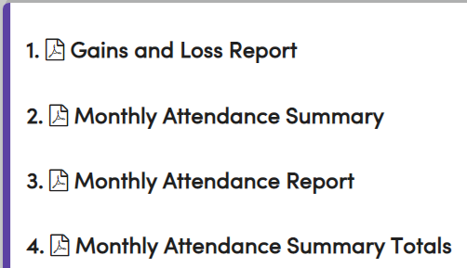
Need to Know
Weekly and Monthly
For weekly management key reports
Attendance Audit to find your “Red Text” errors
Weekly Attendance Report for Teacher Signature (unless approved for electronic signatures by CDE)
Key reports for Monthly
And other reports helpful to Attendance Management
Aeries puts other common reports in the dashboard for easy access
The key monthly reports for running your self-audits or validating your work each 20-day cycle are
1-Gain and Loss report – to validate student enrollment or changes…against your
3-Monthly Attendance Report – to validate your daily work, enrollment and days absent
Once your “self-audit” or validation is done
Report #2 – Monthly Attendance Summary can be run and sent to your Fiscal Office. You can feel confident in the summary numbers if you have already validated your work. You will be ready for your P1 and P2 data reports that your Fiscal Office will calculate for submission of ADA apportionment data

Slide 9
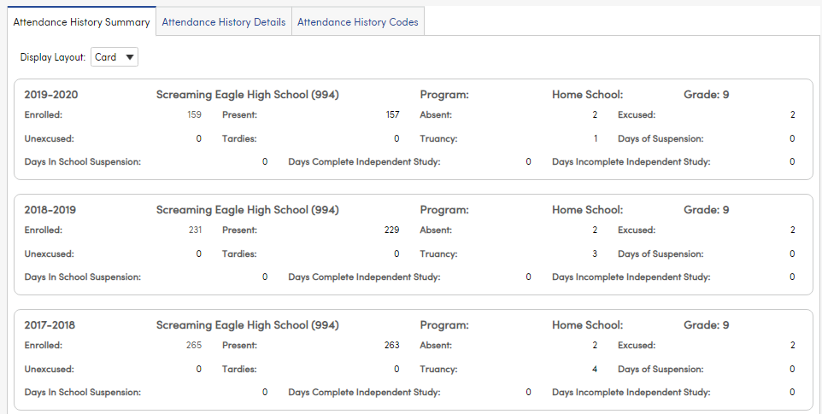
Nice to Know
Maybe a Need to Know
CALPADS
Now that you have managed all daily, weekly and monthly processes where else does your work go...
It also gets compiled nightly to the Attendance History Page for submission to the End of the Year CALPADS Certification to create the LEA Absenteeism Data for the CA Dashboard and Accountability
https://support.aeries.com/support/solutions/folders/14000116293

Slide 10
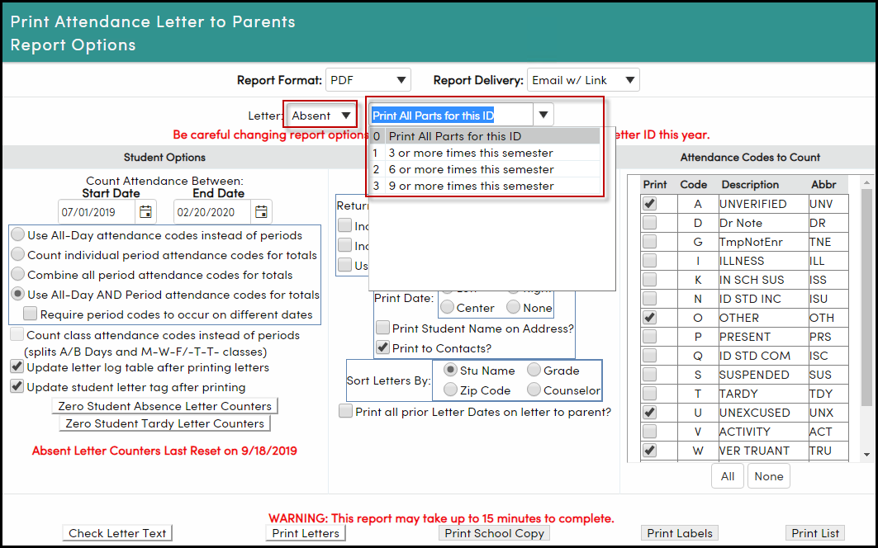
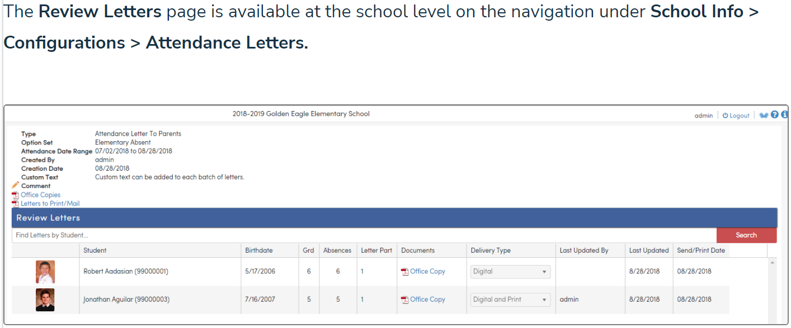
Nice to Know
Maybe a Need to Know
Attendance Letters
School run
The traditional letter text edit and print options for mailing
District run
At the district, the attendance letters are run as a batch. The school sites review the letters for final send
District Run Letters can also use Communications if being used at the LEA for digitally sending a notification and letter attachment by the School

Slide 11
Thanks for joining us!
Info and links
Aeries Demo Data
Aeries Academy
Link to Attendance Accounting Articles
https://support.aeries.com/support/solutions/14000072418
https://support.aeries.com/support/solutions/folders/14000117724
Good-Morning-Aeries-Survey
Aeries.com/aeriescon

